Slide 1
Adapt
Order: structure investigation first, then installation
Adapt instructions to install package (pip list instead of pip freeze)
Add instructions to inspect package
Make sure initial setup of package works (imports etc)
Add importing from different folder as exercise
editable installation

Slide 2
Pip editable installation
Navigate into the 2024-Heraklion-ODD folder (terminal)
Run pip list. What do you see?
Run pip install -e . (full stop = this directory)
Run pip list again. What has changed?
Can you now import x from y REFERENCE TO PREV SECTION EXERCISE!!
Discussion

Slide 3
Editable installation?
Importable packages:
  current directory
  installed packages e.g. numpy, scipy, …
  (saved in system location e.g. /usr/lib64/python3.11/site-packages/
  on Pythonpath => Python can find it)
  core packages e.g. time, math, os, …
Editable installation adds your package to installed packages without moving it
Notes:
This is the part where we solve importing errors

Slide 4
Pip editable install
You can import the package you are currently working on as if it were a package you downloaded.
—> This lets you use your own code as any other package you installed
Advantages:
you can import the objects in the package from any directory
(no longer bound to the directory which contains the package)
at the same time you can keep your project in your current directory
you use your code as someone else would use it, which forces you to write it in a more usable way

Slide 5
Importing own project
Options to install a package using pip
Option 1: if package is included in PyPI
pip install numpy
Option 2: install from a VCS like git
pip install git+https://github.com/<user>/<package-name>.git
Option 3: install your package with -e (--editable) option
pip install -e <path-to-package>
(cd <path-to-package>; conda develop .)

Slide 6
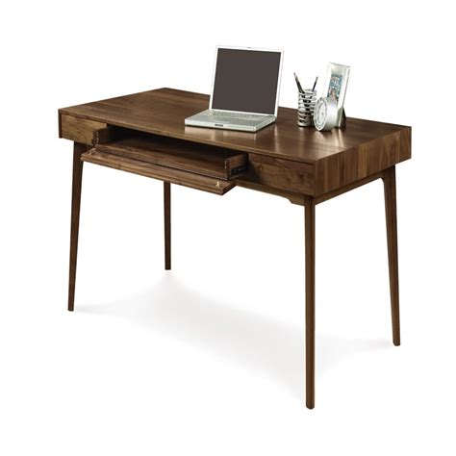

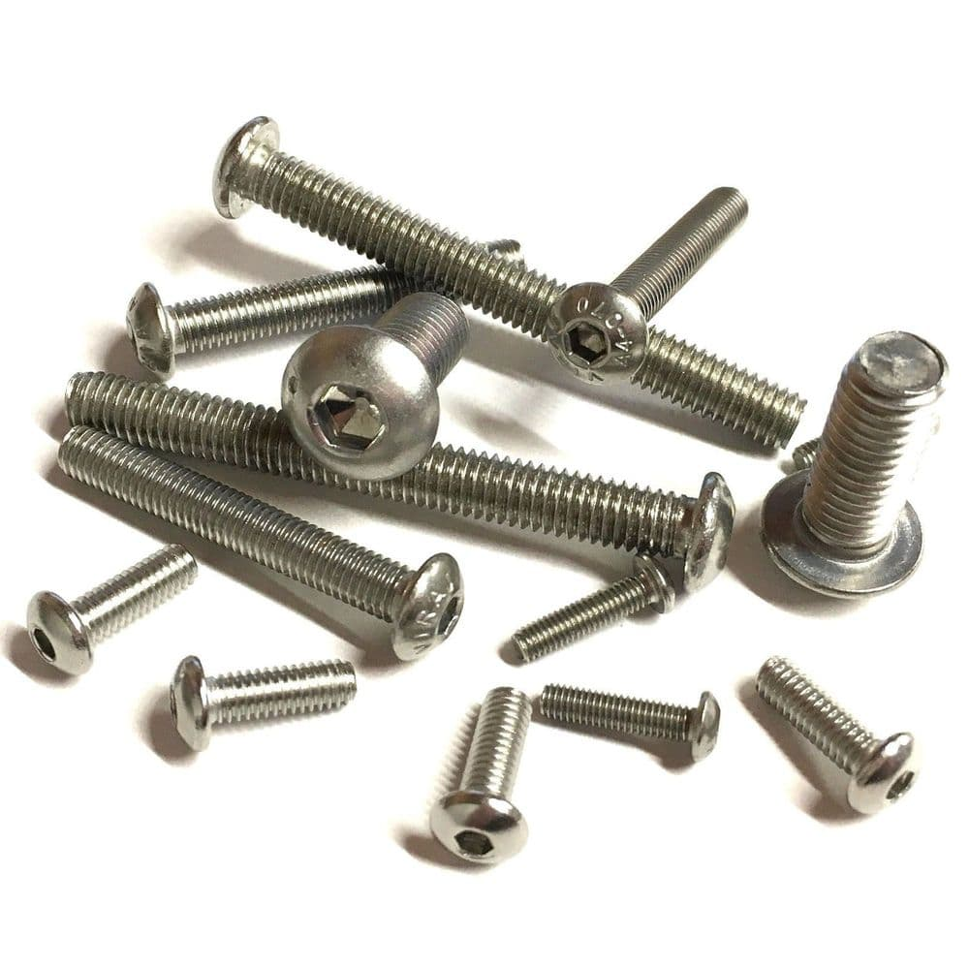

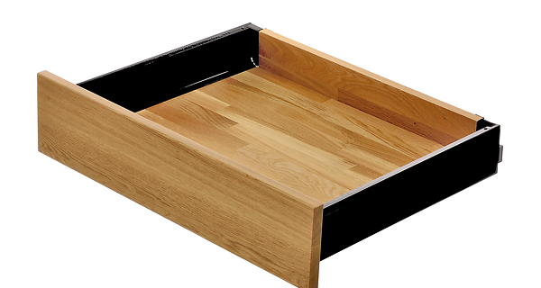
Installing other packages
You can install Python packages in your terminal using a package manager
pip
standard package manager for Python
can install packages from PyPI (Python Package Index) or from VCS e.g. github
conda
open source package manager/ environment manager
can install packages which were reviewed by Anaconda (not all)
Notes:
A bit like buying a desk or wardrobe at Ikea vs a more high end furniture shop.
You may have more control, but if something goes wrong, you have no one else to blame but yourself.

Slide 7
Pip editable installation
Investigate the 2024-heraklion-ODD folder
  What do you notice about the structure?
  Which files are familiar / unfamiliar?
Discussion

Slide 8
Python package structure
Src / <name-of-package>
  __init__.py
  Modules
LICENSE
README
Pyproject.toml
Tests folder is actually here – in order to run tests from this directory, you need to make this possible somehow
* pick one from choosealicense.com
8

Slide 9

Python package files
name of package
orange files = required in order to do an editable pip installation
__init__.py
flags folder as package
modules
your .py files containing your code
LICENSE
makes the package
(legally) usable.*
README
contains more information e.g. instructions on how to use your package.
build instructions &
package metadata
the time has come to explain this…
tests
you know why :)
* pick one from choosealicense.com
9

Slide 10
pyproject.toml
The pyproject.toml file holds static information about the package = meta data
Required entries: name, version, description, authors
dependencies not optional if code relies on other packages to work (go through modules and update regularly, don’t just copy ‘> pip freeze’)
-> can also go into separate requirements.txt file
[project]
name = "brewing"
version = "0.1.0"
description = "a python package for brewing potions"
authors = [{ name = "H. Granger", email = "h.granger@hogwarts.ac.uk" }]
license = { file = "LICENSE" }
readme = "README.md"
requires-python = ">=3.7"
dependencies = ["numpy", "matplotlib >= 3.0.0", "pytest"]
classifiers = [
"Programming Language :: Python :: 3",
"License :: OSI Approved :: BSD License",
"Operating System :: OS Independent"
]
[tool.setuptools]
packages = ["brewing"]
[build-system]
requires = ["setuptools>=42"]
build-backend = "setuptools.build_meta"
>>>

Slide 11
pyproject.toml
dependencies should be kept minimal (only what you actually import in your module files)
When possible don’t depend on a specific version of a package. Conflicting version requirements between packages are annoying to handle as a user.
When possible don’t depend on a specific version of Python. It is usually not necessary.
Add screenshots of imports
>>>

Slide 12

Additional advantages
Your code should be ready to be published
if your code is pip-installable, you can put your tests into a separate folder
your pyproject.toml file acts as a record of the necessary packages to run your code

Slide 13
break

Slide 14
Re-structure
Could use new slides
Re-do slides about workflow?
how to develop code if it’s in a package

Slide 15
Workflow
Set up the project once, then never worry about it again
You set your imports once and then never worry about them again
The more projects you set up like this, the easier it will become. In the end it‘s faster than solving a single import error.
You have not lost any capability, you only gained usability

Slide 16
Workflow
1. set up project
2. develop (can re-use the bug / feature joke?)
3. publish
Timeline of this – the longer the project takes, the less significant the setup costs are and the less problems you have on your way. Making code publishable takes an enourmous amount if you don’t work at it.
If you continue to code after your PhD, this will be the standard you will encounter

Slide 17
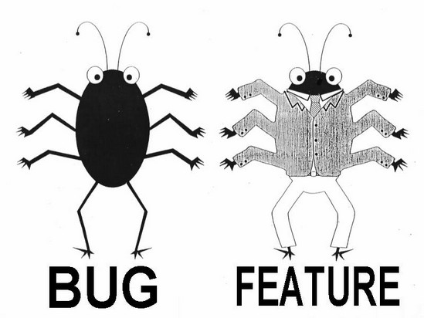
Workflow (ideal)
1
Create
2
Build & Test
3
Publish
Write feature
Set up structure
Create files: __init__.py pyproject.toml
setup.cfg
README
LICENSE
Make installable at this point
In pyproject.toml update:
version
requirements
Update README
Write test
Document
Test

Slide 18
Workflow (realistic?)
1
Create
2
Build & Test
copy that stuff to 2nd ipynb
3
Publish
Write stuff into ipynb
Set up structure
Create files: __init__.py
pyproject.toml
README
LICENSE
Make installable at this point
In pyproject.toml update:
version
requirements
Update README
change code ever so slightly
Write test
abandon test
Smugly write one comment
start new ipynb

Slide 19
Workflow (realistic?)
Publish
Create
Publish
Create
Build & Test
copy that stuff to 2nd ipynb
1
copy that stuff to 2nd ipynb
1
2
2
3
3
Write stuff into ipynb
Set up structure
Create files: __init__.py pyproject.toml
setup.cfg
README
LICENSE
Make installable at this point
Move code to package
Set up structure
Create files: __init__.py
pyproject.toml
setup.cfg
README
LICENSE
Make installable at this point
In pyproject.toml update:
version
requirements
Update README
In pyproject.toml update:
version
requirements
Update README
change code ever so slightly
Write test
Write test
Document
abandon test
Smugly write one comment
start new ipynb
Test

Slide 20
Write your function
Write the last remaining potion making function
we need before sharing the package
Exercise:
Create a branch with a unique name
Follow the instructions in Exercise 4 Workflow to write and test a function to make a “Python expert” potion
Create a Pull Request
Re-structure
How should they work?
Run in terminal + text editor?
Come up with new exercise – was too easy and too hard simultaneously last year.
Add hints where they can find the necessary actions and tools.
Change instructions to guide them towards running the thing line by line.
Add an optional exercise for the ones that are fast.
Add information how to access docstrings

Slide 21
Publishing code
Github/Gitlab
  perfectly fine for publishing publication code
  perfectly fine for hosting research group code
PyPi: Python Package Index
  If you want others to use your library, you must have your code on PyPi to make it easier for others to download and use it

Slide 22
Folder structure

