Slide 1
repo structure

Slide 2
Motivation
We now know what a package is and how to install it.
But often there are additional files you want in a repo.
  .gitignore, LICENSE, tests, examples, data, …
Where should the package and everything else go?

Slide 3


Where things go
There are no “rules” for where things go.
But there are guidelines.

Slide 4
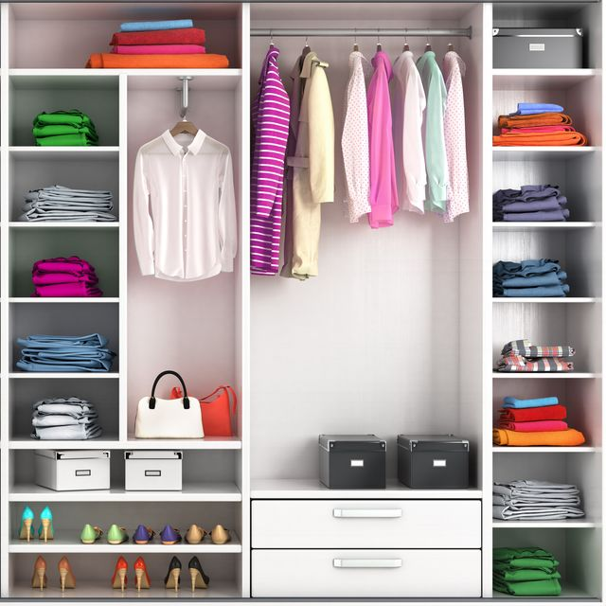

Why you should care
—> know where to find items in someone else’s code
e.g. wardrobe
  suit, shirts
  towels
  socks
—> science/engineering is
collaborative problem
solving. Facilitate
collaboration.

Slide 5
Guidelines
Nest package in src/ folder.
  Recommended by Python Packaging Authority [1]. Reduces accidental imports + other benefits.
  No need to modify pyproject.toml, package will be auto-discovered [2].
Only ship reusable code in your package.
  User-specific settings, examples, data, etc., should go elsewhere.
  Tests may or may not be shipped with your package. Depends on what you want. [3]
Everything else should be…elsewhere.

Slide 6
Organising file contents
Like in many other areas in life,
code is often organized by purpose or thematically
Separate folders:
  src - code that is being developed
  scripts and notebooks – for demonstrations, teaching, examples, accompanying papers
  tests – you will learn about these tomorrow ☺
my_project/
├── notebooks_scripts
│ ├── demo.ipynb
│ ├── recreate_paper_figures.py
├── pyproject.toml
├── README.md
├── requirements.txt
├── src/
│ ├── package_name/
│ │ ├── __init__.py
│ │ ├── analysis.py
│ │ ├── constants.py
│ │ ├── data_preprocessing.py
│ │ ├── data_visualization.py
│ │ ├── file_io.py
│ │ ├── models.py
├── tests/
│ ├── test_analysis.py
│ ├── test_data_processing.py
│ ├── test_models.py
6

Slide 7
Organising file contents
Like in many other areas in life,
code is often organized by purpose or thematically
Separate code into files/folders by
  theme / purpose – data handling,
  preprocessing, plotting, …
  type – i/o config, parameters,
  functions
Single responsibility principle
my_project/
├── notebooks_scripts
│ ├── demo.ipynb
│ ├── recreate_paper_figures.py
├── pyproject.toml
├── README.md
├── requirements.txt
├── src/
│ ├── package_name/
│ │ ├── __init__.py
│ │ ├── analysis.py
│ │ ├── constants.py
│ │ ├── data_preprocessing.py
│ │ ├── data_visualization.py
│ │ ├── file_io.py
│ │ ├── models.py
├── tests/
│ ├── test_analysis.py
│ ├── test_data_processing.py
│ ├── test_models.py

Slide 8
Organising file contents
Within-module standard order:
1. imports
standard Python library
installed packages
local modules
2. constants
DATA_DIR = "/path/to/data"
3. classes and functions
class ClassName:
def func_name():
4. main execution block
if __name__ == "__main__":

Slide 9

What this might look like
name of package
UPDATE TO SRC,
add gitignore
UPDATE animations
__init__.py
flags folder as package
modules
your .py files containing your code
LICENSE
makes the package
(legally) usable.*
README
contains more information e.g. instructions on how to use your package.
build instructions &
package metadata
how Python knows how to install/distribute your package
tests
you know why :)
* pick one from choosealicense.com
9

Slide 10
Retrieval practice
Discuss briefly with your partner.
  How do you structure your repos/code now?
  What, if anything, would you change about your current structure?
  What concerns/questions do you have about these guidelines for repo structure?
(add image of folder structure from prev. slide)

Slide 11
Discussion

Slide 12
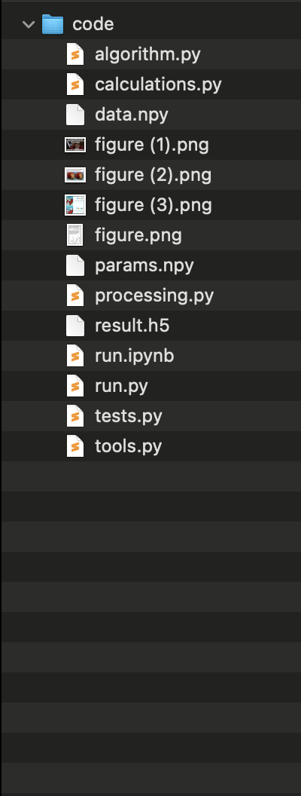
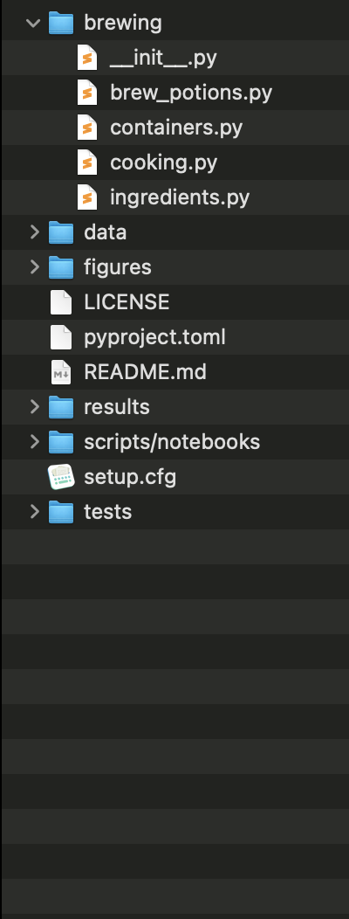
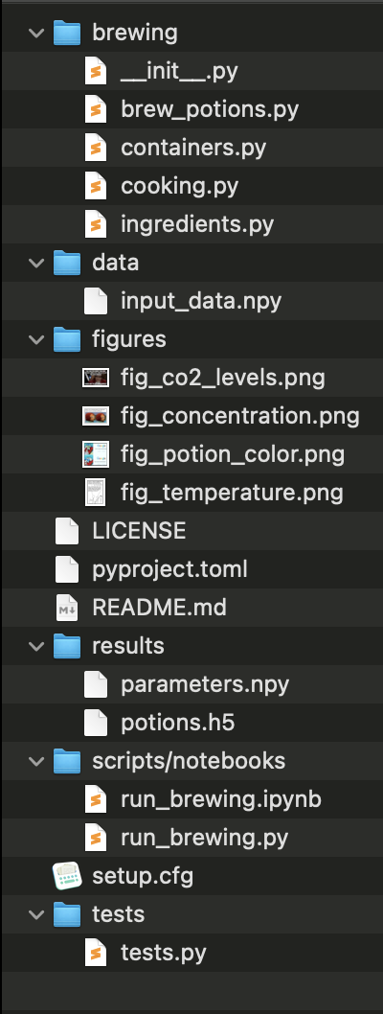
Notes:
This is the part where we solve the problem that we cannot find code we once wrote.
Make clear that this is the package structure they will be using

Slide 13
Advantage 2
it makes all of your code installable*
which makes all of your code importable
Terminal
> pip install brewing
>
> python
>>> import brewing
>>> brewing.brew_a_potion()
>>>
* (need a few other changes we will go over)

Slide 14
Organise what?
Project 1
Project 2
packages
packages
numpy = 1.22.0
pandas = 2.0.3
pandas = 1.2.4
numba = 1.0.2
code
other stuff
code
other stuff
simulation.py
tests/
constants.py
tests/
evaluation.py
notebook23.ipynb
training.py
notebook23.ipynb
14

Slide 15
Re-structure
Needs a different exercise? Hands on still?
defend your code

Slide 16
References
src layout vs flat layout - Python Packaging User Guide
Package Discovery and Namespace Packages
Good Integration Practices - pytest documentation

