Slide 1
repo structure

Slide 2
Motivation
We now know what a package is and how to install it.
But often there are additional files you want in a repo.
  .gitignore, LICENSE, tests, examples, data, …
Where should the package and everything else go?

Slide 3


Where things go
There are no “rules”…
…but there are guidelines.

Slide 4
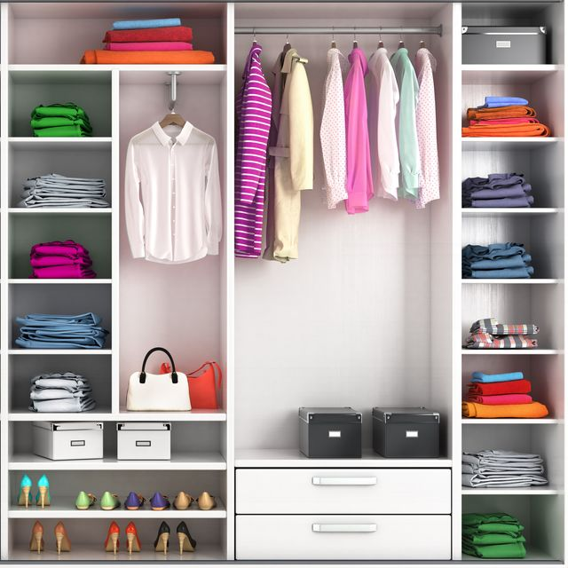

Why you should care
—> know where to find items in someone else’s code
e.g. wardrobe
  suit, shirts
  towels
  socks
—> science/engineering is
collaborative problem
solving. Facilitate
collaboration.

Slide 5
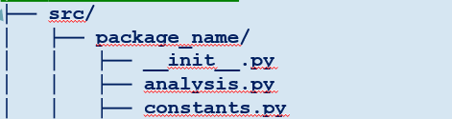
Guidelines
Nest package in src/ folder.
  Recommended by Python Packaging Authority
  [1]. Reduces accidental imports + other benefits.
  No need to modify pyproject.toml to include src/, package will be auto-discovered [2].
Only ship reusable code in your package.
  User-specific settings, examples, data, etc., should go elsewhere.
  Tests may or may not be shipped with your package. Depends on what you want. [3]
Everything else should be…elsewhere.

Slide 6
Organizing files
Like in many other areas in life,
code is often organized by purpose or thematically.
Separate folders:
  src - package
  scripts and notebooks – for demonstrations, teaching, examples, accompanying papers
  tests – you will learn about these tomorrow ☺
Note that tests can be in package OR outside [3].
my_project/
├── .gitignore
├── LICENSE
├── notebooks_scripts
│ ├── demo.ipynb
│ ├── recreate_paper_figures.py
├── pyproject.toml
├── README.md
├── requirements.txt
├── src/
│ ├── package_name/
│ │ ├── __init__.py
│ │ ├── analysis.py
│ │ ├── constants.py
│ │ ├── data_preprocessing.py
│ │ ├── data_visualization.py
│ │ ├── file_io.py
│ │ ├── models.py
├── tests/
│ ├── test_analysis.py
│ ├── test_data_processing.py
│ ├── test_models.py
6

Slide 7
Other notable files
.gitignore
so you don’t add
pycache files ;)
my_project/
├── .gitignore
├── LICENSE
├── notebooks_scripts
│ ├── demo.ipynb
│ ├── recreate_paper_figures.py
├── pyproject.toml
├── README.md
├── requirements.txt
├── src/
│ ├── package_name/
│ │ ├── __init__.py
│ │ ├── analysis.py
│ │ ├── constants.py
│ │ ├── data_preprocessing.py
│ │ ├── data_visualization.py
│ │ ├── file_io.py
│ │ ├── models.py
├── tests/
│ ├── test_analysis.py
│ ├── test_data_processing.py
│ ├── test_models.py
LICENSE
makes the package
(legally) usable.*
README
contains more information e.g. instructions on how to use your package.
requirements.txt
in case dependencies
in pyproject.toml is not
sufficient
7
* pick one from choosealicense.com

Slide 8
Retrieval practice
my_project/
├── .gitignore
├── LICENSE
├── notebooks_scripts
│ ├── demo.ipynb
│ ├── recreate_paper_figures.py
├── pyproject.toml
├── README.md
├── requirements.txt
├── src/
│ ├── package_name/
│ │ ├── __init__.py
│ │ ├── analysis.py
│ │ ├── constants.py
│ │ ├── data_preprocessing.py
│ │ ├── data_visualization.py
│ │ ├── file_io.py
│ │ ├── models.py
├── tests/
│ ├── test_analysis.py
│ ├── test_data_processing.py
│ ├── test_models.py
Discuss briefly with your partner.
  How do you structure your repos/code now?
  What, if anything, would you change about your current structure?
  What concerns/questions do you have about these guidelines for repo structure?
8

Slide 9
Discussion

Slide 10

What this might look like
name of package
UPDATE TO SRC,
add gitignore
UPDATE animations
__init__.py
flags folder as package
modules
your .py files containing your code
LICENSE
makes the package
(legally) usable.*
README
contains more information e.g. instructions on how to use your package.
build instructions &
package metadata
how Python knows how to install/distribute your package
tests
you know why :)
* pick one from choosealicense.com
10

Slide 11
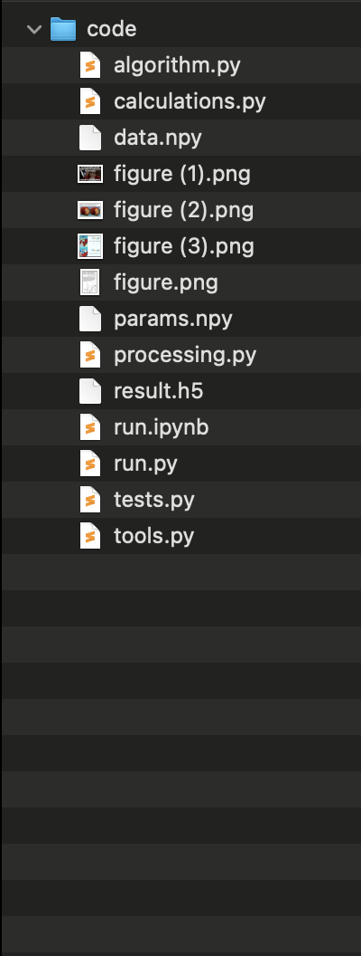
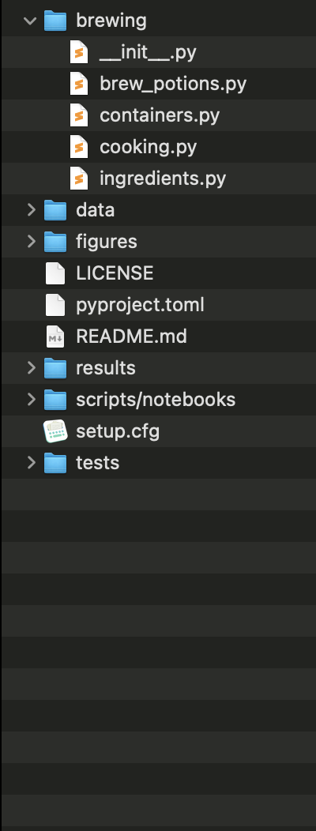
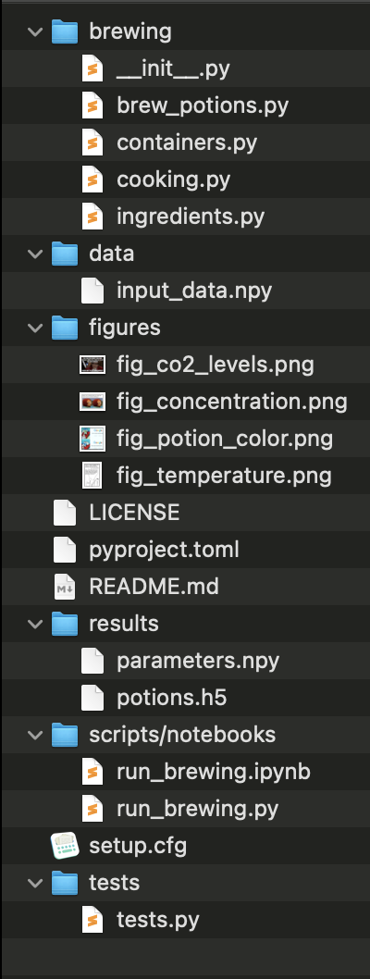
Notes:
This is the part where we solve the problem that we cannot find code we once wrote.
Make clear that this is the package structure they will be using

Slide 12
Advantage 2
it makes all of your code installable*
which makes all of your code importable
Terminal
> pip install brewing
>
> python
>>> import brewing
>>> brewing.brew_a_potion()
>>>
* (need a few other changes we will go over)

Slide 13
Organise what?
Project 1
Project 2
packages
packages
numpy = 1.22.0
pandas = 2.0.3
pandas = 1.2.4
numba = 1.0.2
code
other stuff
code
other stuff
simulation.py
tests/
constants.py
tests/
evaluation.py
notebook23.ipynb
training.py
notebook23.ipynb
13

Slide 14
defend your code

Slide 15
References
src layout vs flat layout - Python Packaging User Guide
Package Discovery and Namespace Packages
Good Integration Practices - pytest documentation

