Slide 1
packages and editable installation

Slide 2
Importable code
Code that we can import
  current directory
  core packages e.g. time, math, os, …
  installed packages
  e.g. numpy, scipy, … installed via pip / conda / …
  (saved in system location e.g. /usr/lib64/python3.11/site-packages/
  on Pythonpath => Python can find it)
Notes:
We talked about importing just now with Jenni.
You were importing things in your current directory and found that you reach limits very quickly if you go outside of that directory.
But there are other things that you can import from any place on your computer, where it does not matter where you are.
Like core packages
and installed packages.
So it would be logical if we tried to get our code to be treated as a package that can be accessed from anywhere, then I wouldn‘t have these problems with errors when I try to import my code from different directories.

Slide 3
Pip editable installation
Navigate into the 2024-Heraklion-ODD folder (terminal)
Run pip list. What do you see?
Run pip install -e . (full stop = this directory)
Run pip list again. What has changed?
Run main.py again from scripts/, which imports the make_example_potion function. Does it work now?

Slide 4
Pip editable install
—> An editable installation lets you use your own code as any other package you installed
Advantages:
you can import the objects in the package from any directory
(no longer bound to the directory which contains the package)
at the same time you can keep your project in your current directory and all changes are immediately available (no re-install required)
you use your code as someone else would use it, which forces you to write it in a more usable way

Slide 5
Importing own project
Options to install a package using pip
Editable installation: install your package with -e (--editable) option
pip install -e <path-to-package>
(cd <path-to-package>; conda develop .)
Other option: if package is included in PyPI
pip install numpy
Other option: install from a VCS like git
pip install git+https://github.com/<user>/<package-name>.git

Slide 6


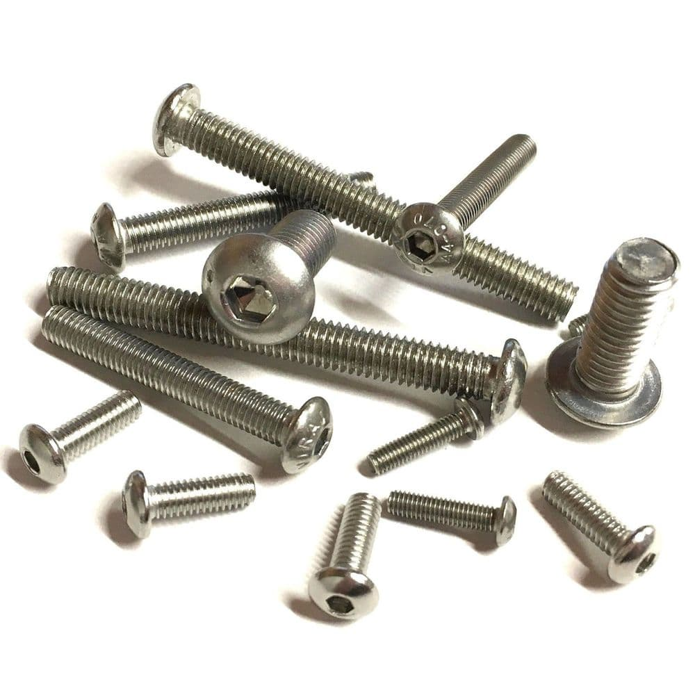

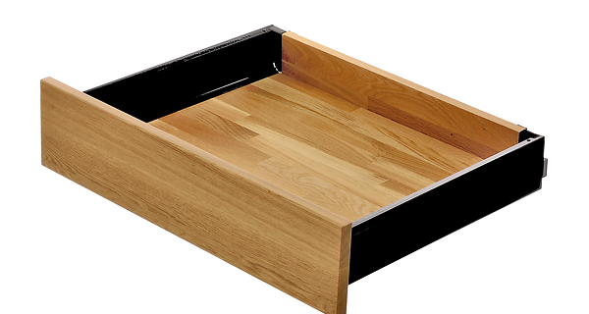
Installing other packages
You can install Python packages in your terminal using a package manager
pip
standard package manager for Python
can install packages from PyPI (Python Package Index) or from VCS e.g. github
conda
open source package manager/ environment manager
can install packages which were reviewed by Anaconda (not all)
Notes:
A bit like buying a desk or wardrobe at Ikea vs a more high end furniture shop.

Slide 7
how to develop code with editable install

Slide 8
Changes to your workflow
None*
* for developing code if you are used to working with .py files.
(you won’t be able to use this if you only develop in jupyter)
Notes:
So I told you that you would not have to change anything about your workflow, but do you really believe me? I mean I would understand if you don't :).
Indeed there are none, with the caveat that you cannot import functions and code from jupyter notebooks and I would advise against it. If you are writing code that is complicated enough that you want to import it from different files, then you may as well switch to modules. Please contact me or anyone else in the faculty if you want to know more about how to use an IDE or another setup.

Slide 9
Write your function
Write the last remaining potion making function
we need before sharing the package
Exercise:
Create a branch with a unique name
Follow the instructions in Exercise 3 Editable Installation Workflow to write and test a function to make a “Python expert” potion
Create a Pull Request
Notes:
I don't just want you to believe me, I want you to experience that nothing really changes. So I want to do do a very quick exercise where you play around with the brewing package you just installed.
The details are in the Exercise 3
Let's have a look at the file I want you to edit.
In brew_potions, you can see the example potion function and you ran that before.
you can also see the python_expert function, which I want you to write.
Spoiler alert, it is very similar to the example potion.
In the if name == main block, we can see that the example potion is run and we have an extra line here where the potion is checked by Professor Snoope.
So let's go ahead an run this file with the inspection

Slide 10
Notes
Notes:
Go over a pull request.
How did it work?
You were working with an editable installation – did you feel anything different?

Slide 11
Changes to your workflow II
None* **
* for developing code if you are used to working with .py files.
(you won’t be able to use this if you only develop in jupyter)
** you will have to do some setup steps at the start and regular updates
Notes:
You have to do some changes, since you cannot just install any code with pip, it needs to have a certain format. Which we will go over in a minute.

Slide 12
Short projects
start with package setup
start without package setup
→ for a small, short project, a package setup might take longer
(but it will still be much better to pick back up later)
setup
develop code
set up folders
set up pyproject.toml
set up README
set up LICENSE
set up new .py files
do editable pip install
time
develop code

Slide 13
Longer (=research) projects
start with package setup
start without package setup
→ for a longer project, having a structure from the start will pay off!
especially when you want to share or publish your code
setup
develop
publish
time
fix imports
search for code
restructure
develop
publish (restructure, fix)

Slide 14
Publishing code
Github/Gitlab
  perfectly fine for publishing publication code
  perfectly fine for hosting research group code
PyPi: Python Package Index
  If you want others to use your library, you must have your code on PyPi to make it easier for others to download and use it

Slide 15
break now?

Slide 16
package structure – required files

Slide 17
Package structure
Here is an example of a Python package structure
  What do you notice about the files and the structure?
  What is familiar / unfamiliar?
my_project/
├── pyproject.toml
├── src/
│ ├── package_name/
│ │ ├── __init__.py
│ │ ├── analysis.py
│ │ ├── constants.py
│ │ ├── data_preprocessing.py
│ │ ├── data_visualization.py
│ │ ├── file_io.py
│ │ ├── models.py

Slide 18
Notes
>>>

Slide 19
Python package structure
Files that make a package (for your own use)
  src / <name-of-package>
    __init__.py
    Modules
  pyproject.toml
my_project/
├── pyproject.toml
├── src/
│ ├── package_name/
│ │ ├── __init__.py
│ │ ├── analysis.py
│ │ ├── constants.py
│ │ ├── data_preprocessing.py
│ │ ├── data_visualization.py
│ │ ├── file_io.py
│ │ ├── models.py
* pick one from choosealicense.com
19

Slide 20
src and __init__.py
src folder holds your code
__init__.py designates your folder with .py files are a package for pyproject.toml
contents of __init__.py file →
* pick one from choosealicense.com
20

Slide 21
Organising file contents
Like in many other areas in life,
code is often organized by purpose or thematically
Separate code into files/folders by
  theme / purpose – data handling,
  preprocessing, plotting, …
  type – i/o config, parameters,
  functions
Single responsibility principle
my_project/
├── pyproject.toml
├── src/
│ ├── package_name/
│ │ ├── __init__.py
│ │ ├── analysis.py
│ │ ├── constants.py
│ │ ├── data_preprocessing.py
│ │ ├── data_visualization.py
│ │ ├── file_io.py
│ │ ├── models.py

Slide 22
Organising file contents
Within-module standard order:
1. imports
standard Python library
installed packages
local modules
2. constants
DATA_DIR = "/path/to/data"
3. classes and functions
class ClassName:
def func_name():
4. main execution block
if __name__ == "__main__":

Slide 23
Python package structure
Files that make a package (for your own use)
  src / <name-of-package>
    __init__.py
    Modules
  pyproject.toml
Tests – wait for tomorrow ☺.
The best way of enable yourself to run tests from this directory is to use an editable install
my_project/
├── pyproject.toml
├── src/
│ ├── package_name/
│ │ ├── __init__.py
│ │ ├── analysis.py
│ │ ├── constants.py
│ │ ├── data_preprocessing.py
│ │ ├── data_visualization.py
│ │ ├── file_io.py
│ │ ├── models.py
├── tests/
│ ├── test_analysis.py
│ ├── test_data_processing.py
│ ├── test_models.py
* pick one from choosealicense.com
23

Slide 24
pyproject.toml
The pyproject.toml file holds static information (meta data) about the package
[project]
name = "brewing"
version = "0.1.0"
description = "a python package for brewing potions"
authors = [{name = "A. SPP", email="a.spp@magic.ac.uk"}]
license = {file = "LICENSE"}
readme = "README.md"
requires-python = ">=3.11"
dependencies = ["numpy", "matplotlib >= 3.0.0", "pytest"]
[tool.setuptools]
packages = ["brewing"]
[build-system]
requires = ["setuptools>=42"]
build-backend = "setuptools.build_meta"
>>>

Slide 25
pyproject.toml
The pyproject.toml file holds static information (meta data) about the package
Dependencies:
  Declare what you import in
  the code → it will not work
  in other places otherwise!
  don’t just copy „pip list“!
  Whenever you add a new
  package, add it to the
  requirements
  Can also go into separate
  requirements.txt file
[project]
name = "brewing"
version = "0.1.0"
description = "a python package for brewing potions"
authors = [{name = "A. SPP", email="a.spp@magic.ac.uk"}]
license = {file = "LICENSE"}
readme = "README.md"
requires-python = ">=3.11"
dependencies = ["numpy", "matplotlib >= 3.0.0", "pytest"]
[tool.setuptools]
packages = ["brewing"]
[build-system]
requires = ["setuptools>=42"]
build-backend = "setuptools.build_meta"
>>>

Slide 26
All the advantages
The setup steps only take time at the start
  Set up the project structure, then never worry about it again
  Set your imports, then never worry about them again
  The more projects you set up like this, the easier it will become. In the end it‘s faster than solving a single import error.
You unlock so many abilities with only a little effort
  sharing code, publishing, endlessly looking for functions or files, avoiding import errors when moving files, …
If you continue coding after inside but especially outside academia, this will be the standard you will encounter.

Slide 27

Our goal
Local importing
  → review and best practices
Packages and editable installations
  → avoid importing errors
Repo structure
  → organize folders and files in a standardized way
Environments
  avoid and alleviate package installation problems
Accessibility
  → make code more readable, understandable and usable
Notes:
You can solve all of these topics by organising your code in a better way

Slide 28
break now?

Slide 29
how to organize content of python files
Notes:
You now have a skeleton or blueprint of what the folders and files to mark your code as a package should look like.
What we have not talked about is how to organise your code within this structure

Slide 30
package structure II
Here is an example of a Python package structure
  What do you notice about how the files and the folders that contain code are organised?
  How do you do this, does it differ?
Discuss with your partner
my_project/
├── notebooks_scripts/
│ ├── demo.ipynb
│ ├── recreate_paper_figures.py
├── LICENSE
├── pyproject.toml
├── README.md
├── src/
│ ├── package_name/
│ │ ├── __init__.py
│ │ ├── analysis.py
│ │ ├── constants.py
│ │ ├── data_preprocessing.py
│ │ ├── data_visualization.py
│ │ ├── file_io.py
│ │ ├── models.py
├── tests/
│ ├── test_analysis.py
│ ├── test_data_processing.py
│ ├── test_models.py

Slide 31
Notes

Slide 32
Organising file contents
Like in many other areas in life,
code is often organized by purpose or thematically
Separate folders:
  src - code that is being developed
  scripts and notebooks – for demonstrations, teaching, examples, accompanying papers
  tests – you will learn about these tomorrow ☺
my_project/
├── notebooks_scripts
│ ├── demo.ipynb
│ ├── recreate_paper_figures.py
├── pyproject.toml
├── README.md
├── requirements.txt
├── src/
│ ├── package_name/
│ │ ├── __init__.py
│ │ ├── analysis.py
│ │ ├── constants.py
│ │ ├── data_preprocessing.py
│ │ ├── data_visualization.py
│ │ ├── file_io.py
│ │ ├── models.py
├── tests/
│ ├── test_analysis.py
│ ├── test_data_processing.py
│ ├── test_models.py

Slide 33
repo structure

Slide 34
What dark magic did we just apply?
Code that we can import
  current directory
  core packages e.g. time, math, os, …
  installed packages
  e.g. numpy, scipy, … installed via pip / conda / …
  (saved in system location e.g. /usr/lib64/python3.11/site-packages/
  on Pythonpath => Python can find it)
  editable installed packages
  adds your code to installed packages without moving it
Notes:
We talked about importing just now with Jenni.
You were importing things in your current directory and found that you reach limits very quickly if you go outside of that directory.

Slide 35
Importing own project
Options to install a package using pip
Option 1: if package is included in PyPI
pip install numpy
Option 2: install from a VCS like git
pip install git+https://github.com/<user>/<package-name>.git
Option 3: install your package with -e (--editable) option
pip install -e <path-to-package>
(cd <path-to-package>; conda develop .)

Slide 36

Python package files
name of package
orange files = required in order to do an editable pip installation
__init__.py
flags folder as package
modules
your .py files containing your code
LICENSE
makes the package
(legally) usable.*
README
contains more information e.g. instructions on how to use your package.
build instructions &
package metadata
the time has come to explain this…
tests
you know why :)
* pick one from choosealicense.com
36

Slide 37
File organisation
Investigate the src/brewing/cooking.py file
  What do you notice about the structure of the file?

Slide 38
Notes

Slide 39

Our goal
Local importing
  → review and best practices
Editable installations
  → avoid importing errors
Python package structure and code organization
  → organize folders and files in a standardized way
Environments
  avoid and alleviate package installation problems
Documentation and formatting tools
  → make code more readable and usable
Notes:
You can solve all of these topics by organising your code in a better way

Slide 40
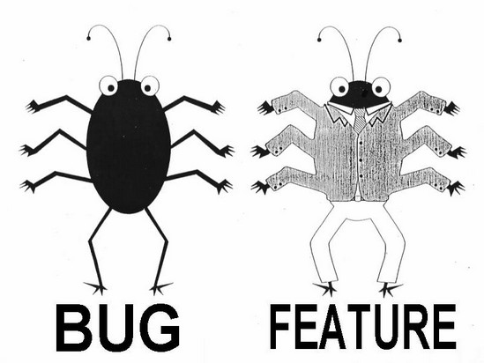
Workflow (ideal)
1
Create
2
Build & Test
3
Publish
Write feature
Set up structure
Create files: __init__.py pyproject.toml
setup.cfg
README
LICENSE
Make installable at this point
In pyproject.toml update:
version
requirements
Update README
Write test
Document
Test

Slide 41
Workflow (realistic?)
1
Create
2
Build & Test
copy that stuff to 2nd ipynb
3
Publish
Write stuff into ipynb
Set up structure
Create files: __init__.py
pyproject.toml
README
LICENSE
Make installable at this point
In pyproject.toml update:
version
requirements
Update README
change code ever so slightly
Write test
abandon test
Smugly write one comment
start new ipynb

Slide 42
Workflow (realistic?)
Publish
Create
Publish
Create
Build & Test
copy that stuff to 2nd ipynb
1
copy that stuff to 2nd ipynb
1
2
2
3
3
Write stuff into ipynb
Set up structure
Create files: __init__.py pyproject.toml
setup.cfg
README
LICENSE
Make installable at this point
Move code to package
Set up structure
Create files: __init__.py
pyproject.toml
setup.cfg
README
LICENSE
Make installable at this point
In pyproject.toml update:
version
requirements
Update README
In pyproject.toml update:
version
requirements
Update README
change code ever so slightly
Write test
Write test
Document
abandon test
Smugly write one comment
start new ipynb
Test

Slide 43
Short projects
start with package setup
setup
develop code
set up folders
set up pyproject.toml
set up README
set up LICENSE
set up new .py files
do editable pip install
time

Slide 44
Short projects
start with package setup
setup
development cycle
development cycle
update
development cycle
update
development cycle
set up folders
set up pyproject.toml
set up README
set up LICENSE
set up new .py files
do editable pip install
data cleanup
implement clustering algorithm
test second clustering algorithm
create figure
time

Slide 45
Short projects
start with package setup
start without package setup
→ for a small, short project, a package setup might take longer
(but it will still be much better to pick back up later)
setup
development cycle
development cycle
update
development cycle
update
development cycle
set up folders
set up pyproject.toml
set up README
set up LICENSE
set up new .py files
do editable pip install
data cleanup
implement clustering algorithm
test second clustering algorithm
create figure
time
development cycle
development cycle
development cycle
development cycle
data cleanup
implement clustering algorithm
test second clustering algorithm
create figure

Slide 46
Longer (=research) projects
start with package setup
start without package setup
→ for a longer project, having a structure from the start will pay off!
setup
develop
time
fix imports
search for code
restructure
develop

Slide 47
Longer (=research) projects
start with package setup
start without package setup
→ for a longer project, having a structure from the start will pay off!
setup
cycle
cycle
cycle
cycle
cycle
cycle
cycle
cycle
cycle
data
clust alg 1
clust alg 2
fig
…
time
fix imports
search for code
restructure
cycle
cycle
cycle
cycle
cycle
cycle
cycle
cycle
cycle
data
clust alg 1
clust alg 2
fig
…

Slide 48
Longer (=research) projects
start with package setup
start without package setup
→ for a longer project, having a structure from the start will pay off!
especially when you want to share or publish your code
setup
cycle
cycle
cycle
cycle
cycle
cycle
cycle
cycle
cycle
publish
data
clust alg 1
clust alg 2
fig
…
time
fix imports
search for code
restructure
cycle
cycle
cycle
cycle
cycle
cycle
cycle
cycle
cycle
publish (restructure, fix)
data
clust alg 1
clust alg 2
fig
…

Slide 49
Organising file contents
Within-module standard order:
  imports
    standard library
    installed packages
    local modules
import os
import pandas as pd
from my_io_module import load_data
DATA_DIR = "/path/to/data"
class DataProcessor:
def __init__(self, config):
self.config = config
def clean(self, data):
data = _remove_outliers(data)
return _fill_missing(data)
def load_data(file_path):
return pd.read_csv(file_path)
if __name__ == "__main__":
data = load_data("data.csv")
processor = DataProcessor()
data = processor.clean(data)

Slide 50
Organising file contents
Within-module standard order:
  imports
    standard library
    installed packages
    local modules
  constants
import os
import pandas as pd
from my_io_module import load_data
DATA_DIR = "/path/to/data"
class DataProcessor:
def __init__(self, config):
self.config = config
def clean(self, data):
data = _remove_outliers(data)
return _fill_missing(data)
def load_data(file_path):
return pd.read_csv(file_path)
if __name__ == "__main__":
data = load_data("data.csv")
processor = DataProcessor()
data = processor.clean(data)

Slide 51
Organising file contents
Within-module standard order:
  imports
    standard library
    installed packages
    local modules
  constants
  classes and functions
import os
import pandas as pd
from my_io_module import load_data
DATA_DIR = "/path/to/data"
class DataProcessor:
def __init__(self, config):
self.config = config
def clean(self, data):
data = _remove_outliers(data)
return _fill_missing(data)
def load_data(file_path):
return pd.read_csv(file_path)
if __name__ == "__main__":
data = load_data("data.csv")
processor = DataProcessor()
data = processor.clean(data)

Slide 52
Organising file contents
Within-module standard order:
  imports
    standard library
    installed packages
    local modules
  constants
  classes and functions
  main execution block
import os
import pandas as pd
from my_io_module import load_data
DATA_DIR = "/path/to/data"
class DataProcessor:
def __init__(self, config):
self.config = config
def clean(self, data):
data = _remove_outliers(data)
return _fill_missing(data)
def load_data(file_path):
return pd.read_csv(file_path)
if __name__ == "__main__":
data = load_data("data.csv")
processor = DataProcessor()
data = processor.clean(data)

Slide 53
Organising file contents
Within-module standard order:
  imports
    standard library
    installed packages
    local modules
  constants
  classes and functions
  main execution block
import os
import pandas as pd
from my_io_module import load_data
DATA_DIR = "/path/to/data"
class DataProcessor:
def __init__(self, config):
self.config = config
def clean(self, data):
data = _remove_outliers(data)
return _fill_missing(data)
def load_data(file_path):
return pd.read_csv(file_path)
if __name__ == "__main__":
data = load_data("data.csv")
processor = DataProcessor()
data = processor.clean(data)

Slide 54
Organising file contents
Like in many other areas in life,
code is often organized thematically
(think closets, fridges, personal docs…)
Separate code into files/folders by
  theme – data handling, algorithm,
  plotting, …
  type – i/o config, parameters,
  functions
my_project/
├── notebooks_scripts
│ ├── demo.ipynb
│ ├── recreate_paper_figures.py
├── pyproject.toml
├── README.md
├── requirements.txt
├── src/
│ ├── package_name/
│ │ ├── __init__.py
│ │ ├── analysis.py
│ │ ├── constants.py
│ │ ├── data_preprocessing.py
│ │ ├── data_visualization.py
│ │ ├── file_io.py
│ │ ├── models.py
├── tests/
│ ├── test_analysis.py
│ ├── test_data_processing.py
│ ├── test_models.py

Slide 55
Longer (=research) projects
start without package setup, testing
cycle
cycle
cycle
cycle
cycle
cycle
cycle
cycle
cycle
cycle
publish (restructure, fix)
data
clust alg 1
clust alg 2
fig
…
time
realistic - start without package setup, testing
re-structure
fix imports
search for code
cycle
cycle
cycle
cycle
cycle
cycle
cycle
cycle
cycle
cycle
publish (restructure, fix)
data
clust alg 1
clust alg 2
fig
…
do package setup
→ for longer project, a package setup will save you time!
setup
cycle
cycle
cycle
cycle
cycle
cycle
cycle
cycle
cycle
cycle
publish
data
clust alg 1
clust alg 2
fig
…

Slide 56
Longer (= research) projects
start without package setup, testing
cycle
cycle
cycle
cycle
cycle
cycle
cycle
cycle
cycle
cycle
publish (restructure, fix)
data
clust alg 1
clust alg 2
fig
…
time
realistic - start without package setup, testing
re-structure
fix imports
search for code
cycle
cycle
cycle
cycle
cycle
cycle
cycle
cycle
cycle
cycle
publish (restructure, fix)
data
clust alg 1
clust alg 2
fig
…
do package setup
→ for longer project, a package setup will save you time!
setup
cycle
cycle
cycle
cycle
cycle
cycle
cycle
cycle
cycle
cycle
publish
data
clust alg 1
clust alg 2
fig
…

Slide 57
Short projects
start with package setup
start without package setup
→ for a small, short project, a package setup might take longer
(but it will still be much better to pick back up later)
setup
development cycle
development cycle
update
development cycle
update
development cycle
set up folders
set up pyproject.toml
set up README
set up LICENSE
set up new .py files
do editable pip install
data cleanup
implement clustering algorithm
test second clustering algorithm
create figure
time
development cycle
development cycle
development cycle
development cycle
data cleanup
implement clustering algorithm
test second clustering algorithm
create figure

Slide 58
Short projects
start without package setup, testing
development cycle
development cycle
development cycle
development cycle
data cleanup
implement clustering algorithm
test second clustering algorithm
create figure
time
do package setup
→ for a small, short project, a package setup might take longer
setup
development cycle
development cycle
update
development cycle
update
development cycle
data cleanup
implement clustering algorithm
test second clustering algorithm
create figure

Slide 59
Additional advantages
Your code should be ready to be published
if your code is pip-installable, you can put your tests into a separate folder
your pyproject.toml file acts as a record of the necessary packages to run your code

