Slide 1
Ok?
Folder structure

Slide 2
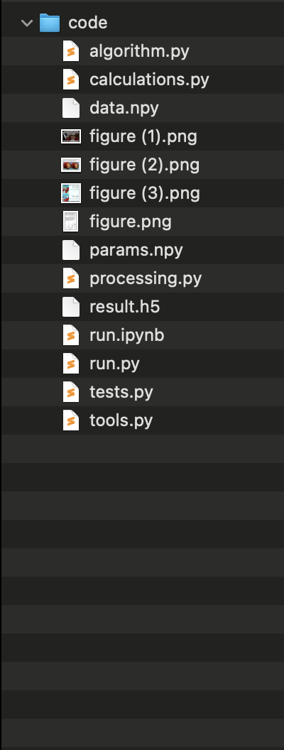
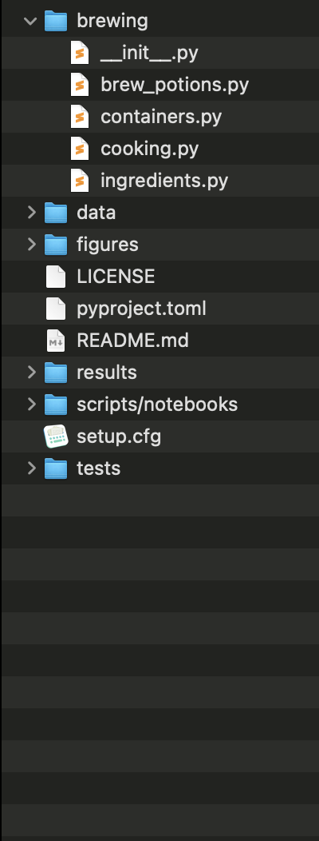
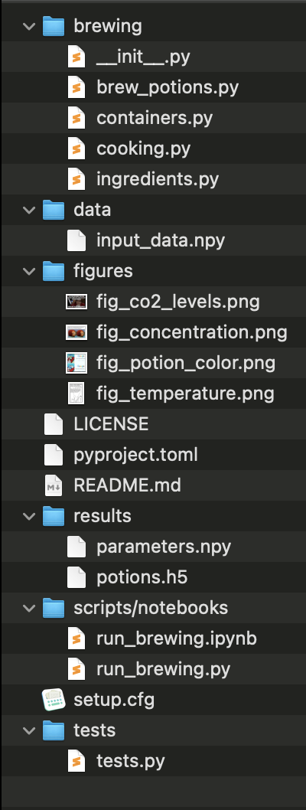
Notes:
This is the part where we solve the problem that we cannot find code we once wrote.
Make clear that this is the package structure they will be using

Slide 3

Python repo structure
name of package
__init__.py
flags folder as package
modules
your .py files containing your code
LICENSE
makes the package
(legally) usable.*
README
contains more information e.g. instructions on how to use your package.
build instructions &
package metadata
will explain more later :)
tests
you know why :)
* pick one from choosealicense.com
3

Slide 4
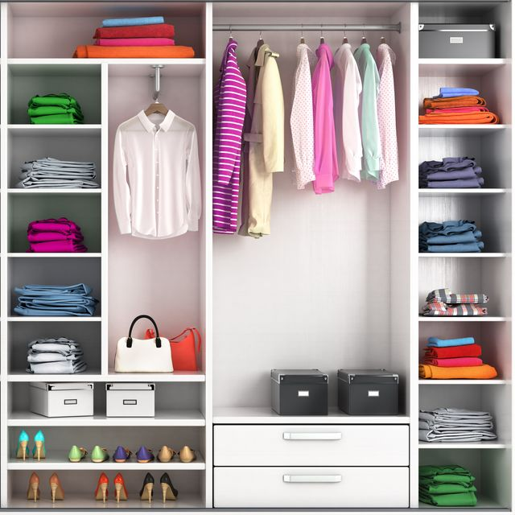

Advantage 1
—> know where to find items
e.g. wardrobe
  suit, shirts
  towels
  socks
same concept applies to code
—> use meaningful
file names

Slide 5
Advantage 2
it makes all of your code installable*
which makes all of your code importable
Terminal
> pip install brewing
>
> python
>>> import brewing
>>> brewing.brew_a_potion()
>>>
* (need a few other changes we will go over)

Slide 6
Organise what?
Project 1
Project 2
packages
packages
numpy = 1.22.0
pandas = 2.0.3
pandas = 1.2.4
numba = 1.0.2
code
other stuff
code
other stuff
simulation.py
tests/
constants.py
tests/
evaluation.py
notebook23.ipynb
training.py
notebook23.ipynb
6

Slide 7
Re-structure
Needs a different exercise? Hands on still?
defend your code

