Slide 1
make sure initial setup of pacakge works incl imports
editable installation

Slide 2
Pip editable installation
Navigate into the 2024-Heraklion-ODD folder (terminal)
Run pip list. What do you see?
Run pip install -e . (full stop = this directory)
Run pip list again. What has changed?
Run your file from Exercise 2c again, which imports the make_example_potion function. Does it work now?

Slide 3
Notes

Slide 4
What dark magic did we just apply?
Importable packages:
  current directory
  installed packages e.g. numpy, scipy, …
  (saved in system location e.g. /usr/lib64/python3.11/site-packages/
  on Pythonpath => Python can find it)
  core packages e.g. time, math, os, …
Editable installation adds your package to installed packages without moving it
Notes:
This is the part where we solve importing errors

Slide 5
Pip editable install
You can import the package you are currently working on as if it were a package you downloaded.
—> This lets you use your own code as any other package you installed
Advantages:
you can import the objects in the package from any directory
(no longer bound to the directory which contains the package)
at the same time you can keep your project in your current directory
you use your code as someone else would use it, which forces you to write it in a more usable way

Slide 6
Importing own project
Options to install a package using pip
Option 1: if package is included in PyPI
pip install numpy
Option 2: install from a VCS like git
pip install git+https://github.com/<user>/<package-name>.git
Option 3: install your package with -e (--editable) option
pip install -e <path-to-package>
(cd <path-to-package>; conda develop .)

Slide 7
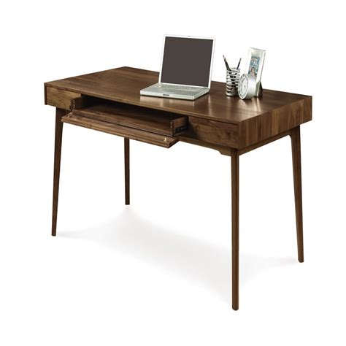

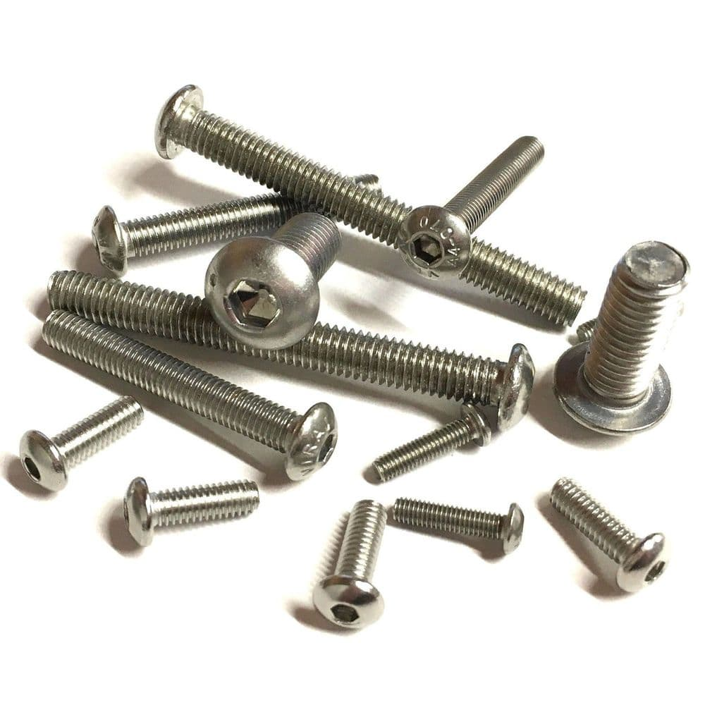
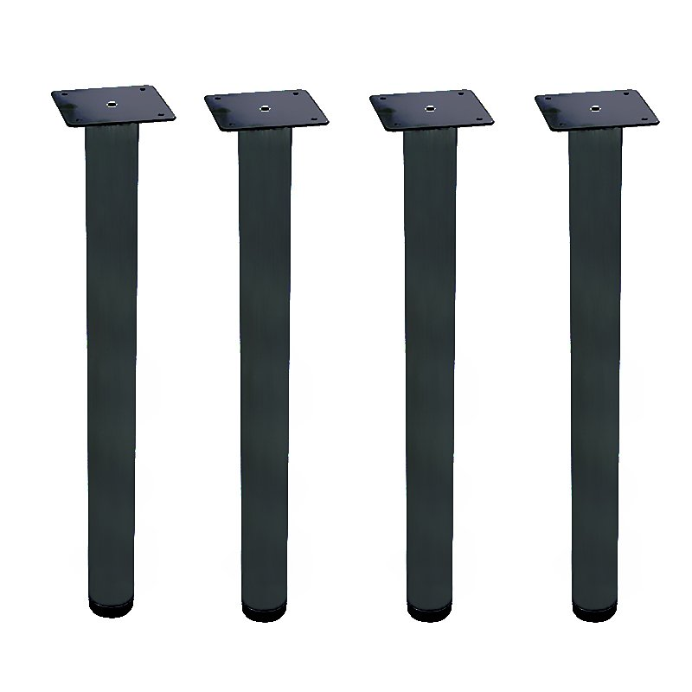
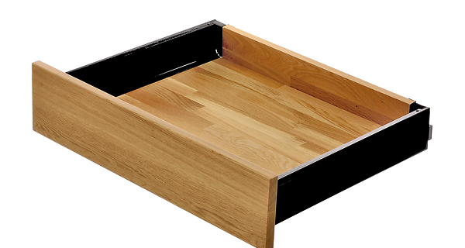
Installing other packages
You can install Python packages in your terminal using a package manager
pip
standard package manager for Python
can install packages from PyPI (Python Package Index) or from VCS e.g. github
conda
open source package manager/ environment manager
can install packages which were reviewed by Anaconda (not all)
Notes:
A bit like buying a desk or wardrobe at Ikea vs a more high end furniture shop.
You may have more control, but if something goes wrong, you have no one else to blame but yourself.

Slide 8
how to develop code with editable install

Slide 9
Changes to your workflow
None*
* for developing code if you are used to working with .py files.
(you won’t be able to use this if you only develop in jupyter)

Slide 10
Write your function
Write the last remaining potion making function
we need before sharing the package
Exercise:
Create a branch with a unique name
Follow the instructions in Exercise 3 Workflow to write and test a function to make a “Python expert” potion
Create a Pull Request
Re-structure
How should they work?
Run in terminal + text editor?
Come up with new exercise – was too easy and too hard simultaneously last year.
Add hints where they can find the necessary actions and tools.
Change instructions to guide them towards running the thing line by line.
Add an optional exercise for the ones that are fast.
Add information how to access docstrings
additional exercise:
there is another potion that can be made (name and
it uses another method –stirring
take some time to observe your own behaviour.
where would you go look for this method?
when you found it, how did you find out how to use it?
if you had problems, what would have helped?
did you write a lot of code and then ran snape? did you run step by step?
rename snape → snoope
add type hints?

Slide 11
Notes

Slide 12
Changes to your workflow II
None* **
* for developing code if you are used to working with .py files.
(you won’t be able to use this if you only develop in jupyter)
** you will have to do some setup steps at the start and regular updates

Slide 13
Short projects
start with package setup
start without package setup
→ for a small, short project, a package setup might take longer
(but it will still be much better to pick back up later)
setup
develop code
set up folders
set up pyproject.toml
set up README
set up LICENSE
set up new .py files
do editable pip install
time
develop code

Slide 14
Longer (=research) projects
start with package setup
start without package setup
→ for a longer project, having a structure from the start will pay off!
especially when you want to share or publish your code
setup
develop
publish
time
fix imports
search for code
restructure
develop
publish (restructure, fix)

Slide 15
Publishing code
Github/Gitlab
  perfectly fine for publishing publication code
  perfectly fine for hosting research group code
PyPi: Python Package Index
  If you want others to use your library, you must have your code on PyPi to make it easier for others to download and use it

Slide 16
All the advantages
The setup steps only take time at the start
  Set up the project structure, then never worry about it again
  Set your imports, then never worry about them again
  The more projects you set up like this, the easier it will become. In the end it‘s faster than solving a single import error.
You unlock so many abilities with only a little effort
  sharing code, publishing, endlessly looking for functions or files, avoiding import errors when moving files, …
If you continue coding after inside but especially outside academia, this will be the standard you will encounter.

Slide 17

Our goal
Local importing
  → review and best practices
Editable installations
  → avoid importing errors
Python package structure and code organization
  → organize folders and files in a standardized way
Environments
  avoid and alleviate package installation problems
Documentation and formatting tools
  → make code more readable and usable
Notes:
You can solve all of these topics by organising your code in a better way

Slide 18
break now?

Slide 19
package structure – required files

Slide 20
package structure I
Here is an example of a Python package structure
  What do you notice about the files and the structure?
  What is familiar / unfamiliar?
Discuss with your partner
my_project/
├── notebooks_scripts/
│ ├── demo.ipynb
│ ├── recreate_paper_figures.py
├── LICENSE
├── pyproject.toml
├── README.md
├── src/
│ ├── package_name/
│ │ ├── __init__.py
│ │ ├── analysis.py
│ │ ├── constants.py
│ │ ├── data_preprocessing.py
│ │ ├── data_visualization.py
│ │ ├── file_io.py
│ │ ├── models.py
├── tests/
│ ├── test_analysis.py
│ ├── test_data_processing.py
│ ├── test_models.py

Slide 21
Notes
>>>

Slide 22
Python package structure
Required
  src / <name-of-package>
    __init__.py
    Modules
  LICENSE
  README
  pyproject.toml
Tests – wait for tomorrow ☺.
The best way of enable yourself to run tests from this directory is to use an editable install
my_project/
├── notebooks_scripts/
│ ├── demo.ipynb
│ ├── recreate_paper_figures.py
├── LICENSE
├── pyproject.toml
├── README.md
├── src/
│ ├── package_name/
│ │ ├── __init__.py
│ │ ├── analysis.py
│ │ ├── constants.py
│ │ ├── data_preprocessing.py
│ │ ├── data_visualization.py
│ │ ├── file_io.py
│ │ ├── models.py
├── tests/
│ ├── test_analysis.py
│ ├── test_data_processing.py
│ ├── test_models.py
* pick one from choosealicense.com
22

Slide 23
pyproject.toml
The pyproject.toml file holds static information (meta data) about the package
[project]
name = "brewing"
version = "0.1.0"
description = "a python package for brewing potions"
authors = [{name = "A. SPP", email="a.spp@magic.ac.uk"}]
license = {file = "LICENSE"}
readme = "README.md"
requires-python = ">=3.11"
dependencies = ["numpy", "matplotlib >= 3.0.0", "pytest"]
[tool.setuptools]
packages = ["brewing"]
[build-system]
requires = ["setuptools>=42"]
build-backend = "setuptools.build_meta"
>>>

Slide 24
pyproject.toml
The pyproject.toml file holds static information (meta data) about the package
Required entries:
  [project] section:
  name, version, …
  [build-system] section:
  information on how to
  build package
[project]
name = "brewing"
version = "0.1.0"
description = "a python package for brewing potions"
authors = [{name = "A. SPP", email="a.spp@magic.ac.uk"}]
license = {file = "LICENSE"}
readme = "README.md"
requires-python = ">=3.11"
dependencies = ["numpy", "matplotlib >= 3.0.0", "pytest"]
[tool.setuptools]
packages = ["brewing"]
[build-system]
requires = ["setuptools>=42"]
build-backend = "setuptools.build_meta"
>>>

Slide 25
pyproject.toml
The pyproject.toml file holds static information (meta data) about the package
Dependencies:
  Declare what you import in
  the code → it will not work
  in other places otherwise!
  don’t just copy „pip list“!
  Whenever you add a new
  package, add it to the
  requirements
  Can also go into separate
  requirements.txt file
[project]
name = "brewing"
version = "0.1.0"
description = "a python package for brewing potions"
authors = [{name = "A. SPP", email="a.spp@magic.ac.uk"}]
license = {file = "LICENSE"}
readme = "README.md"
requires-python = ">=3.11"
dependencies = ["numpy", "matplotlib >= 3.0.0", "pytest"]
[tool.setuptools]
packages = ["brewing"]
[build-system]
requires = ["setuptools>=42"]
build-backend = "setuptools.build_meta"
>>>

Slide 26
break now?

Slide 27
how to organize content of python files
move into part 4?

Slide 28
File organisation
Investigate the src/brewing/cooking.py file
  What do you notice about the structure of the file?

Slide 29
Notes

Slide 30
Organising file contents
Within-module standard order:
1. imports
standard Python library
installed packages
local modules
2. constants
DATA_DIR = "/path/to/data"
3. classes and functions
class ClassName:
def func_name():
4. main execution block
if __name__ == "__main__":

Slide 31
package structure II
Here is an example of a Python package structure
  What do you notice about how the files and the folders are organised?
  How do you do this, does it differ?
Discuss with your partner
my_project/
├── notebooks_scripts/
│ ├── demo.ipynb
│ ├── recreate_paper_figures.py
├── LICENSE
├── pyproject.toml
├── README.md
├── src/
│ ├── package_name/
│ │ ├── __init__.py
│ │ ├── analysis.py
│ │ ├── constants.py
│ │ ├── data_preprocessing.py
│ │ ├── data_visualization.py
│ │ ├── file_io.py
│ │ ├── models.py
├── tests/
│ ├── test_analysis.py
│ ├── test_data_processing.py
│ ├── test_models.py

Slide 32
Notes

Slide 33
Organising file contents
Like in many other areas in life,
code is often organized thematically
(think closets, fridges, personal docs…)
Separate folders:
  src - code that is being developed
  scripts and notebooks – for demonstrations, teaching, examples, accompanying papers
  tests – you will learn about these tomorrow ☺
my_project/
├── notebooks_scripts
│ ├── demo.ipynb
│ ├── recreate_paper_figures.py
├── pyproject.toml
├── README.md
├── requirements.txt
├── src/
│ ├── package_name/
│ │ ├── __init__.py
│ │ ├── analysis.py
│ │ ├── constants.py
│ │ ├── data_preprocessing.py
│ │ ├── data_visualization.py
│ │ ├── file_io.py
│ │ ├── models.py
├── tests/
│ ├── test_analysis.py
│ ├── test_data_processing.py
│ ├── test_models.py

Slide 34
Organising file contents
Like in many other areas in life,
code is often organized thematically
(think closets, fridges, personal docs…)
Separate code into files/folders by
  theme / purpose – data handling,
  algorithm, plotting, …
  type – i/o config, parameters,
  functions
Single responsibility principle
my_project/
├── notebooks_scripts
│ ├── demo.ipynb
│ ├── recreate_paper_figures.py
├── pyproject.toml
├── README.md
├── requirements.txt
├── src/
│ ├── package_name/
│ │ ├── __init__.py
│ │ ├── analysis.py
│ │ ├── constants.py
│ │ ├── data_preprocessing.py
│ │ ├── data_visualization.py
│ │ ├── file_io.py
│ │ ├── models.py
├── tests/
│ ├── test_analysis.py
│ ├── test_data_processing.py
│ ├── test_models.py

Slide 35

Our goal
Local importing
  → review and best practices
Editable installations
  → avoid importing errors
Python package structure and code organization
  → organize folders and files in a standardized way
Environments
  avoid and alleviate package installation problems
Documentation and formatting tools
  → make code more readable and usable
Notes:
You can solve all of these topics by organising your code in a better way

Slide 36
python package file/folder structure

Slide 37

Python package files
name of package
orange files = required in order to do an editable pip installation
__init__.py
flags folder as package
modules
your .py files containing your code
LICENSE
makes the package
(legally) usable.*
README
contains more information e.g. instructions on how to use your package.
build instructions &
package metadata
the time has come to explain this…
tests
you know why :)
* pick one from choosealicense.com
37

Slide 38
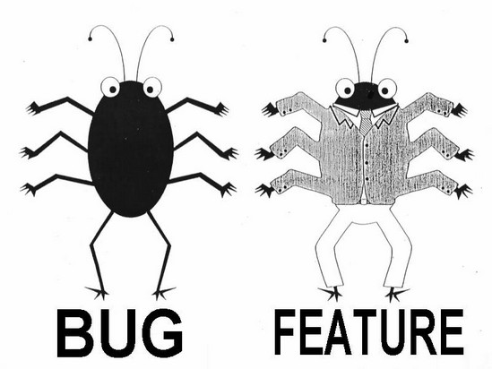
Workflow (ideal)
1
Create
2
Build & Test
3
Publish
Write feature
Set up structure
Create files: __init__.py pyproject.toml
setup.cfg
README
LICENSE
Make installable at this point
In pyproject.toml update:
version
requirements
Update README
Write test
Document
Test

Slide 39
Workflow (realistic?)
1
Create
2
Build & Test
copy that stuff to 2nd ipynb
3
Publish
Write stuff into ipynb
Set up structure
Create files: __init__.py
pyproject.toml
README
LICENSE
Make installable at this point
In pyproject.toml update:
version
requirements
Update README
change code ever so slightly
Write test
abandon test
Smugly write one comment
start new ipynb

Slide 40
Workflow (realistic?)
Publish
Create
Publish
Create
Build & Test
copy that stuff to 2nd ipynb
1
copy that stuff to 2nd ipynb
1
2
2
3
3
Write stuff into ipynb
Set up structure
Create files: __init__.py pyproject.toml
setup.cfg
README
LICENSE
Make installable at this point
Move code to package
Set up structure
Create files: __init__.py
pyproject.toml
setup.cfg
README
LICENSE
Make installable at this point
In pyproject.toml update:
version
requirements
Update README
In pyproject.toml update:
version
requirements
Update README
change code ever so slightly
Write test
Write test
Document
abandon test
Smugly write one comment
start new ipynb
Test

Slide 41
Short projects
start with package setup
setup
develop code
set up folders
set up pyproject.toml
set up README
set up LICENSE
set up new .py files
do editable pip install
time

Slide 42
Short projects
start with package setup
setup
development cycle
development cycle
update
development cycle
update
development cycle
set up folders
set up pyproject.toml
set up README
set up LICENSE
set up new .py files
do editable pip install
data cleanup
implement clustering algorithm
test second clustering algorithm
create figure
time

Slide 43
Short projects
start with package setup
start without package setup
→ for a small, short project, a package setup might take longer
(but it will still be much better to pick back up later)
setup
development cycle
development cycle
update
development cycle
update
development cycle
set up folders
set up pyproject.toml
set up README
set up LICENSE
set up new .py files
do editable pip install
data cleanup
implement clustering algorithm
test second clustering algorithm
create figure
time
development cycle
development cycle
development cycle
development cycle
data cleanup
implement clustering algorithm
test second clustering algorithm
create figure

Slide 44
Longer (=research) projects
start with package setup
start without package setup
→ for a longer project, having a structure from the start will pay off!
setup
develop
time
fix imports
search for code
restructure
develop

Slide 45
Longer (=research) projects
start with package setup
start without package setup
→ for a longer project, having a structure from the start will pay off!
setup
cycle
cycle
cycle
cycle
cycle
cycle
cycle
cycle
cycle
data
clust alg 1
clust alg 2
fig
…
time
fix imports
search for code
restructure
cycle
cycle
cycle
cycle
cycle
cycle
cycle
cycle
cycle
data
clust alg 1
clust alg 2
fig
…

Slide 46
Longer (=research) projects
start with package setup
start without package setup
→ for a longer project, having a structure from the start will pay off!
especially when you want to share or publish your code
setup
cycle
cycle
cycle
cycle
cycle
cycle
cycle
cycle
cycle
publish
data
clust alg 1
clust alg 2
fig
…
time
fix imports
search for code
restructure
cycle
cycle
cycle
cycle
cycle
cycle
cycle
cycle
cycle
publish (restructure, fix)
data
clust alg 1
clust alg 2
fig
…

Slide 47
Organising file contents
Within-module standard order:
  imports
    standard library
    installed packages
    local modules
import os
import pandas as pd
from my_io_module import load_data
DATA_DIR = "/path/to/data"
class DataProcessor:
def __init__(self, config):
self.config = config
def clean(self, data):
data = _remove_outliers(data)
return _fill_missing(data)
def load_data(file_path):
return pd.read_csv(file_path)
if __name__ == "__main__":
data = load_data("data.csv")
processor = DataProcessor()
data = processor.clean(data)

Slide 48
Organising file contents
Within-module standard order:
  imports
    standard library
    installed packages
    local modules
  constants
import os
import pandas as pd
from my_io_module import load_data
DATA_DIR = "/path/to/data"
class DataProcessor:
def __init__(self, config):
self.config = config
def clean(self, data):
data = _remove_outliers(data)
return _fill_missing(data)
def load_data(file_path):
return pd.read_csv(file_path)
if __name__ == "__main__":
data = load_data("data.csv")
processor = DataProcessor()
data = processor.clean(data)

Slide 49
Organising file contents
Within-module standard order:
  imports
    standard library
    installed packages
    local modules
  constants
  classes and functions
import os
import pandas as pd
from my_io_module import load_data
DATA_DIR = "/path/to/data"
class DataProcessor:
def __init__(self, config):
self.config = config
def clean(self, data):
data = _remove_outliers(data)
return _fill_missing(data)
def load_data(file_path):
return pd.read_csv(file_path)
if __name__ == "__main__":
data = load_data("data.csv")
processor = DataProcessor()
data = processor.clean(data)

Slide 50
Organising file contents
Within-module standard order:
  imports
    standard library
    installed packages
    local modules
  constants
  classes and functions
  main execution block
import os
import pandas as pd
from my_io_module import load_data
DATA_DIR = "/path/to/data"
class DataProcessor:
def __init__(self, config):
self.config = config
def clean(self, data):
data = _remove_outliers(data)
return _fill_missing(data)
def load_data(file_path):
return pd.read_csv(file_path)
if __name__ == "__main__":
data = load_data("data.csv")
processor = DataProcessor()
data = processor.clean(data)

Slide 51
Organising file contents
Within-module standard order:
  imports
    standard library
    installed packages
    local modules
  constants
  classes and functions
  main execution block
import os
import pandas as pd
from my_io_module import load_data
DATA_DIR = "/path/to/data"
class DataProcessor:
def __init__(self, config):
self.config = config
def clean(self, data):
data = _remove_outliers(data)
return _fill_missing(data)
def load_data(file_path):
return pd.read_csv(file_path)
if __name__ == "__main__":
data = load_data("data.csv")
processor = DataProcessor()
data = processor.clean(data)

Slide 52
Organising file contents
Like in many other areas in life,
code is often organized thematically
(think closets, fridges, personal docs…)
Separate code into files/folders by
  theme – data handling, algorithm,
  plotting, …
  type – i/o config, parameters,
  functions
my_project/
├── notebooks_scripts
│ ├── demo.ipynb
│ ├── recreate_paper_figures.py
├── pyproject.toml
├── README.md
├── requirements.txt
├── src/
│ ├── package_name/
│ │ ├── __init__.py
│ │ ├── analysis.py
│ │ ├── constants.py
│ │ ├── data_preprocessing.py
│ │ ├── data_visualization.py
│ │ ├── file_io.py
│ │ ├── models.py
├── tests/
│ ├── test_analysis.py
│ ├── test_data_processing.py
│ ├── test_models.py

Slide 53
Longer (=research) projects
start without package setup, testing
cycle
cycle
cycle
cycle
cycle
cycle
cycle
cycle
cycle
cycle
publish (restructure, fix)
data
clust alg 1
clust alg 2
fig
…
time
realistic - start without package setup, testing
re-structure
fix imports
search for code
cycle
cycle
cycle
cycle
cycle
cycle
cycle
cycle
cycle
cycle
publish (restructure, fix)
data
clust alg 1
clust alg 2
fig
…
do package setup
→ for longer project, a package setup will save you time!
setup
cycle
cycle
cycle
cycle
cycle
cycle
cycle
cycle
cycle
cycle
publish
data
clust alg 1
clust alg 2
fig
…

Slide 54
Longer (= research) projects
start without package setup, testing
cycle
cycle
cycle
cycle
cycle
cycle
cycle
cycle
cycle
cycle
publish (restructure, fix)
data
clust alg 1
clust alg 2
fig
…
time
realistic - start without package setup, testing
re-structure
fix imports
search for code
cycle
cycle
cycle
cycle
cycle
cycle
cycle
cycle
cycle
cycle
publish (restructure, fix)
data
clust alg 1
clust alg 2
fig
…
do package setup
→ for longer project, a package setup will save you time!
setup
cycle
cycle
cycle
cycle
cycle
cycle
cycle
cycle
cycle
cycle
publish
data
clust alg 1
clust alg 2
fig
…

Slide 55
Short projects
start with package setup
start without package setup
→ for a small, short project, a package setup might take longer
(but it will still be much better to pick back up later)
setup
development cycle
development cycle
update
development cycle
update
development cycle
set up folders
set up pyproject.toml
set up README
set up LICENSE
set up new .py files
do editable pip install
data cleanup
implement clustering algorithm
test second clustering algorithm
create figure
time
development cycle
development cycle
development cycle
development cycle
data cleanup
implement clustering algorithm
test second clustering algorithm
create figure

Slide 56
Short projects
start without package setup, testing
development cycle
development cycle
development cycle
development cycle
data cleanup
implement clustering algorithm
test second clustering algorithm
create figure
time
do package setup
→ for a small, short project, a package setup might take longer
setup
development cycle
development cycle
update
development cycle
update
development cycle
data cleanup
implement clustering algorithm
test second clustering algorithm
create figure

Slide 57
Additional advantages
Your code should be ready to be published
if your code is pip-installable, you can put your tests into a separate folder
your pyproject.toml file acts as a record of the necessary packages to run your code

