Slide 1
make sure initial setup of pacakge works incl imports
editable installation

Slide 2
Pip editable installation
Navigate into the 2024-Heraklion-ODD folder (terminal)
Run pip list. What do you see?
Run pip install -e . (full stop = this directory)
Run pip list again. What has changed?
Can you now import x from y REFERENCE TO PREV SECTION EXERCISE!!
Discussion

Slide 3
Notes

Slide 4
Editable installation?
Importable packages:
  current directory
  installed packages e.g. numpy, scipy, …
  (saved in system location e.g. /usr/lib64/python3.11/site-packages/
  on Pythonpath => Python can find it)
  core packages e.g. time, math, os, …
Editable installation adds your package to installed packages without moving it
Notes:
This is the part where we solve importing errors

Slide 5
Pip editable install
You can import the package you are currently working on as if it were a package you downloaded.
—> This lets you use your own code as any other package you installed
Advantages:
you can import the objects in the package from any directory
(no longer bound to the directory which contains the package)
at the same time you can keep your project in your current directory
you use your code as someone else would use it, which forces you to write it in a more usable way

Slide 6
Importing own project
Options to install a package using pip
Option 1: if package is included in PyPI
pip install numpy
Option 2: install from a VCS like git
pip install git+https://github.com/<user>/<package-name>.git
Option 3: install your package with -e (--editable) option
pip install -e <path-to-package>
(cd <path-to-package>; conda develop .)

Slide 7
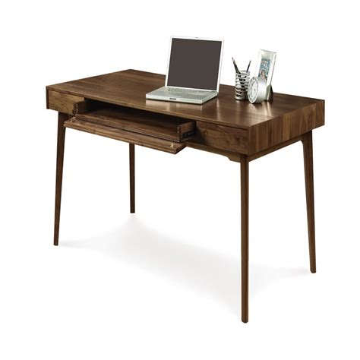

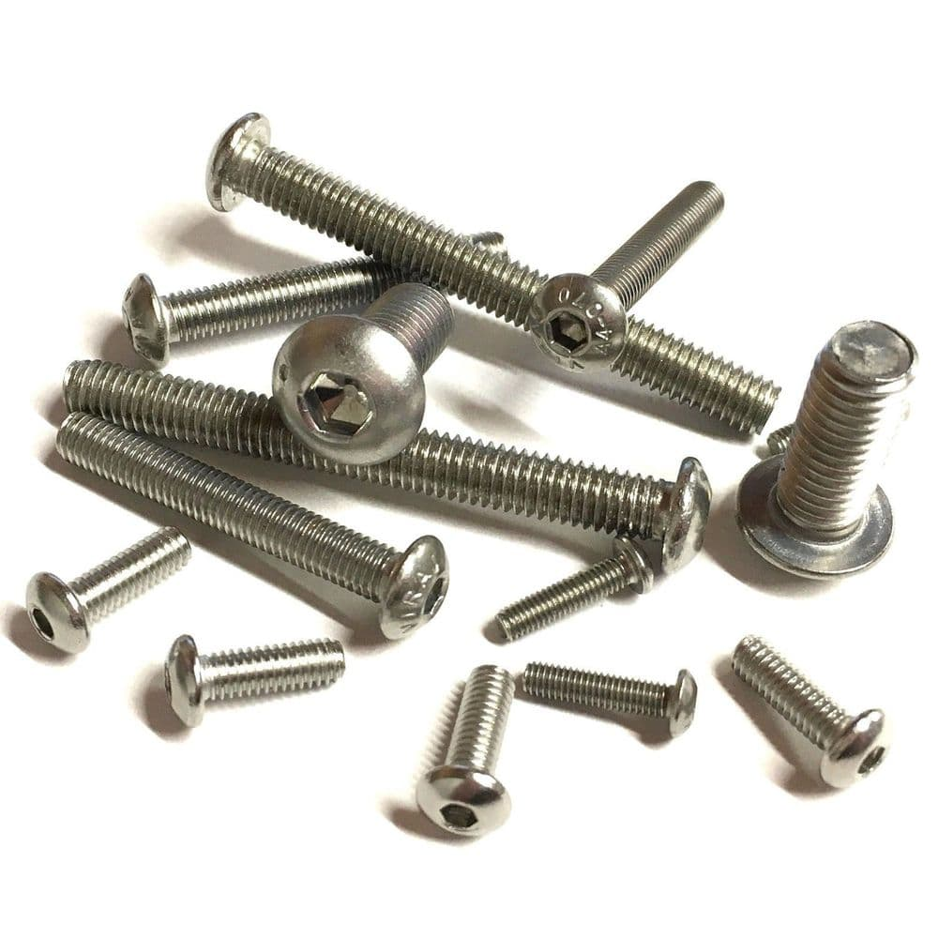
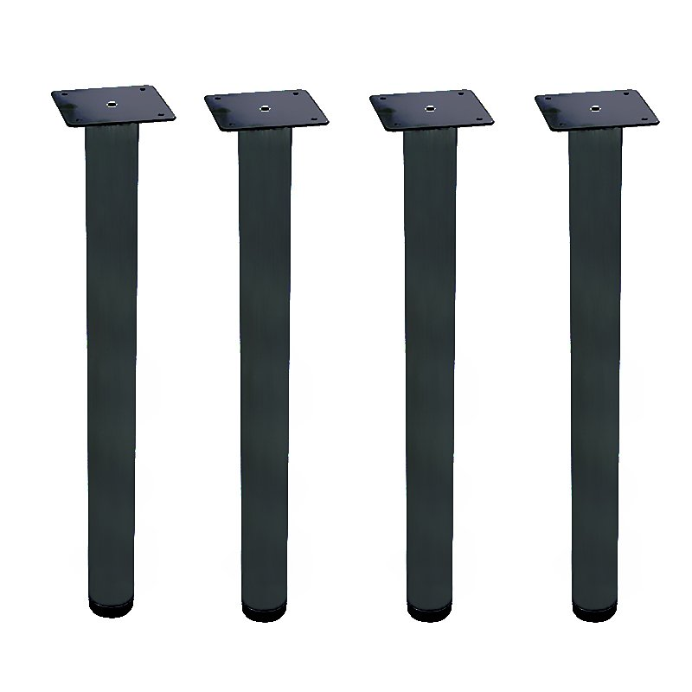
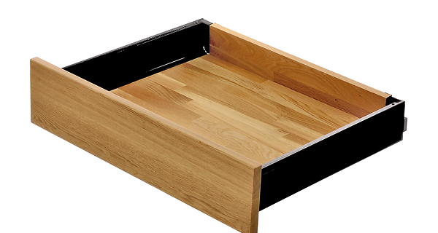
Installing other packages
You can install Python packages in your terminal using a package manager
pip
standard package manager for Python
can install packages from PyPI (Python Package Index) or from VCS e.g. github
conda
open source package manager/ environment manager
can install packages which were reviewed by Anaconda (not all)
Notes:
A bit like buying a desk or wardrobe at Ikea vs a more high end furniture shop.
You may have more control, but if something goes wrong, you have no one else to blame but yourself.

Slide 8
Pip editable installation
Investigate the 2024-heraklion-ODD folder
  What do you notice about the structure?
  Which files are familiar / unfamiliar?
Discussion

Slide 9
Notes

Slide 10
Python package structure
Src / <name-of-package>
  __init__.py
  Modules
LICENSE
README
Pyproject.toml
Tests folder is actually here – in order to run tests from this directory, you need to make this possible somehow
wait for Jenny to publish her pacakge structure
* pick one from choosealicense.com
10

Slide 11
pyproject.toml
The pyproject.toml file holds static information (meta data) about the package
[project]
name = "brewing"
version = "0.1.0"
description = "a python package for brewing potions"
authors = [{name = "A. SPP", email="a.spp@magic.ac.uk"}]
license = {file = "LICENSE"}
readme = "README.md"
requires-python = ">=3.11"
dependencies = ["numpy", "matplotlib >= 3.0.0", "pytest"]
[tool.setuptools]
packages = ["brewing"]
[build-system]
requires = ["setuptools>=42"]
build-backend = "setuptools.build_meta"
>>>

Slide 12
pyproject.toml
The pyproject.toml file holds static information (meta data) about the package
Required entries:
  [project] section:
  name, version, …
  [build-system] section:
  information on how to
  build package
[project]
name = "brewing"
version = "0.1.0"
description = "a python package for brewing potions"
authors = [{name = "A. SPP", email="a.spp@magic.ac.uk"}]
license = {file = "LICENSE"}
readme = "README.md"
requires-python = ">=3.11"
dependencies = ["numpy", "matplotlib >= 3.0.0", "pytest"]
[tool.setuptools]
packages = ["brewing"]
[build-system]
requires = ["setuptools>=42"]
build-backend = "setuptools.build_meta"
>>>

Slide 13
pyproject.toml
The pyproject.toml file holds static information (meta data) about the package
Dependencies:
  Declare what you import in
  the code → it will not work
  in other places otherwise!
  don’t just copy „pip list“!
  Whenever you add a new
  package, add it to the
  requirements
  Can also go into separate
  requirements.txt file
[project]
name = "brewing"
version = "0.1.0"
description = "a python package for brewing potions"
authors = [{name = "A. SPP", email="a.spp@magic.ac.uk"}]
license = {file = "LICENSE"}
readme = "README.md"
requires-python = ">=3.11"
dependencies = ["numpy", "matplotlib >= 3.0.0", "pytest"]
[tool.setuptools]
packages = ["brewing"]
[build-system]
requires = ["setuptools>=42"]
build-backend = "setuptools.build_meta"
>>>

Slide 14

Our goal
Importing
  → best practices
Editable installations
  → avoid importing errors
Python package structure and code organization
  → organize folders and files in a standardized way
Documentation and formatting tools
  → make code more readable and usable
Environments
  → avoid and alleviate package installation problems
Notes:
You can solve all of these topics by organising your code in a better way

Slide 15
break

Slide 16
how to develop code if it’s in a package
where to put organisation within files?

Slide 17
Workflow
start without package setup, testing
development cycle
development cycle
development cycle
development cycle
data cleanup
implement clustering algorithm
test second clustering algorithm
create figure
time
do package setup
→ for a small, short project, a package setup might take longer
setup
development cycle
development cycle
update
development cycle
update
development cycle
data cleanup
implement clustering algorithm
test second clustering algorithm
create figure

Slide 18
Workflow
start without package setup, testing
cycle
cycle
cycle
cycle
cycle
cycle
cycle
cycle
cycle
cycle
publish (restructure, fix)
data
clust alg 1
clust alg 2
fig
…
time
realistic - start without package setup, testing
re-structure
fix imports
search for code
cycle
cycle
cycle
cycle
cycle
cycle
cycle
cycle
cycle
cycle
publish (restructure, fix)
data
clust alg 1
clust alg 2
fig
…
do package setup
→ for longer project, a package setup will save you time!
setup
cycle
cycle
cycle
cycle
cycle
cycle
cycle
cycle
cycle
cycle
publish
data
clust alg 1
clust alg 2
fig
…

Slide 19
Workflow
The setup steps only take time at the start
  Set up the project structure, then never worry about it again
  Set your imports, then never worry about them again
The more projects you set up like this, the easier it will become. In the end it‘s faster than solving a single import error.
You unlock so many abilities with only a little effort
  sharing code, publishing, avoiding import errors when moving files, …
If you continue coding after your research career, this will be the standard you will encounter.

Slide 20
Write your function
Write the last remaining potion making function
we need before sharing the package
Exercise:
Create a branch with a unique name
Follow the instructions in Exercise 3 Workflow to write and test a function to make a “Python expert” potion
Create a Pull Request
Re-structure
How should they work?
Run in terminal + text editor?
Come up with new exercise – was too easy and too hard simultaneously last year.
Add hints where they can find the necessary actions and tools.
Change instructions to guide them towards running the thing line by line.
Add an optional exercise for the ones that are fast.
Add information how to access docstrings
additional exercise:
there is another potion that can be made (name and
it uses another method –stirring
take some time to observe your own behaviour.
where would you go look for this method?
when you found it, how did you find out how to use it?
if you had problems, what would have helped?
did you write a lot of code and then ran snape? did you run step by step?
rename snape → snoope
add type hints?

Slide 21
Publishing code
Github/Gitlab
  perfectly fine for publishing publication code
  perfectly fine for hosting research group code
PyPi: Python Package Index
  If you want others to use your library, you must have your code on PyPi to make it easier for others to download and use it

Slide 22
how to organize content of python files
where to put organisation within files?

Slide 23
File organisation
Investigate the src/brewing/cooking.py file
  What do you notice about the structure?
  What do you notice about the format?

Slide 24
Notes

Slide 25
Organising file contents
improve slide aesthetics
Organize code into separate files/folders
  theme – data handling, algorithm, plotting, …
  type – i/o config, parameters, functions
Within a file, follow an order
  import statements, constants, functions/classes, if __name__ …
Naming
  CONSTANT_1, function_name, ClassName
Scripts and notebooks
  do not contain code that is being developed
  outside of package code (src)

Slide 26
Folder structure

Slide 27

Python package files
name of package
orange files = required in order to do an editable pip installation
__init__.py
flags folder as package
modules
your .py files containing your code
LICENSE
makes the package
(legally) usable.*
README
contains more information e.g. instructions on how to use your package.
build instructions &
package metadata
the time has come to explain this…
tests
you know why :)
* pick one from choosealicense.com
27

Slide 28
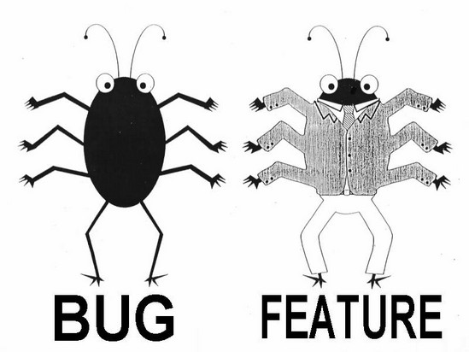
Workflow (ideal)
1
Create
2
Build & Test
3
Publish
Write feature
Set up structure
Create files: __init__.py pyproject.toml
setup.cfg
README
LICENSE
Make installable at this point
In pyproject.toml update:
version
requirements
Update README
Write test
Document
Test

Slide 29
Workflow (realistic?)
1
Create
2
Build & Test
copy that stuff to 2nd ipynb
3
Publish
Write stuff into ipynb
Set up structure
Create files: __init__.py
pyproject.toml
README
LICENSE
Make installable at this point
In pyproject.toml update:
version
requirements
Update README
change code ever so slightly
Write test
abandon test
Smugly write one comment
start new ipynb

Slide 30
Workflow (realistic?)
Publish
Create
Publish
Create
Build & Test
copy that stuff to 2nd ipynb
1
copy that stuff to 2nd ipynb
1
2
2
3
3
Write stuff into ipynb
Set up structure
Create files: __init__.py pyproject.toml
setup.cfg
README
LICENSE
Make installable at this point
Move code to package
Set up structure
Create files: __init__.py
pyproject.toml
setup.cfg
README
LICENSE
Make installable at this point
In pyproject.toml update:
version
requirements
Update README
In pyproject.toml update:
version
requirements
Update README
change code ever so slightly
Write test
Write test
Document
abandon test
Smugly write one comment
start new ipynb
Test

Slide 31
Additional advantages
Your code should be ready to be published
if your code is pip-installable, you can put your tests into a separate folder
your pyproject.toml file acts as a record of the necessary packages to run your code

