Slide 1
Kahoot link
https://create.kahoot.it/share/multithreading-or-multiprocessing/420c5efc-305b-4d6e-8790-fa037b8df9a6

Slide 3
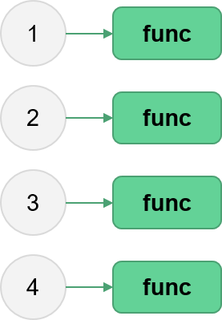
Parallel Python
Aitor Morales-Gregorio
Jenni Rinker
Zbigniew Jędrzejewski-Szmek
ASPP 2024, Heraklion
Fork/clone the repo now!

Slide 4
Outline
Processes, threads and THE GIL
Hands-on investigations of embarrassingly parallel problems
  Multithreading with NumPy
  The multiprocessing package
  Blending processes and threads
Going further
Wrap-up
4

Slide 5
Exercise: brainstorm
Why do we parallelize?
Talk to your partner and come up with three practical examples of where parallelization could be beneficial (in your work or another application).
5

Slide 6
Exercise: brainstorm
Why do we parallelize?
Talk to your partner and come up with three practical examples of where parallelization could be beneficial (in your work or another application).
In short, two reasons why:
Speed up computations.
Process “big” things.
As for the “how”...we’ll come back to that later.
6

Slide 7
Process, threads and THE GIL
7

Slide 8
The dakos program.
8

Slide 9
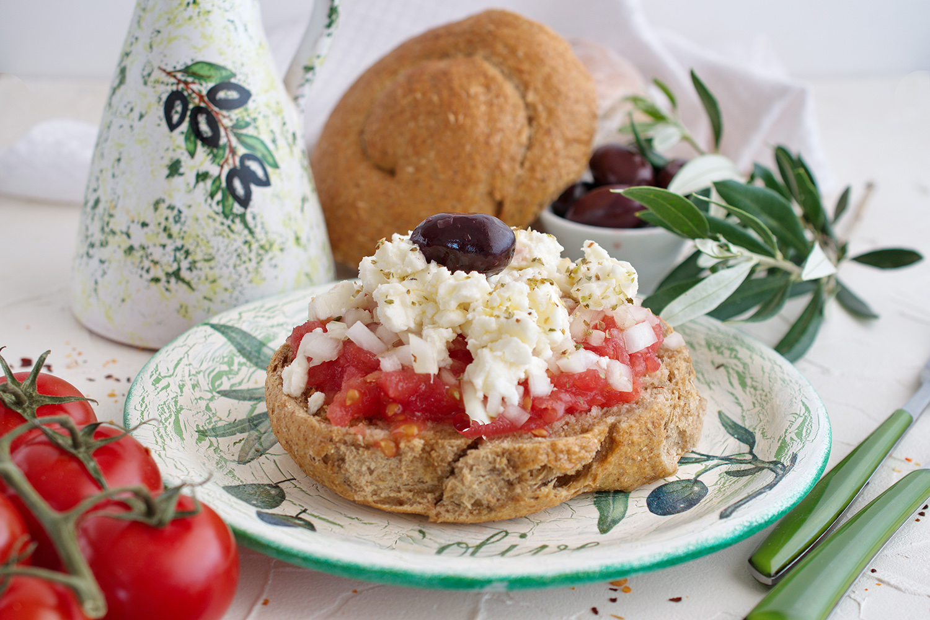
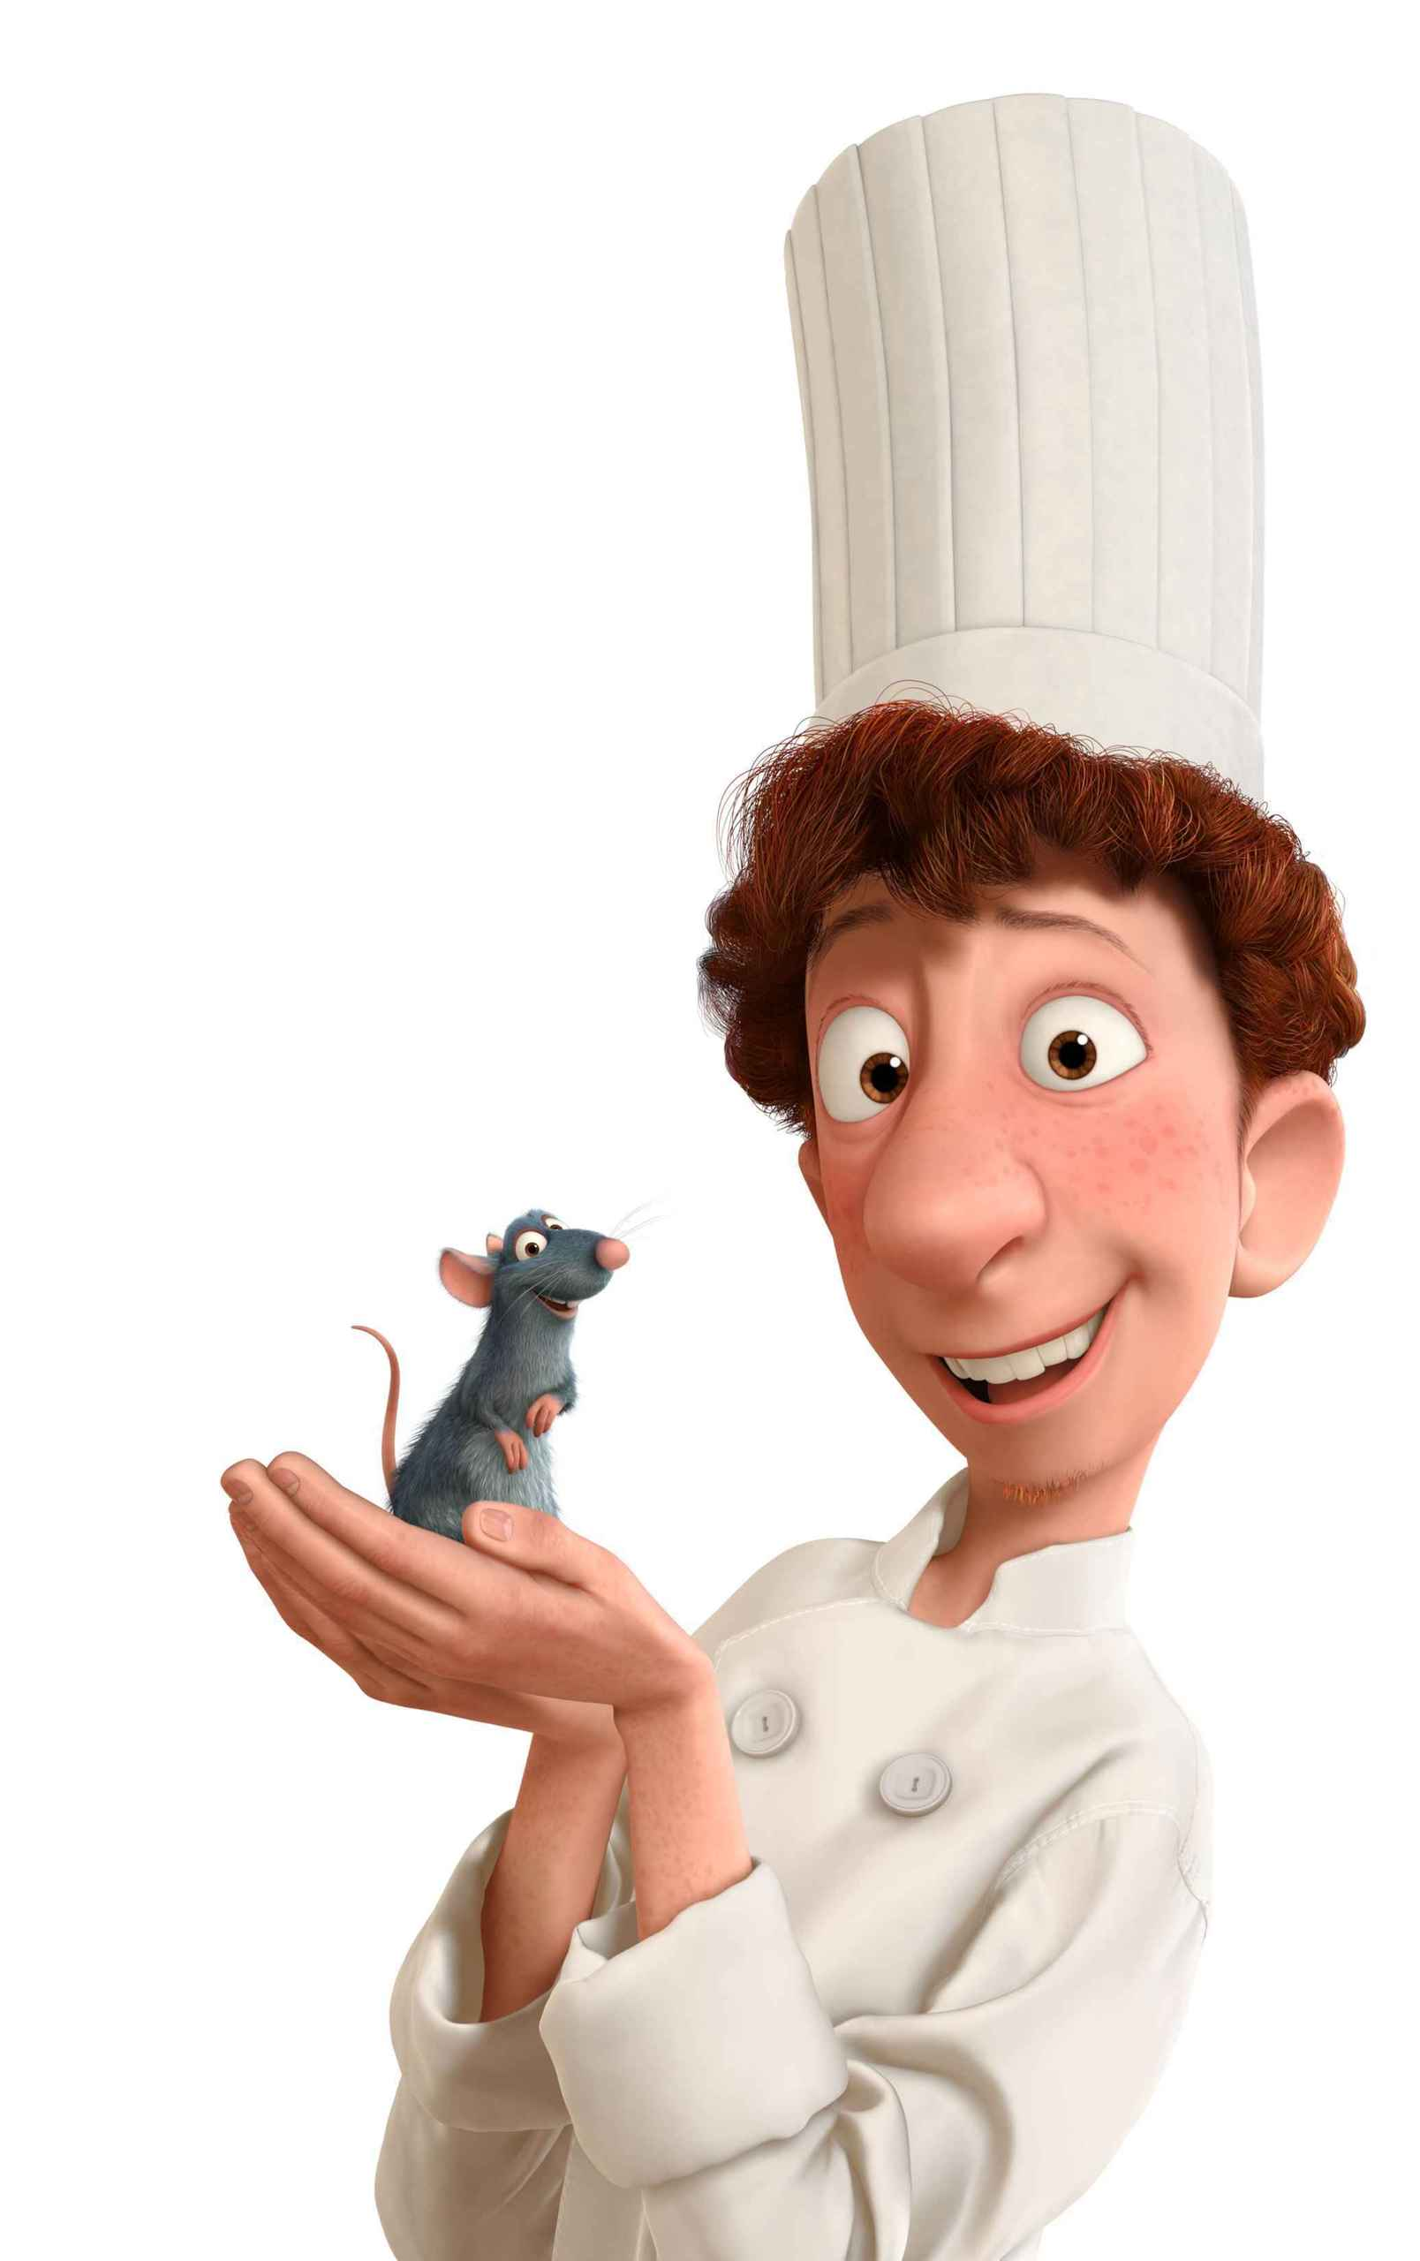
The dakos program.
We need to make a single dish: DAKOS.
This requires:
Fetch olive oil from the pantry
Fetch rusks from the pantry
Drizzle the rusks with water
Drizzle the rusks with olive oil
Fetch tomatoes from the pantry
Wash the tomatoes
Grate the tomatoes
Fetch feta from the pantry
Grate the feta cheese
Combine the softened rusks, grated tomatoes, and grated cheese
Place the finished dakos in the pantry
9
Notes:
Explain the dakos program (instructions) as a single-threaded process. Mention
(1) the pantry is across the street
(2) the countertop with the copy of the recipe, where everything is stored when it’s not being acted upon.
(3) that the chef is a stupid box who can only do one thing at a time.

Slide 10

workstation
place for non-fetch actions
Optimize the dakos program.
Fetch olive oil from the pantry
Fetch rusks from the pantry
Drizzle the rusks with water
Drizzle the rusks with olive oil
Fetch tomatoes from the pantry
Wash the tomatoes
Grate the tomatoes
Fetch feta from the pantry
Grate the feta cheese
Combine the softened rusks, grated tomatoes, and grated cheese
Place the finished dakos in the pantry
chef
a stupid box (does actions)
countertop
temporarily holds things (recipe, intermediate ingredients, etc.)
pantry
across the street
10
Notes:
Your goal is to optimize the dakos program, to make a dakos as fast as possible.
You can choose how many chefs and workstations you need, but you need to figure out which chefs do which tasks and in which order.
(estimate around 7 minutes -- put up green stickies when done)

Slide 11
Congratulations!
You have just designed a
multi-threaded process.
11

Slide 12
Decoding the metaphor
Key concepts:
Process
  An instance of a program being executed. OS assigns it space in memory for instructions/data.
Thread
  Unit of computation (i.e., set of instructions) that the OS sends to CPU for execution.
…and others
  Recall the computer architecture lecture!
  NOTE this metaphor ignores caching.
Elements of our kitchen metaphor:
Workstations
Countertop
Stupid boxChef with list of tasks
Pantry
(extra) Restaurant owner
So which element is which?
Workstations:
Countertop:
Chef w/tasks:
Pantry:
Restaurant owner:
12
Notes:
* Talk to your partner for a minute and make your own explanations for which element of the metaphor corresponds to which computer.

Slide 13

But there is a problem…
…and that problem is tomatoes.
Consider a scenario:
The dakos program requires fetching tomatoes one-by-one.
The “fetch tomatoes” task includes a sub-task:
    count all the tomatoes in the pantry,
    take X tomatoes for the dako, and
    write on a note on the countertop how many are left in the pantry (the memory)
What happens if two chefs making dakos execute their tasks at the same time?
  The number of tomatoes will be off by 1!
13

Slide 14
This problem is called a race condition
Race conditions are problematic in any multithreaded code. In Python, race conditions can lead to memory corruption.
To avoid race conditions, *Python implemented something special called…
*To be specific, only CPython – Python built on the C language. Other types of Python may not have this, but you are almost certainly using CPython.
14

Slide 15

The “Global Interpreter Lock” (GIL)
A “mutex” (mutual exclusion) lock.
Within the process, only 1 thread is allowed to execute pure-Python code in a given instance.
The lock is acquired and released by threads, approximately every 100 bytecode instructions. Also released in other cases, e.g., I/O.
Hypothesize with your partner:
NumPy can (and by default does) run code with multiple threads in parallel. How is this possible?
15
Notes:
(GIL introduced in Python version 1.5, January of 1998.)
Define what a lock is, keep the kitchen analogy (it’s a good one). “mutex lock” (mutual exclusion). “The lock is explicitly released and re-acquired periodically by each Python thread, specifically after approximately every 100 bytecode instructions executed within the interpreter. This allows other threads within the Python process to run, if present.
The lock is also released in some circumstances, allowing other threads to run.
An important example is when a thread performs an I/O operation, such as reading or writing from an external resource like a file, socket, or device.
The lock is also explicitly released by some third-party Python libraries when performing computationally expensive operations in C-code.”

Slide 16


NumPy interfaces with non-Python libraries that, by default, use as many threads as you have cores.
NumPy’s trick
In other words, it is many chefs disguised as one!
16

Slide 17
What does this all mean?
Computationally heavy, pure-Python code will generally have 0 speed-up with multiple threads.
Some specific packages (NumPy) get around this by spinning up multiple threads without the Python interpreter knowing.
Note that network- and IO-bound problems release the lock and thus can be handled with multithreading.
So how can we get around the GIL for non-NumPy, non-I/O code?
Instead of multiple threads, use multiple processes.
17

Slide 18




Multiprocessing: multiple teams of chefs
Each process is an instance of the Python interpreter and therefore has its own GIL!
BUT processes have separate memory, so data must be duplicated in each process.
Multiple processes therefore have additional computational overhead and memory usage.
Each team can have 1 chef working
18
Notes:
Back to our dakos program -- we have the red team who is doing some of the dakos tasks, and they have some reserved countertop space. But because of the GIL, only 1 red chef can execute at a time! So we add the purple team, who can also have 1 chef working at a time. And the purple team also has some reserved countertop space.
Because 2 chefs can work at the same time, we can make our dakos faster. BUT each team has their own countertop space, the boss does not let them share with each other. STUPID BOXES. So the recipe needs to be duplicated. And it takes the boss longer to set up the kitchen.
So using multiple process increases memory usage and has higher computational overhead for spinning up.

Slide 19
To wrap things up…a pop quiz!
On your pair computer, please navigate to kahoot.it and enter game pin
19
Notes:
https://create.kahoot.it/share/multithreading-or-multiprocessing/420c5efc-305b-4d6e-8790-fa037b8df9a6

Slide 20
Outline
Processes, threads and THE GIL
Hands-on investigations of embarrassingly parallel problems
  Multithreading with NumPy
  The multiprocessing package
  Blending processes and threads
Going further
Wrap-up
20

