Slide 2
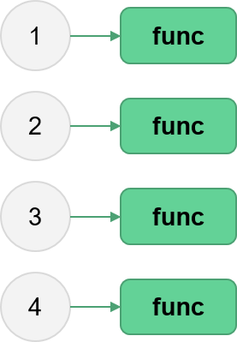
Parallel Python
Aitor Morales-Gregorio
Zbigniew Jędrzejewski-Szmek
ASPP 2023, Heraklion
Fork/clone the repo now!

Slide 3
Outline
Multithreading, the GIL, and multiprocessing
Embarrassingly parallel problems with the built-in multiprocessing module
Investigation of NumPy threading on execution time
Going further
Wrapping up
3

Slide 4
Going further
4

Slide 5
Larger-than-memory problems
Consider a problem: calculating the mean value of each column in a numpy array, where the array is so big that you cannot hold it in memory.
Discuss for a minute with your partner: what code could you write to get around this problem?
5

Slide 6
A pseudocode solution
Break the array into n_chunks vertical chunks.
initialize mean_values to array of zeros
for each chunk in the array:
load the chunk into memory
calculate the mean values of all columns
divide the chunk mean values by n_chunks
add the result to mean_values
mean_values[i]
mean(chunk)
n_chunk
mean_values[i+1]
6

Slide 7
Other Python packages for parallel computing
https://github.com/mpi4py/mpi4py/ (de facto standard for low-level massive parallelization)
https://ipyparallel.readthedocs.io/en/latest/ (parallel IPython)
https://github.com/ray-project/ray (parallelization for ML-style workflows)
https://github.com/modin-project/modin (parallel pandas)
https://www.bodo.ai/ (SQL & data processing)
https://spark.apache.org/docs/latest/api/python/index.html (big data analytics)
7

Slide 8
Add slide
Coroutines (asyncio) and subinterpreters
Slide summarizing common use cases and recommended (generally) parallalelization methods

Slide 9
Add other parallelization tools
dask, snakemake, etc.
But use whatever tools is on your cluster

Slide 10
Wrapping up
10

Slide 11
Let’s wrap it up. What have we learned?
Threads
Processes
The GIL
How to use pure python parallelization
...
11

Slide 12
Thanks!
12

Slide 13
Supplementary material
13

Slide 14
Further reading
When Python releases the GIL When Python can’t thread: a deep-dive into the GIL’s impact (pythonspeed.com)
NumPy and the GIL NumPy vs the Global Interpreter Lock (GIL) (superfastpython.com)
How the GIL prevents memory leaks in Python programs What Is the Python Global Interpreter Lock (GIL)? – Real Python
Advanced Python topics: Threads in Python
Sharing data in threads and processes Threads are 4x Faster at Sharing Data Than Processes in Python (superfastpython.com)
14

Slide 15


MPI (Message Passing Interface)
process 0
process 1
data xyz
data xyz
computer 0
computer 1
MPI is a standard for passing data ("messages") between processes.
OpenMPI/MPICH/… are C-libraries following the MPI standard.
mpi4py allows you to use these libraries from Python to communicate between processes.
15

Slide 16


Why (not) MPI?
high-level of flexibility
high performance (when used correctly)
leverage the combined power of thousands of computers
cognitive overhead
difficult to use effectively
debugging can is a nightmare
(pictured: typical MPI user)
16

