Slide 2
Outline
Processes, threads and THE GIL
Hands-on investigations of embarrassingly parallel problems
  Multithreading with NumPy
  The multiprocessing package
  Blending processes and threads
Going further
Wrap-up
2

Slide 3
Going further
3

Slide 4
Topics
Asyncio and coroutines
The near-future: sub-interpreters
Larger-than-memory problems
Not-embarrassingly-parallel problems
Other tools
Parallelism on clusters
4

Slide 5
Concurrency in Python
Concurrency: multiple tasks making progress at the same time.
Parallelism is a type of concurrency.
Multithreading (<=2.3)
Multiprocessing (<=2.6)
Coroutines and asyncio (3.4)
Sub-interpreters (3.12)
See [1] for more discussion.
5

Slide 6
The asyncio package
Pseudocode
Inspired by [3]
async def main():
urls = [‘www.yes.com’,
‘www.no.com’]
# asynchronously collect
# url content with 1 thread
content = await scrape(urls)
# process content here...
As of Python 3.4.
Concurrent but not parallel.
Single thread that can switch between tasks at points you specify.
Use case: slow I/O with many connections [2].
E.g., web scraping.
A bit of a learning curve.
6
Notes:
Concurrent: multiple tasks make progress at the same time. Parallel: two threads at the same time.

Slide 7
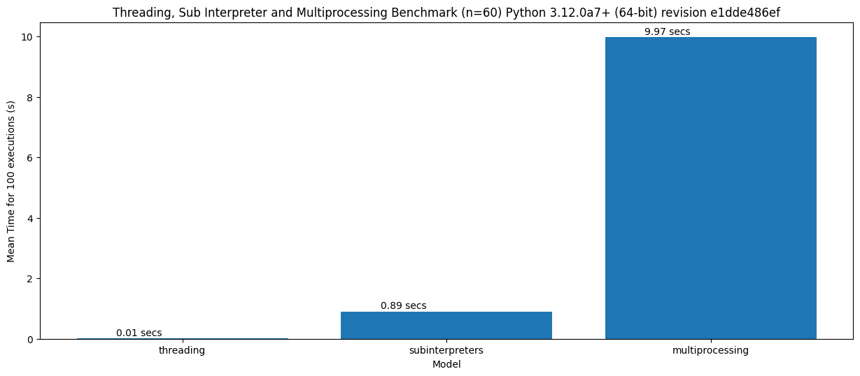
Sub-interpreters.
Released with 3.12. Still undergoing bug fixes. [1]
Different Python interpreters within the same process.
Own GIL, shared memory.
Less time to spin up
compared to
multiprocessing [4]:
7
Notes:
Concurrent: multiple tasks make progress at the same time. Parallel: two threads at the same time.

Slide 8
Larger-than-memory problems
Consider a problem: calculating the mean value of each column in a numpy array, where the array is so big that you cannot hold it in memory.
Discuss for a minute with your partner: what code could you write to get around this problem?
8

Slide 9
A pseudocode solution
Break the array into n_chunks vertical chunks.
initialize mean_values to array of zeros
for each chunk in the array:
load the chunk into memory
calculate the mean values of all columns
divide the chunk mean values by n_chunks
add the result to mean_values
mean_values[i]
mean(chunk)
n_chunk
mean_values[i+1]
9

Slide 10
Not-embarrassingly parallel problems
It gets complicated. ☹
If I/O bound and relatively independent tasks, perhaps asyncio.
CPU-bound...
MPI: Message Passing Interface. De facto standard for low-level massive parallelization. https://github.com/mpi4py/mpi4py/
Slides at end of deck.
10

Slide 11
Other Python packages for parallel computing
https://www.dask.org/ (data objects [arrays, dataframes] for scaled computation, from laptop to cluster)
https://snakemake.readthedocs.io/en/stable/index.html (tool to create reproducible and scalable analyses)
https://ipyparallel.readthedocs.io/en/latest/ (parallel IPython)
https://github.com/ray-project/ray (parallelization for ML-style workflows)
https://github.com/modin-project/modin (parallel pandas)
https://www.bodo.ai/ (SQL & data processing)
https://spark.apache.org/docs/latest/api/python/index.html (big data analytics)
11

Slide 12
On the cluster at your institute
If a parallel Python workflow is available, use it.
If no workflow is available, be ready for challenges.
Efficacy of certain packages is cluster-dependent.
12

Slide 13
Wrapping up
13

Slide 14



Outline
Processes, threads and THE GIL
Hands-on investigations of embarrassingly parallel problems
  Multithreading with NumPy
  The multiprocessing package
  Blending processes and threads
Going further
Wrap-up
14

Slide 15
Thanks!
15

Slide 16
Supplementary material
16

Slide 17
Further reading
4 concurrency in Python and subinterpreters Python subinterpreters and free-threading [LWN.net]
Concurrency in Python. Note that code snippets are a little outdated. Async Python: The Different Forms of Concurrency · Abu Ashraf Masnun
Example of webscraping with asyncio Asynchronous Web Scraping in Python [2024] - ZenRows
Sub-interpreters in 3.12 https://tonybaloney.github.io/posts/sub-interpreter-web-workers.html
17

Slide 18


MPI (Message Passing Interface)
process 0
process 1
data xyz
data xyz
computer 0
computer 1
MPI is a standard for passing data ("messages") between processes.
OpenMPI/MPICH/… are C-libraries following the MPI standard.
mpi4py allows you to use these libraries from Python to communicate between processes.
18

Slide 19


Why (not) MPI?
high-level of flexibility
high performance (when used correctly)
leverage the combined power of thousands of computers
cognitive overhead
difficult to use effectively
debugging can is a nightmare
(pictured: typical MPI user)
19

