Slide 2
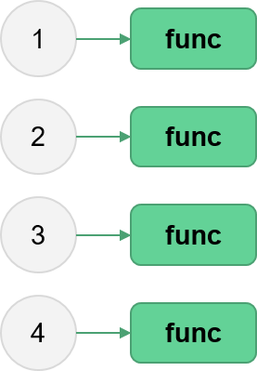
Parallel Python
Aitor Morales-Gregorio
Jenni Rinker
Zbigniew Jędrzejewski-Szmek
ASPP 2024, Heraklion
Fork/clone the repo now!

Slide 3
Outline
Processes, threads and the GIL
Embarrassingly parallel problems with the built-in multiprocessing module
Investigation of NumPy threading on execution time
Going further
Wrapping up
3

Slide 4
Exercise: brainstorm
Why do we parallelize?
Talk to your partner and come up with three practical examples of where parallelization could be beneficial (in your work or another application).
4

Slide 5
Exercise: brainstorm
Why do we parallelize?
Talk to your partner and come up with three practical examples of where parallelization could be beneficial (in your work or another application).
In short, two reasons why:
Speed up computations.
Process “big” things.
As for the “how”...we’ll come back to that later.
5

Slide 6
Multithreading, the GIL, and multiprocessing
6

Slide 7
Parallelization as ...
7
Notes:
We have a head chef and a group of sous chefs who are trying to make a pasta carbonara as quickly as possible to feed hungry people. Tasks are (1) inventory the vegetables, (2) was and chop vegetables and cook them in a pot to a sauce, (3) boil and strain noodles. Everything is returned to the head chef, who then plates the final dish.

Slide 8

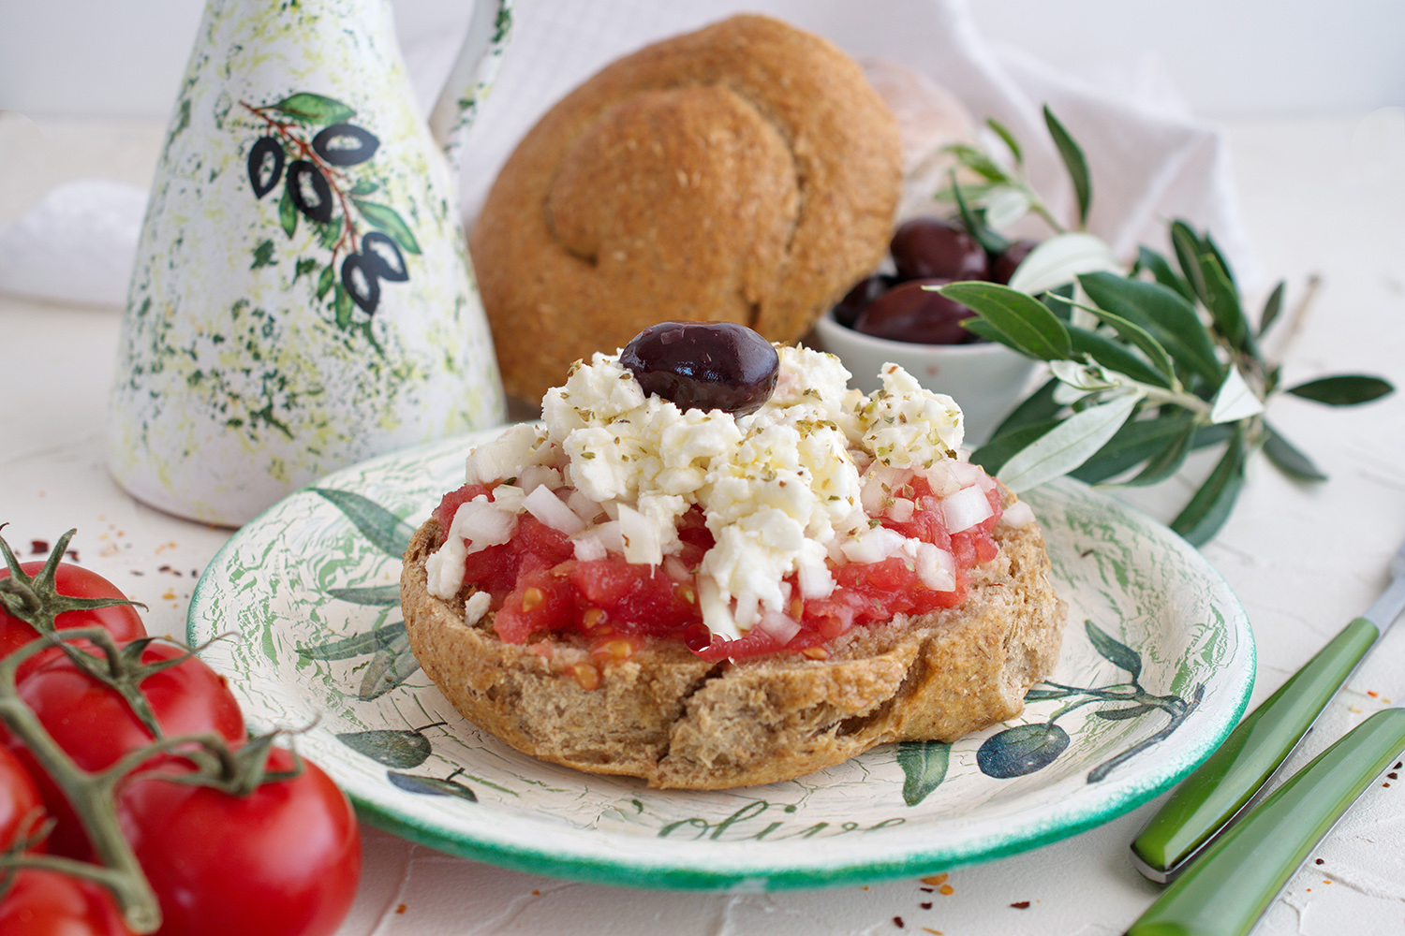
Parallelization as a kitchen
We need to make a single dish: DAKOS. This requires*:
Soaking rye bread in olive oil
Chopping tomatoes
Crumbling feta
All the preparations are passed to the Chef for the final plating
8
Notes:
We have a head chef and a group of sous chefs who are trying to make a pasta carbonara as quickly as possible to feed hungry people. Tasks are (1) inventory the vegetables, (2) was and chop vegetables and cook them in a pot to a sauce, (3) boil and strain noodles. Everything is returned to the head chef, who then plates the final dish.

Slide 9
Parallelization as a kitchen
The kitchen consists of:
Head Chef
Sous chefs
Fixed number of workstations
Dish logbook
Bread | Done
Olive oil | In progress
Toppings | In progress
9
Notes:
We have a head chef and a group of sous chefs who are trying to make a pasta carbonara as quickly as possible to feed hungry people. Tasks are (1) inventory the vegetables, (2) was and chop vegetables and cook them in a pot to a sauce, (3) boil and strain noodles. Everything is returned to the head chef, who then plates the final dish.

Slide 10
But how is a kitchen related to a computer???
Key concepts:
Process
  An instance of a program being executed, for us the Python interpreter interpreting your script. Spins up threads.
Thread
  A unit of computation sent to CPU for execution.
Number of cores
  The number of independent units in your CPU that execute threads.
Memory
  Where information/variables are kept/updated during execution.
Elements of our kitchen metaphor:
Sous chefs, each with their own dako task
Fixed number of workstations
Dish logbook
Head Chef
So which element is which?
Process: Chef
Thread: Sous chef with a task
Number of cores: Number of workstations in the kitchen
Memory: Dish logbook
10

Slide 11




Ideal situation: All 3 sous chefs are working on their tasks simultaneously
Most efficient way for a single dako
11
Notes:
(present kitchen) Based on our example here, what would be the fastest way to make me a taco?

Slide 12

But there is a problem…
…and that problem is tomatoes.
Consider a scenario:
We’re trying to make 2 Dakos at once.
We have plenty of workstations (cores) and sous chefs (threads).
The “chop tomatoes” task includes a sub-task:
    count all the tomatoes in the pantry,
    take X tomatoes for the Dako, and
    write in the logbook how many are left in the pantry (the memory)
What happens if two sous chefs making dakos execute their tasks at the same time?
  The number of tomatoes reported to Chef will be off by X!
12

Slide 13
This problem is called a race condition
Race conditions are problematic in any multithreaded code. In Python, race conditions can lead to memory corruption.
To avoid race conditions, *Python implemented something special called…
*To be specific, only CPython – Python built on the C language. Other types of Python may not have this, but you are almost certainly using CPython.
13

Slide 14

The “Global Interpreter Lock” (GIL)
A “mutex” (mutual exclusion) lock. Forces each thread in pure-Python code to acquire the lock before execution.
In other words, only one thread is allowed to run at a time!
Hypothesize with your partner:
NumPy can (and by default does) run code with multiple threads in parallel. How is this possible?
14
Notes:
Define what a lock is, keep the kitchen analogy (it’s a good one). “mutex lock” (mutual exclusion). “The lock is explicitly released and re-acquired periodically by each Python thread, specifically after approximately every 100 bytecode instructions executed within the interpreter. This allows other threads within the Python process to run, if present.
The lock is also released in some circumstances, allowing other threads to run.
An important example is when a thread performs an I/O operation, such as reading or writing from an external resource like a file, socket, or device.
The lock is also explicitly released by some third-party Python libraries when performing computationally expensive operations in C-code.”

Slide 15


NumPy interfaces with non-Python libraries that, by default, use as many threads as you have cores.
NumPy’s trick
In other words, it is many sous chefs disguised as one!
15

Slide 16
What does this all mean?
Computationally heavy, pure-Python code will generally have 0 speed-up with multiple threads.
Some specific packages (NumPy) get around this by spinning up multiple threads without the Python interpreter knowing.
Note that network- and IO-bound problems can be handled with multithreading.
So how can we get around this?
Instead of multiple threads, use multiple processes.
16

Slide 17

Instead of multiple sous chefs, multiple kitchens
Each process is an instance of the Python interpreter and therefore has its own GIL!
BUT processes have separate memory, so data must be duplicated in each process.
Multiple processes therefore have additional computational overhead and memory usage.
17

Slide 18
To wrap things up…a pop quiz!
On your pair computer, please navigate to kahoot.it and enter game pin
18

Slide 19
Next up: let’s learn how to apply it
19

