Slide 1
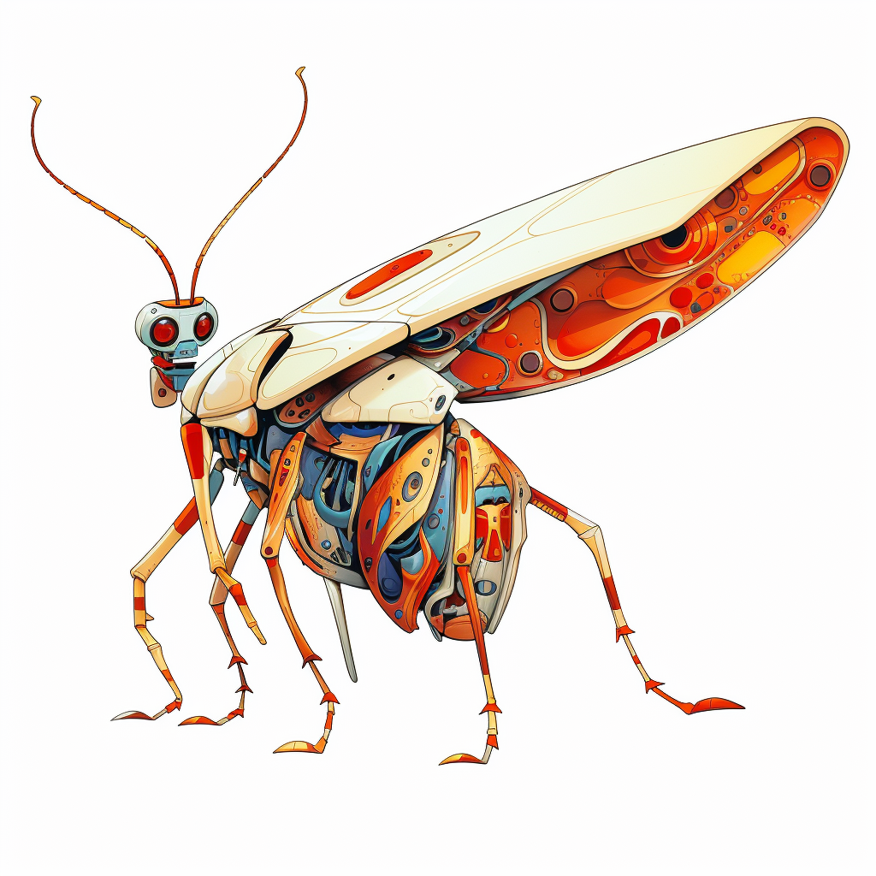
Debugging
Fix problems
Lisa Schwetlick and Pamela Hathway
Notes:
If something goes wrong in your code and you get an error or a wring result, what do you do?
Does anyone just read their code, think about it, and find the error that way?
No?
So, How do you find the error? How do you find out how to fix it?
Probable answers
Debugger
Print statements
Jupyter: copy value into a new cell and execute cell
Who uses those strategies regularly?
The goal of this section is to motivate you to give debugging a try if you think you could improve the way to fix the problems in your code.

Slide 2

The agile development cycle
Pick your next feature
Write tests
to check that feature works
pytest
Write simplest code
that makes tests pass
Run tests and debug
until all tests pass
pdb
timeit
cProfile
line_profiler
Refactor and optimize
only if necessary
August 2023, CC BY-SA 4.0
Testing scientific code, v16.0

Slide 3

What is Debugging?
The best way to debug is to avoid bugs
  By writing tests, you anticipate the bugs
Your test cases should already exclude a big portion of the possible causes
Core idea in debugging: you can stop the execution of your application at any point, look at the state of the variables, and execute the code step by step
August 2023, CC BY-SA 4.0
Debugging, v2.0
Notes:
First two points
BUT Bugs are inevitable.
And finding them after you have written them is something that we spend a lot of time on,
so we want to have a good way of finding and eliminating them.
This is why we want to show you how to debug,
Debugging is <<<third point>>>
This is helpful because you obviously wrote some code that you think does one thing, but actually is doing something else.
And you want to be able to find out at what point exactly it is going wrong, why it is going wrong and how to fix it
WITHOUT littering your code with commented out code, print statement, creating new cells in jupyter, …

Slide 4

pdb, the Python debugger
Command-line based debugger
pdb opens an interactive shell, in which one can interact with the code
  examine and change value of variables
  execute code line by line
  set up breakpoints
  examine calls stack
August 2023, CC BY-SA 4.0
Debugging, v2.0
Notes:
We will work with pdb in this session, which is the Python-default debugger.
Raise hands (also faculty), who uses a debugger?
Of those, how many use pdb?
Not that many.
Pdb is very basic and very command line-y, so if you like working on the command line, then you will probably like it.
If you like to work in jupyter or in an IDE, you might find it a bit weird.
Because in this course we don‘t want to push an IDE, we are going to work with pdb first.
All other debuggers in IDEs work exactly the same, so you will find the concepts translate 1:1.
This is just to tell you that if you find it strange to work with pdb, I want to you know there are other options I will show later, so have some patience.
Debugging is not set up in VSCodium by default, but anyone who wants to use debugging later during the project, let me know, I can set it up for you.
So let‘s get into pdb!!

Slide 5
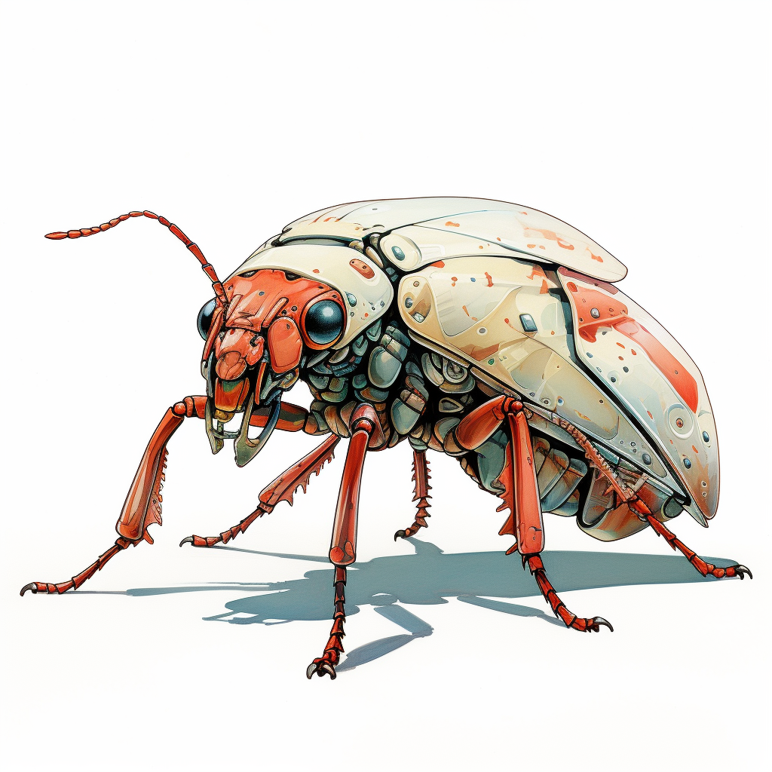
Entering the debugger
Enter debugger at the start of a file:
python –m pdb myscript.py
Enter at a specific point in the code (easy alternative to print):
# some code here
# the debugger starts here
breakpoint()
# rest of the code
August 2023, CC BY-SA 4.0
Debugging, v2.0

Slide 6

Demonstration!
Debugging with pdb
August 2023, CC BY-SA 4.0
Debugging, v2.0
Notes:
DEBUGGING EXERCISE LIVE CODING PDB
The idea is that I wrote a version of a find_maxima solution.
I also worte a few more tests for it
And I want you to use debugging to figure out what is going wrong in the cases where the tests fail, fix the find_maxima function and create a pull request.
Introduce find maxima function that I wrote
First and last elements are checked
Then it checks for the plateau in the middle
Let's run it first and then go through it in detail
Run with default happy path values
Change to plateau
Run with plateau
So it works, but I am not sure why. Let's step through the code line by line and see what happens
Put breakpoint at start (line 17)
Use only c
Add breakpoint before return of large function
Use c
Use c and n
Start again to Step through one by one
Step into - s + run until end of function - r + Next - n to step out
Remove breakpoints
I could now manually check different values, e.g. [0], and see what happens
But we have learned about tests, so what we should be doing is write a test and if it fails, fix it.
Run all tests with pytest
5 pass, the others fail
We can see that the first pass, the others fail
Can we debug tests as well?
Yes of course, it workes the same way
Let's take one test: first below comment and run it without breakpoint
Assert in the order is wrong
Where does this order come from
Let's step through the code line by line and find out
See that the final maxima is added at the start, should be at end
Move to end
Run specific test again without breakpoint
Run all tests again to check if I broke anything else with this change

Slide 7
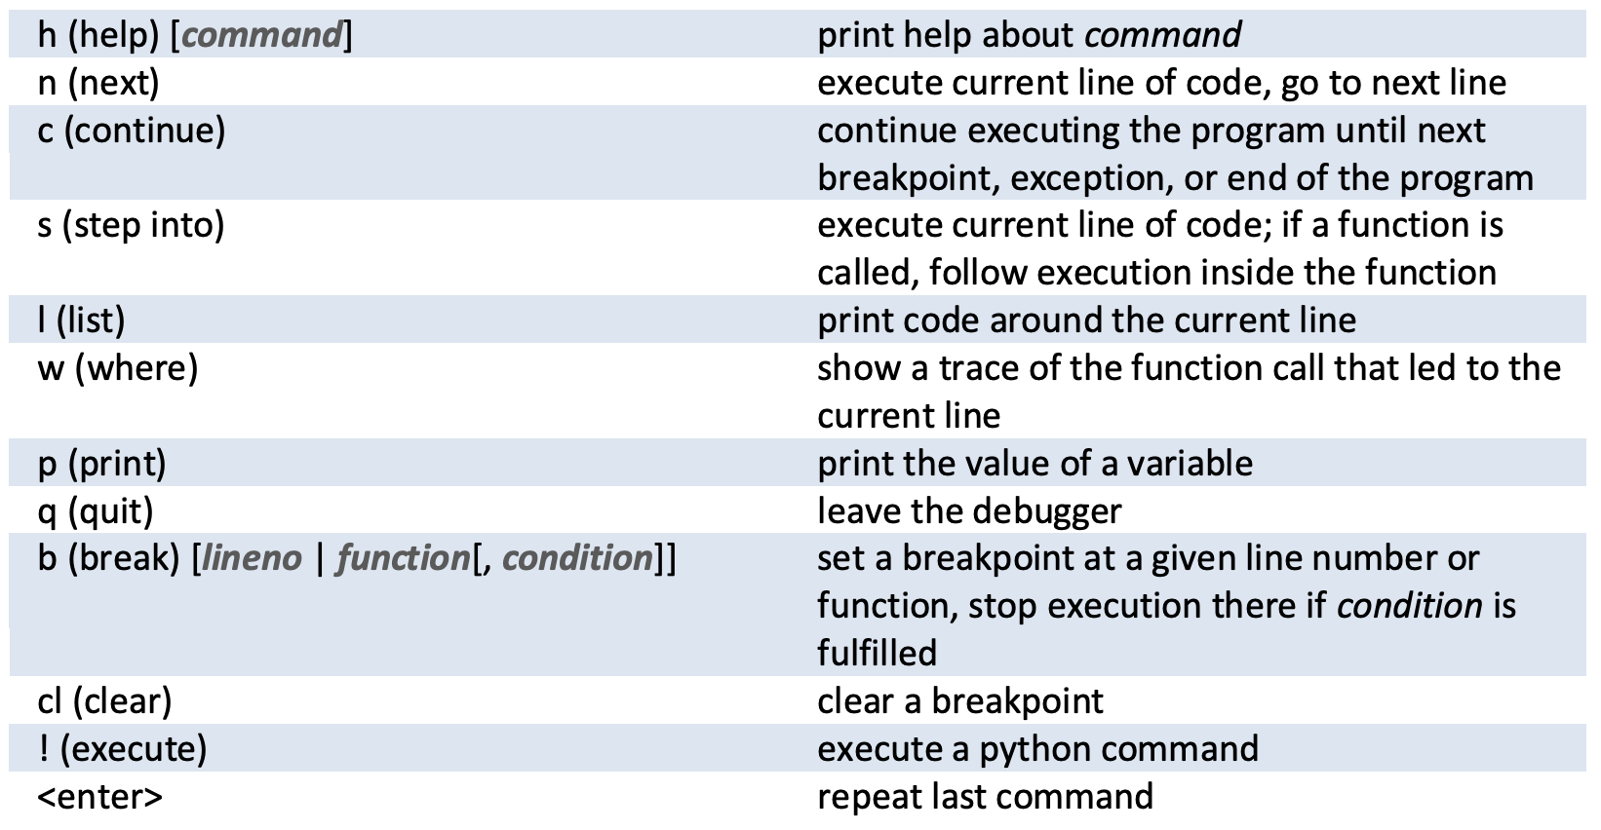

Hands-on! – Issue #2
1) Go to local_maxima_part3_debug/local_maxima.py and execute it
2) Go to local_maxima_part3_debug/test_local_maxima.py and execute all the tests there using pytest
3) Fix the tests one by one and create a PR for each one you fix
pdb cheatsheet:
August 2023, CC BY-SA 4.0
Debugging, v2.0

Slide 8
Demonstration!
Debugging with pdb
Debugging from an IDE
August 2023, CC BY-SA 4.0
Debugging, v2.0

Slide 9
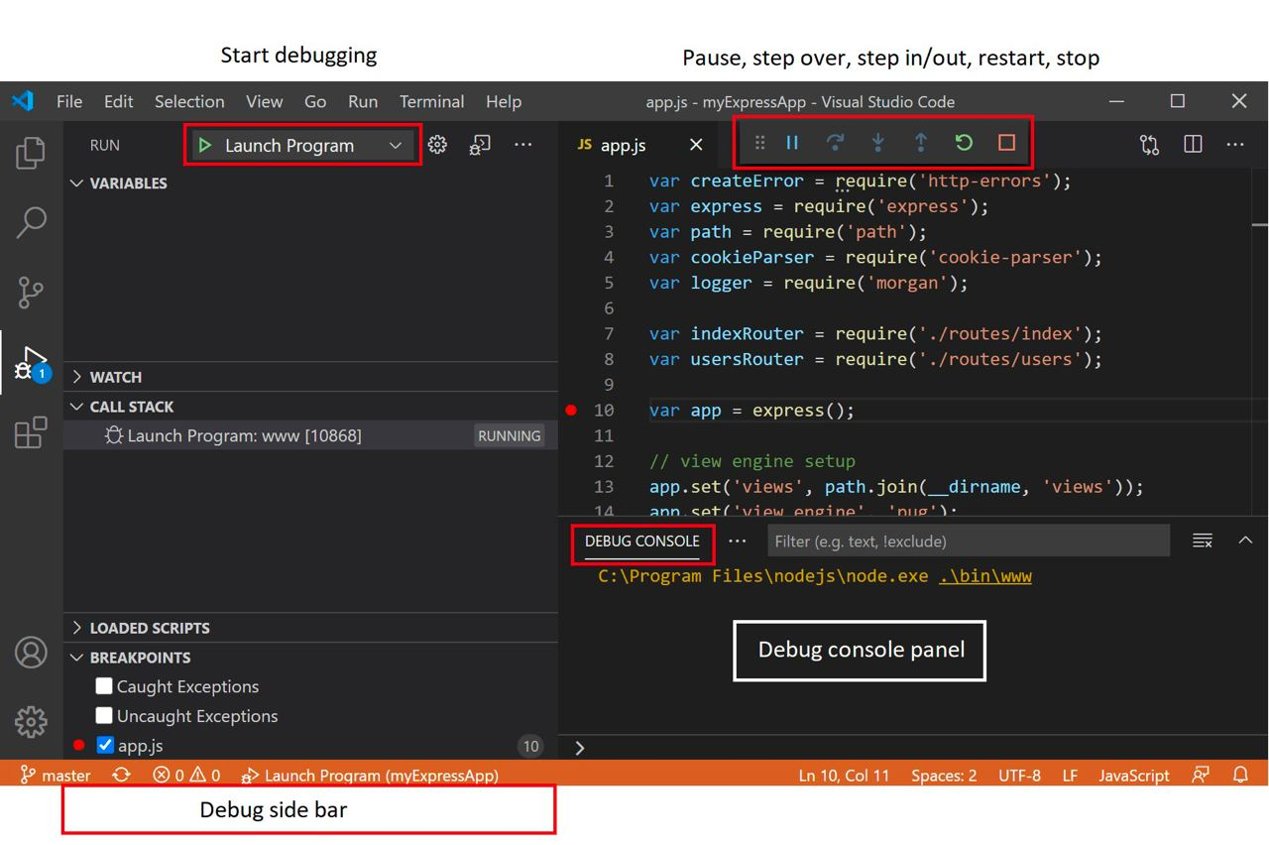

Entering the debugger from VSCode
August 2023, CC BY-SA 4.0
Debugging, v2.0

Slide 10

How to react to a bug
Add a test that matches the behavior you expect. It will fail and reproduce the bug
Debug and fix the the bug
Run the tests until they all pass (go back to 2 if necessary)
Now your bug is fixed *and* it will never occur again!
August 2023, CC BY-SA 4.0
Debugging, v2.0

Slide 11

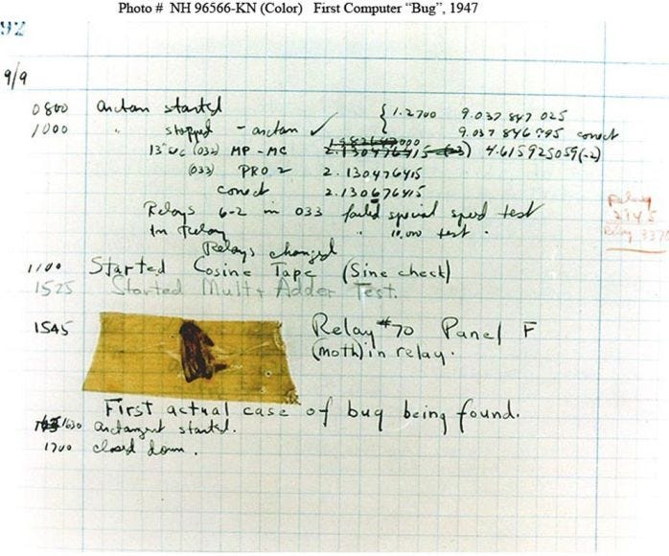
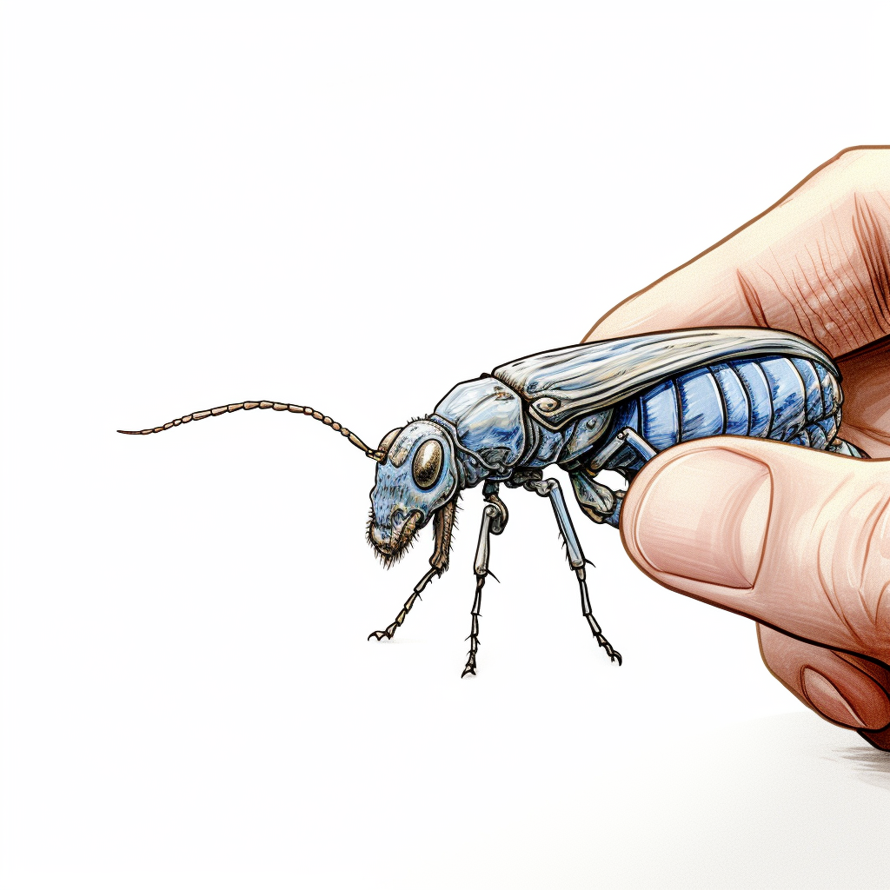
Where does ”debug” come from
Team around Grace Hopper at Harvard found a moth in their computer in 1947 in maybe the first description of a computer bug.
August 2023, CC BY-SA 4.0
Debugging, v2.0

Slide 12
August 2023, CC BY-SA 4.0
Debugging, v2.0

Slide 13
Set up debugging in IDEs
Generally IDEs can do very similar things.
But…
VSCode/VSCodium is really cumbersome to set up (my opinion).
Pycharm is a lot less hassle to set up (no setup needed) and better to use and with better functionality (my opinion). caveat: I use the paid version, so I am only 95% confident all features are available in free version
… However at this school we only have access to VSCodium -.-
August 2023, CC BY-SA 4.0
Testing scientific code, v16.0

Slide 14
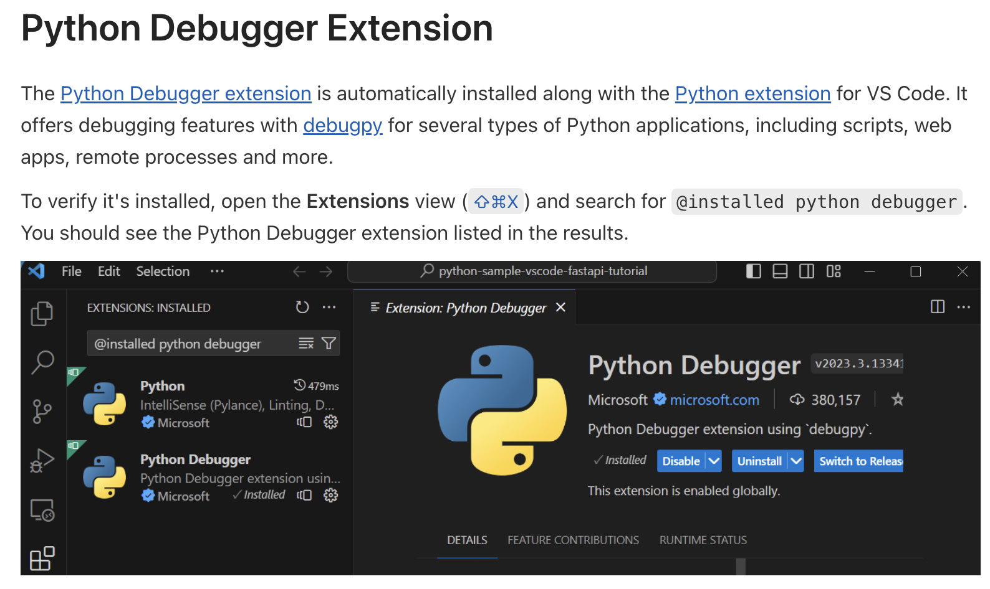
Set up debugging in VSCode
Debugging configurations for Python apps in Visual Studio Code
(links to code.visualstudio.com/docs/python/debugging)
You need to do these steps
install Python Extension (automatically installs Python Debugging extension
August 2023, CC BY-SA 4.0
Testing scientific code, v16.0

Slide 15
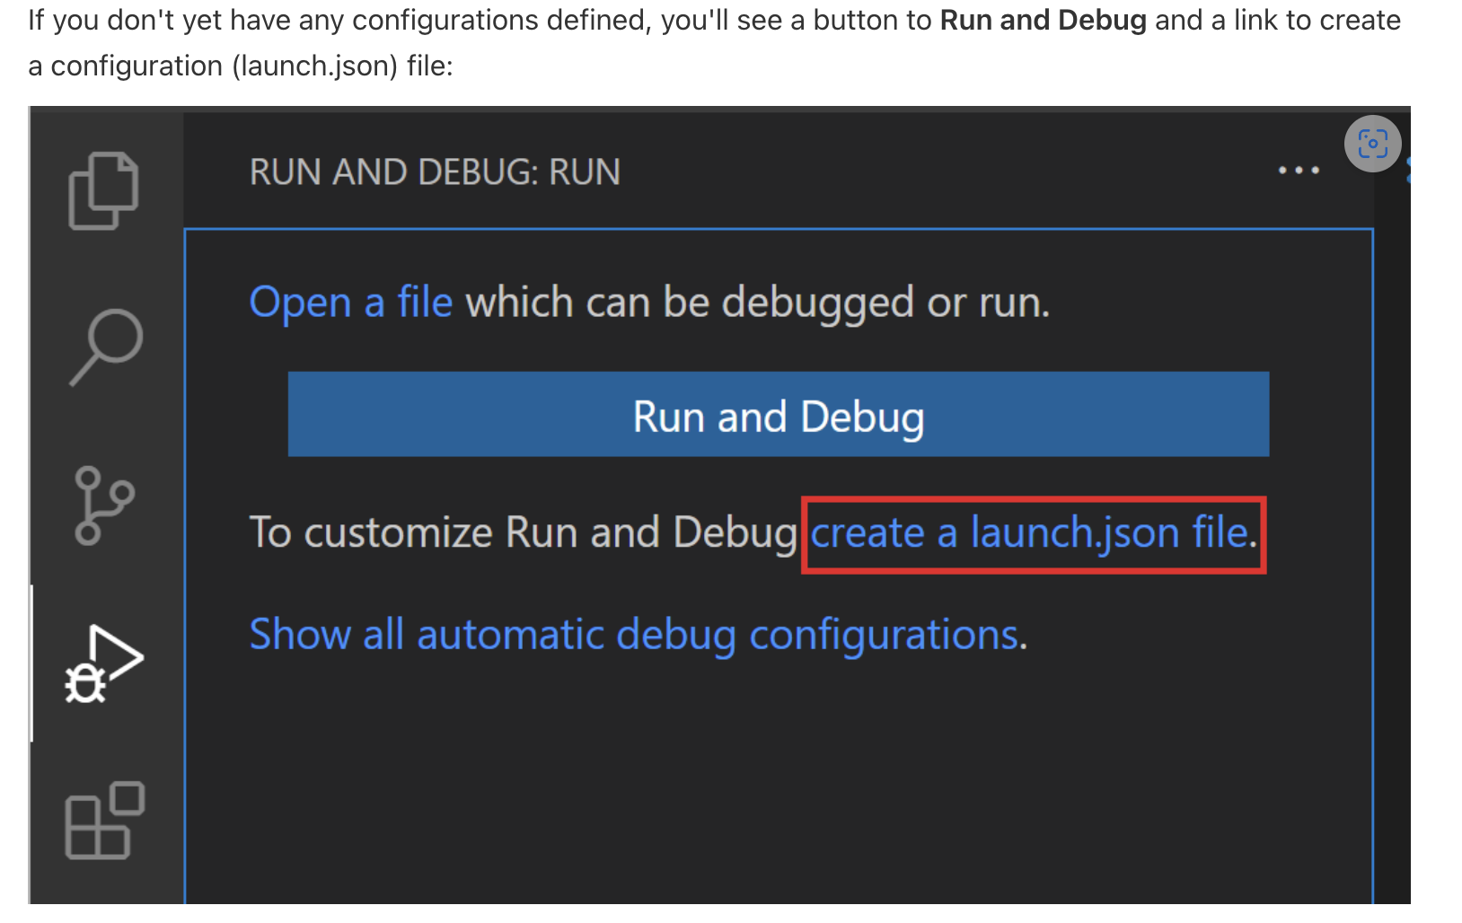

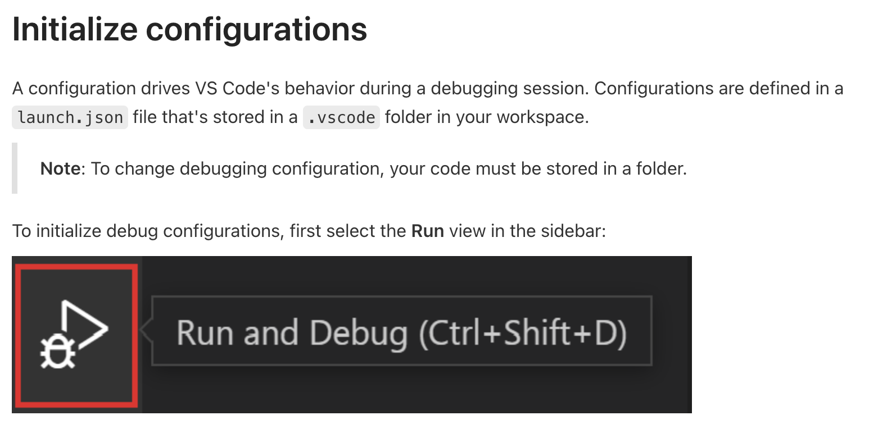
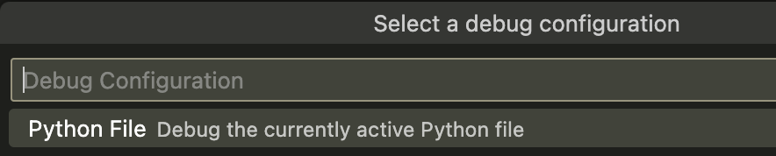
Set up debugging in VSCode
Debugging configurations for Python apps in Visual Studio Code
(links to code.visualstudio.com/docs/python/debugging)
You need to do these steps
install Python Extension (automatically installs Python Debugging extension
In order to call the debugger on the current file, you need to create a launch.json file
1
2
4
3
August 2023, CC BY-SA 4.0

Slide 16
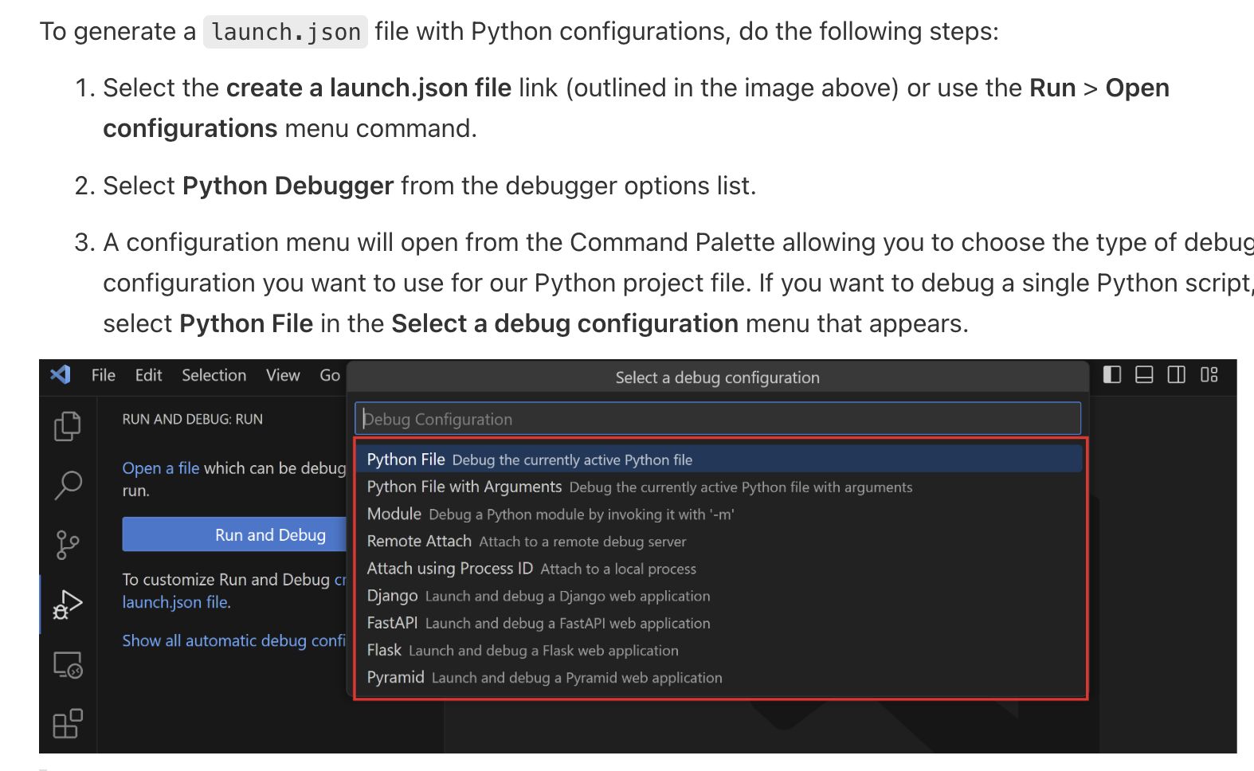
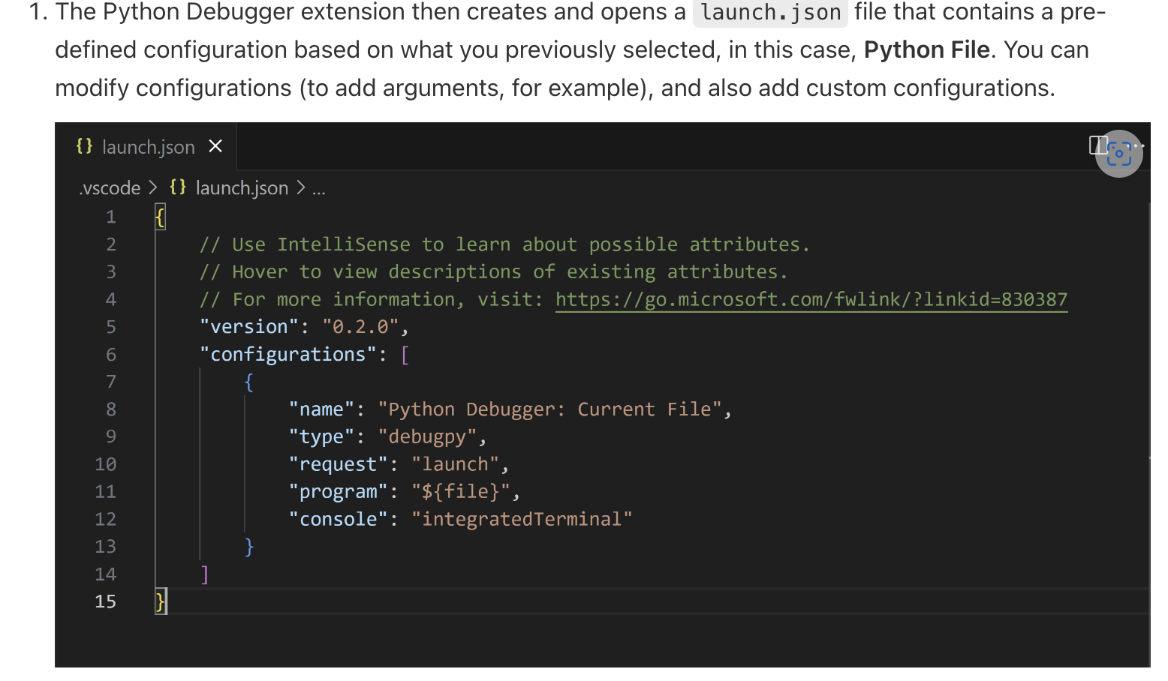
Set up debugging in VSCode
Debugging configurations for Python apps in Visual Studio Code
(links to code.visualstudio.com/docs/python/debugging)
You need to do these steps
install Python Extension (automatically installs Python Debugging extension
In order to call the debugger on the current file, you need to create a launch.json file
this file with this content should be created automatically!!
August 2023, CC BY-SA 4.0

Slide 17
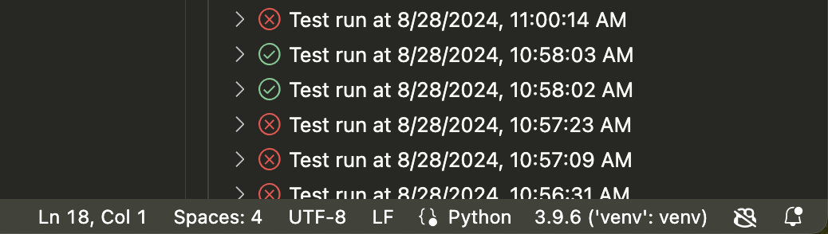
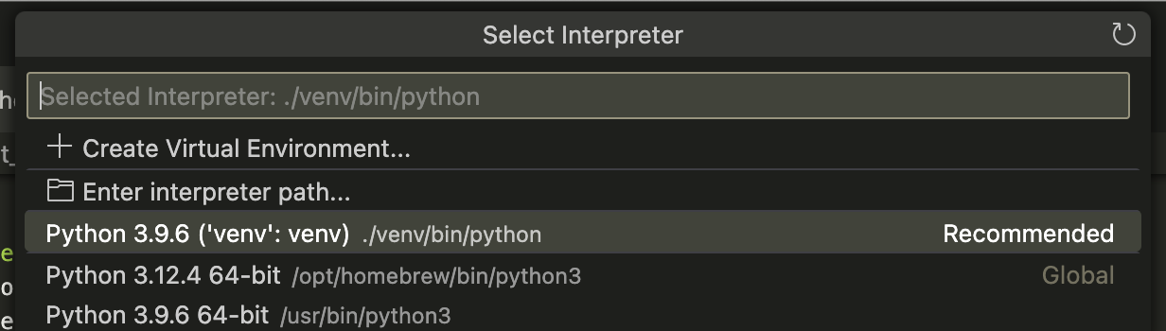
Set up debugging in VSCode
Debugging configurations for Python apps in Visual Studio Code
(links to code.visualstudio.com/docs/python/debugging)
You need to do these steps
install Python Extension (automatically installs Python Debugging extension
In order to call the debugger on the current file, you need to create a launch.json file
Make sure that the main system Python is selected as the Python Interpreter
Click on displayed Python version in bottom right corner, which will bring up the menu seen here on the right. The paths will be different, make sure you select the Python in usr/bin/python3
→ generally, you can specify / create virtual environments here
August 2023, CC BY-SA 4.0

Slide 18
Set up debugging in VSCode
accessing EVERYTHING in VSCode
  Mac: Command + Shift + p
  Linux: Control + Shift + p (?)
  then type what you want to do / access e.g.
    open preferences (type “preferences“)
    setting interpreter (type „Interpreter“)
    open Keyboard shortcuts settings (type „Keyboard“)
August 2023, CC BY-SA 4.0
Testing scientific code, v16.0

Slide 19
Set up debugging in VSCode
you are done with setting up!
next are optional keyboard shortcuts
August 2023, CC BY-SA 4.0
Testing scientific code, v16.0

Slide 20
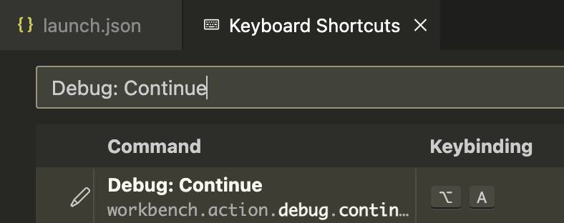
Set up debugging in VSCode III
other settings – controlling debugger with keyboard shortcuts
you can bind debugging actions to the keyboard shortcuts you want (continue, step/next, step into, restart …)
August 2023, CC BY-SA 4.0
Testing scientific code, v16.0

Slide 21
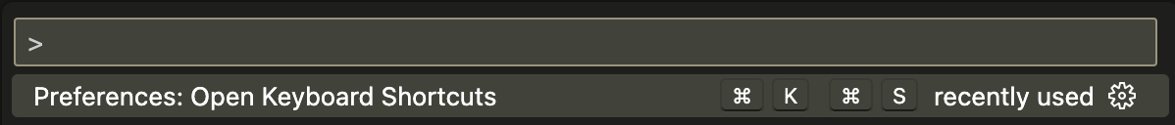
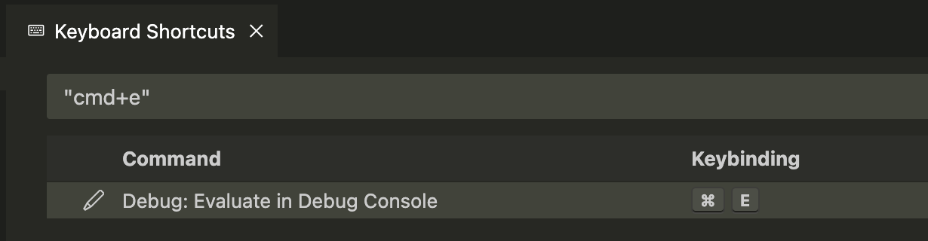
Set up debugging in VSCode IV
other settings – executing highlighted code in debug console
August 2023, CC BY-SA 4.0
Testing scientific code, v16.0

Slide 22
Debugging example
inspecting state of code
  variables
  call stack incl. variables
August 2023, CC BY-SA 4.0
Testing scientific code, v16.0

Slide 23
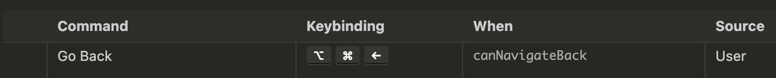
Other useful IDE things
go to function definitions / usages by clicking
hover over functions to see docstrings
go to last place you were before
Run all tests, debug tests
Search across all code
adding import statements support
August 2023, CC BY-SA 4.0
Testing scientific code, v16.0

Slide 24
Set up debugging in VSCode +
another example launch configuration – with command line arguments (not needed in this school I think)
add this into configurations list in launch.json
{
"name": “<file_name> with data",
"type": "debugpy",
"request": "launch",
"program": "${workspaceFolder}/src/pkg_name/main.py", // replace with the path to main.py
"console": "integratedTerminal",
"args": ["--input_dir", "data", "--output_file", "output_dir/file.csv"],
},
August 2023, CC BY-SA 4.0
Testing scientific code, v16.0

Slide 25
Set up debugging in VSCode +
another example launch configuration – you can also debug streamlit applications
add this into configurations list in launch.json
{
"name": "main Streamlit",
"type": "debugpy",
"request": "launch",
"program": "/Users/pamelahathway/Library/Caches/pypoetry/virtualenvs/pkg_name-E5WlELVw-py3.12/bin/streamlit",
"args": ["run", "${workspaceFolder}/src/pkg_name/main.py"],
"env": {"PYTHONPATH": "${workspaceFolder}"},
"console": "integratedTerminal"
}
August 2023, CC BY-SA 4.0
Testing scientific code, v16.0

Slide 26
Debug Pelita in VSCode
set up VSCode as described in slides 14 – 19, especially launch configuration
add this into configurations list into .vscode/launch.json (which was created during setup)
change the „name“ and the paths / seed in the “args“ part accordingly
{
  "name": “Debug GroupX vs BasicDef",
  "type": "debugpy",
  "request": "launch",
  "program": "~/.local/bin/pelita",
  "args": [
  "--seed", "4563463", "--no-timeout", "/home/student/groupX/bot.py", "/home/student/groupX/demo3_basic_defender.py"
  ],
}
August 2023, CC BY-SA 4.0
Testing scientific code, v16.0

Slide 27
talk about testing directory and that it only works to have tests in a different folder
if you have installed your code as a package
August 2023, CC BY-SA 4.0
Debugging, v2.0

Slide 28
The agile development cycle
Pick your next feature
Write tests
to check that feature works
pytest
Write simplest code
that makes tests pass
Run tests and debug
until all tests pass
pdb
timeit
cProfile
line_profiler
Refactor and optimize
only if necessary
August 2023, CC BY-SA 4.0
Debugging, v2.0

Slide 29

Entering the debugger from Jupyter
%pdb – preventive
%debug – post-mortem
August 2023, CC BY-SA 4.0
Debugging, v2.0

Slide 30
Hands-on!
Change this exercise!!!!
Maybe debug a script or maybe even better - a test?
Go to bug_hunt/file_datastore.py and execute it
It fails! But… it works when the base_path is an absolute path :-(
data = b'A test! 012'
datastore = FileDatastore(base_path='./datastore')
datastore.write('a/mydata.bin', data)
# This should pass!
assert os.path.exists('./datastore/a/mydata.bin’)
August 2023, CC BY-SA 4.0
Debugging, v2.0
Notes:
Live coding, right?
Exercise/example:
multiple function calls within each other to see stack calls
Multiple variables where values are unclear / can be None
Unexpected behaviour of a function (maybe an if not that then returns None, …)
Multiple bugs that grow in severity with one test each and if they fixed one, they go on to fix the next
Maybe my own find_maxima function with some more complicated stuff in there?
main function with function calls to finding maxima (option to choose what to do with saddle points, and then not having defined that properly or given this variable to the lower function), plotting maxima
Level 1: Easy fix to add an if [] return []
Level 2:
Level 3: something about saving the figure in an absolute path or not?
Remember that they are using the pdf debugger for this. Show running of pytest, then finding the line that errors out, adding a breakpoint to there and then running pytest again.
Suggest to have the terminal and the module side by side!
Show
evaluation of variables
Plotting options

Slide 31
Static checking and linting
Modify this and adapt to not have overlap with organising lecture
One of the problems with debugging in Python is that most bugs only appear when the code executes.
“Static checking” tools analyze the code without executing it.
pep8: check that the style of the files is compatible with PEP8
pyflakes: look for errors like defined but unused variables, undefined names, etc.
flake8: pep8 and pyflakes in a single, handy command
and also: yapf, black, …
August 2023, CC BY-SA 4.0
Debugging, v2.0
Notes:
Run flake8 on the *initial* pyanno code.

Slide 32
Hands-on!
Fix the bug in file_datastore.py, using the debugger
Submit a PR for issue #1 in the repository
pdb cheatsheet
August 2023, CC BY-SA 4.0
Debugging, v2.0

Slide 33
Tools for Debugging
Text editor + terminal → pdb (Python’s built-in debugger)
VSCode (IDE) → VSCode built-in debugger
PyCharm (IDE) → PyCharm built-in debugger
Jupyter → (?) built-in debugger
August 2023, CC BY-SA 4.0
Debugging, v2.0
Notes:
Did not cover jupyter debugging, because if you are doing such complicated things in jupyter that require debugging, you would probably be better off using an IDE ☺.
Also, the concept is the same, you will figure it out if you need to
Did not cover jupyter in general, because pytest does not cover tests in jupyter notebooks, it is designed to work with .py files.
Notes from previous slides:
Note that the agile development cycle works best when you are using modules, so .py files and pytest and not Jupyter notebooks.
Notebooks cannot run tests properly.
There maybe is a way to run pytest within one Jupyter notebook, but you lose the possibility of running all of your tests automatically across all files, which really is what you want.
I will not cover debugging in jupyter because it is defeating the point. Jupyter imo is a replacement for debugging, but is not necessary.

Slide 34

Hands-on!
Run flake8 on one the files you edited today
August 2023, CC BY-SA 4.0
Debugging, v2.0

