Slide 1
Outline
Local importing
  → review and best practices
Packages and editable installations
  → avoid importing errors
Repo structure
  → organize folders and files in a standardized way
Accessibility
  → make code more readable, understandable and usable
Environments
  avoid and alleviate package installation problems

Slide 2
repo structure

Slide 3
Motivation
We now know what a package is and how to install it.
But often there are additional files you want in a repo.
  .gitignore, LICENSE, tests, examples, data, …
Where should the package code and everything else go?

Slide 4


Where things go
There are no “rules”…
…but there are guidelines.

Slide 5


Why you should care
—> know where to find items in someone else’s code
e.g. kitchen
where would you look for
  cutlery
  pots
  cleaning products
—> science/engineering is
collaborative problem
solving. Facilitate
collaboration.

Slide 6
Organizing files
Separate folders:
  src - package
  scripts and notebooks – for demonstrations, teaching, examples, accompanying papers
Jupyter Notebooks do not belong in the source code
Note that tests can be in package OR outside [3].
my_project/
├── .gitignore
├── LICENSE
├── notebooks_scripts
│ ├── demo.ipynb
│ ├── recreate_paper_figures.py
├── pyproject.toml
├── README.md
├── requirements.txt
├── src/
│ ├── package_name/
│ │ ├── __init__.py
│ │ ├── analysis.py
│ │ ├── constants.py
│ │ ├── data_preprocessing.py
│ │ ├── data_visualization.py
│ │ ├── file_io.py
│ │ ├── models.py
├── tests/
│ ├── test_analysis.py
│ ├── test_data_processing.py
│ ├── test_models.py
6

Slide 7
Organising file contents
Like in many other areas in life,
code is often organized by purpose or thematically
Separate code into files/folders by
  purpose / theme – data handling,
  preprocessing, plotting, …
  type – i/o config, parameters,
  functions
my_project/
├── pyproject.toml
├── src/
│ ├── package_name/
│ │ ├── __init__.py
│ │ ├── analysis.py
│ │ ├── constants.py
│ │ ├── data_preprocessing.py
│ │ ├── data_visualization.py
│ │ ├── file_io.py
│ │ ├── models.py

Slide 8
Retrieval practice
my_project/
├── .gitignore
├── LICENSE
├── notebooks_scripts
│ ├── demo.ipynb
│ ├── recreate_paper_figures.py
├── pyproject.toml
├── README.md
├── requirements.txt
├── src/
│ ├── package_name/
│ │ ├── __init__.py
│ │ ├── analysis.py
│ │ ├── constants.py
│ │ ├── data_preprocessing.py
│ │ ├── data_visualization.py
│ │ ├── file_io.py
│ │ ├── models.py
├── tests/
│ ├── test_analysis.py
│ ├── test_data_processing.py
│ ├── test_models.py
Discuss briefly with your partner.
  How do you structure your repos/code now?
  What, if anything, would you change about your current structure?
  What concerns/questions do you have about these guidelines for repo structure?
(5 min)
8

Slide 9
Discussion

Slide 10
defend your code

Slide 11
References
src layout vs flat layout - Python Packaging User Guide
Package Discovery and Namespace Packages
Good Integration Practices - pytest documentation

Slide 12
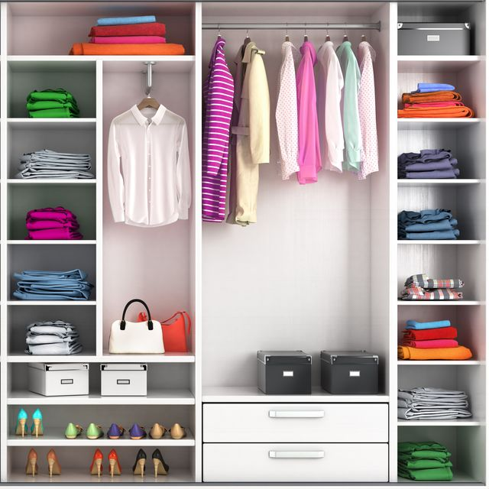
Why you should care
—> know where to find items in someone else’s code
e.g. wardrobe
  suit, shirts
  towels
  socks
—> science/engineering is
collaborative problem
solving. Facilitate
collaboration.

Slide 13
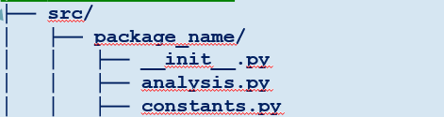
Guidelines
Nest package in src/ folder.
  Recommended by Python Packaging Authority
  [1]. Reduces accidental imports + other benefits.
  No need to modify pyproject.toml to include src/, package will be auto-discovered [2].
Only ship reusable code in your package.
  User-specific settings, examples, data, etc., should go elsewhere.
  Tests may or may not be shipped with your package. Depends on what you want. [3]
Everything else should be…elsewhere.

