Slide 1
Outline
Local importing
  → review and best practices
Packages and editable installations
  → avoid importing errors
Repo structure
  → organize folders and files in a standardized way
Accessibility
  → make code more readable, understandable and usable
Environments
  avoid and alleviate package installation problems

Slide 2
defend your code
Notes:
So we heard about how to make our code installable.
We now have a package.
So now we want to talk about how to handle packages in general.
Specifically we want to talk about virtual environments.

Slide 3
Virtual Environments
What is a virtual environment?
A semi-isolated python environment -> you cannot access packages (libraries and their dependencies) installed in other environments.
packages are installed inside a project-specific virtual environment folder (not added to general python path)
If something goes wrong with one environment, it does not affect the others.

Slide 4
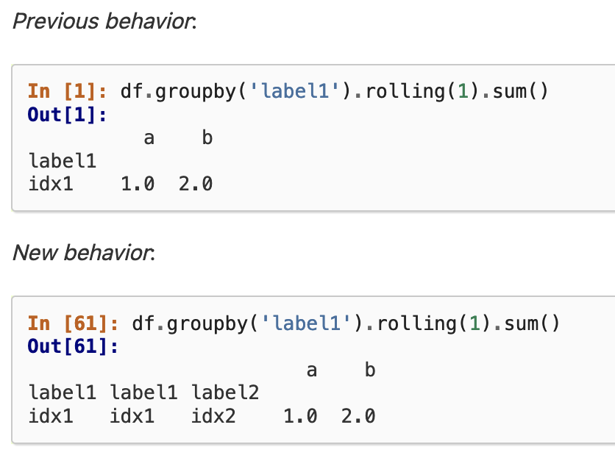
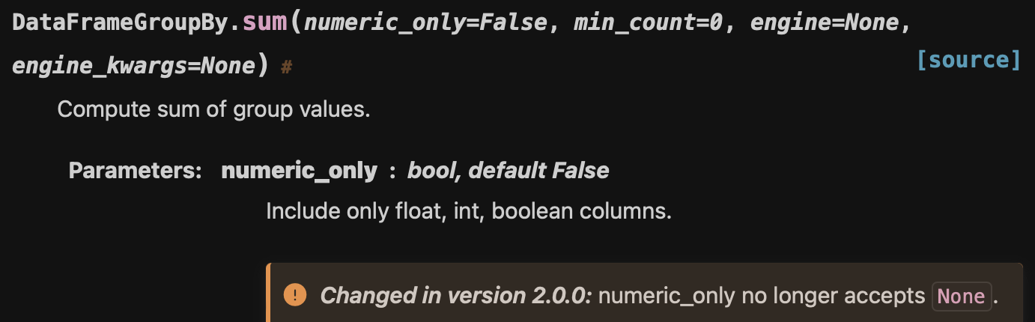
Why environments?
  Avoid errors when working on multiple projects / updating your Python packages
—> if you keep updating your python
packages, you will run into issues
  code errors
  unexpected results

Slide 5
Why environments?
  Avoid importing errors when working on multiple projects / updating your Python packages
scipy=1.3
pandas=1.5.3
scipy=1.3
pandas=1.5.3
numpy=1.20.0
numpy=1.23.0

Slide 6
Virtual Environments
Create and activate a virtual environment following
the directions in Exercise 5 Virtual Environments.md
Notes:
Where does it make sense to put the venv folder?

Slide 7
Notes

Slide 8
Environment Managers
venv - current standard recommended by Python
uv - super fast and super useful
...
a description of the chaos:
https://chriswarrick.com/blog/2023/01/15/how-to-improve-python-packaging/
https://alpopkes.com/posts/python/packaging_tools/

Slide 9
Why environments?
  Avoid errors when working on multiple projects / updating your Python packages
  Increased reproducibility: give yourself / other people the exact instructions and tools to run your code (cluster, collaboration)

Slide 10

Additional advantages
The main advantage is that you can start over if something goes wrong and you have broken nothing!

Slide 11

Our goal
Local importing
  → review and best practices
Packages and editable installations
  → avoid importing errors
Repo structure
  → organize folders and files in a standardized way
Accessibility
  → make code more readable, understandable and usable
Environments
  avoid and alleviate package installation problems

Slide 12
Why environments?
Project 1
= 1st year
PhD project
tensorflow
numpy
Project 2
= collaboration
with another lab
word2vec
seaborn
stats
pandas
pytorch
dependencies
Notes:
This is the part where we solve installation errors

Slide 13
Why environments?
pandas = 2.0.3
x
Project 1
= 1st year
PhD project
Project 2
= 2nd year
PhD project
pandas = 1.2.4
pandas = 1.2.4
dependencies

