Slide 1

Outline
Local importing
  → review and best practices
Packages and editable installations
  → avoid importing errors
Repo structure
  → organize folders and files in a standardized way
Accessibility
  → make code more readable, understandable and usable
Environments
  avoid and alleviate package installation problems

Slide 2
make your code self-explanatory*
*content liberally inspired by Pietro Berkes and Lisa Schwetlick’s lecture at ASPP ”Scientific coding patterns”

Slide 3
Motivation
You want to make your code as predictable as possible
to reduce cognitive effort needed to understand it
if you follow certain rules for writing code, it will become
  easier to read and understand
  easier to modify
  easier to reuse and share

Slide 4

Code smell #1
class Pizza:
name: str
def __init__(self):
self.name = name
    def add_toppings(self, toppings):
  self.toppings = toppings
import numpy as np
def check_toppings(pizza):
  if FORBIDDEN_TOPIC in pizza.toppings:
raise ValueError(“Pineapple cannot be on a pizza
in this restaurant!“)
if __name__ == ”__main__”:
import time
hawaii = Pizza(“Hawaii”)
hawaii.add_toppings([”tomato+mozz”, “pineapple”])
check_toppings(hawaii)
import local_module
FORBIDDEN_TOPPING = “pineapple”
imports
standard Python library
installed packages
local modules
2. constants
3. classes, then functions
4. main execution block
if __name__ == "__main__":

Slide 5
Within-module order
import numpy as np
import local_module
FORBIDDEN_TOPPING = “pineapple”
class Pizza:
name: str
def __init__(self):
self.name = name
    def add_toppings(self, toppings):
  self.toppings = toppings
def check_toppings(pizza):
  if FORBIDDEN_TOPIC in pizza.toppings:
raise ValueError(“Pineapple cannot be on a pizza
in this restaurant!“)
if __name__ == ”__main__”:
import time
hawaii = Pizza(“Hawaii”)
hawaii.add_toppings([”tomato+mozz”, “pineapple”])
check_toppings(hawaii)
imports
standard Python library
installed packages
local modules
2. constants
3. classes, then functions
4. main execution block
if __name__ == "__main__":

Slide 6
Code smell #2
import time
import numpy as np
import local_module
forbiddentopping = “pineapple”
class pizza:
name: str
def __init__(self):
self.name = name
    def addtoppings(self, toppings):
  self.toppings = toppings
def checktoppings(pizza):
  if forbiddentopping in pizza.toppings:
raise ValueError(“Pineapple cannot be
on a pizza in this restaurant!“)
from module import forbiddentopping, checktoppings, pizza

Slide 7
Variable format
import time
import numpy as np
import local_module
FORBIDDEN_TOPIC = “pineapple”
class Pizza:
name: str
def __init__(self):
self.name = name
    def addtoppings(self, toppings):
  self.toppings = toppings
def checktoppings(pizza):
  if forbiddentopping in pizza.toppings:
raise ValueError(“Pineapple cannot be
on a pizza in this restaurant!“)
from module import FORBIDDEN_TOPIC, check_toppings, Pizza
2. constants
SCREAMING SNAKE_CASE
3. classes, then functions
ClassName: CamelCase
func_name(): snake_case
variables in functions: snake_case
private variables start with “_“
(cafeful with code completion!)

Slide 8
Code smell #3
name your variables so that you can later go back and read what the code does
(same principle as with module names)
x=10
😭 terrible
p=10
😪 just as terrible
poi=10
😞 still pretty terrible
points=10
🥲 better- potentially a bit unspecific
points_add = 10
😄 possibly better yet
points_to_be_added = 10
🤓 clear – but maybe a bit long

Slide 9
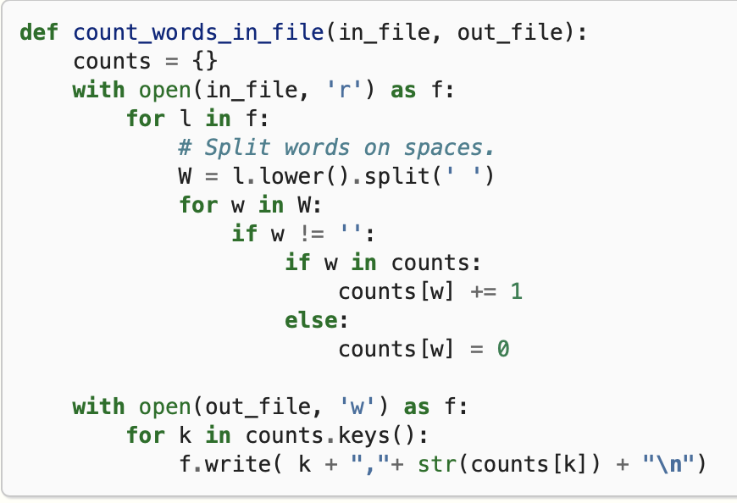
Variable names
name your variables so that you can later go back and read what the code does
(same principle as with module names)
Notes:
Ask them: what do you think of variable names in this function, what does it do?

Slide 10
Variable names
name your variables so that you can later go back and *read* what the code does
(same principle as with module names)
x = 10
p = 10
poi = 10
points = 10
points_add = 10
points_to_be_added = 10
x = 10 —> terrible
p = 10 —> just as terrible
poi = 10 —> still terrible
points = 10 —> better, but potentially unspecific
points_add = 10 —> possibly better, possible worse that the one before
points_to_be_added = 10 # clear, but maybe a bit long
def add(p, e):
x = p + e
return x

Slide 11

Notes

Slide 12

Single responsibility principle
Avoid writing spaghetti code
get rid of code repetitions
make things modular
how do you get there?
break up long functions
e.g.: loading, saving and plotting
in dedicated functions

Slide 13
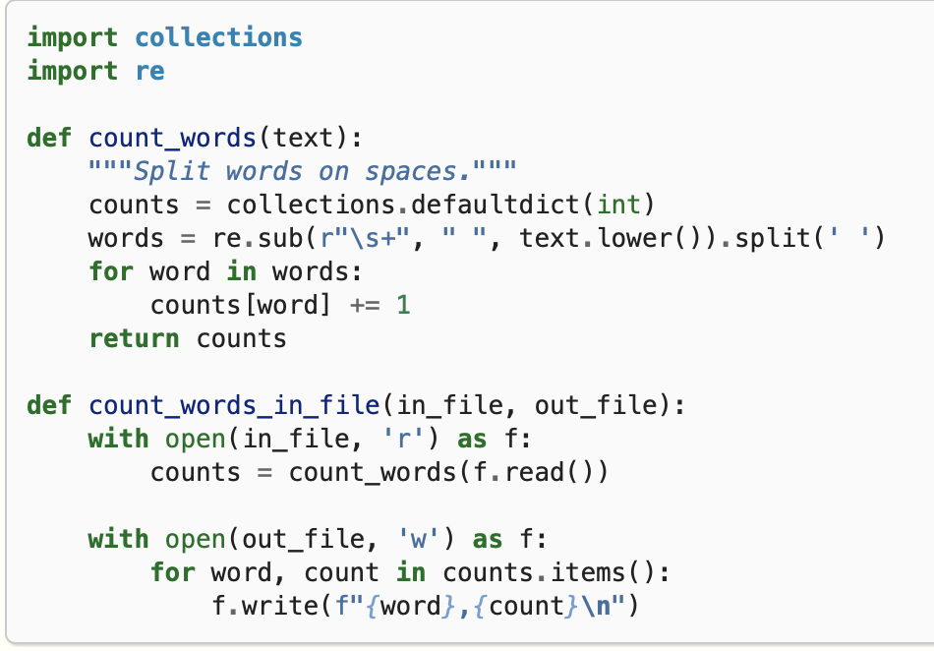
Reduce code complexity
a function should do one thing 🤝
Together with descriptive variable names you can later go back and *read* what the code does.
This reduces code complexity.
Notes:
This is a slightly improved version..
Collections.defaultdict(int)

Slide 14
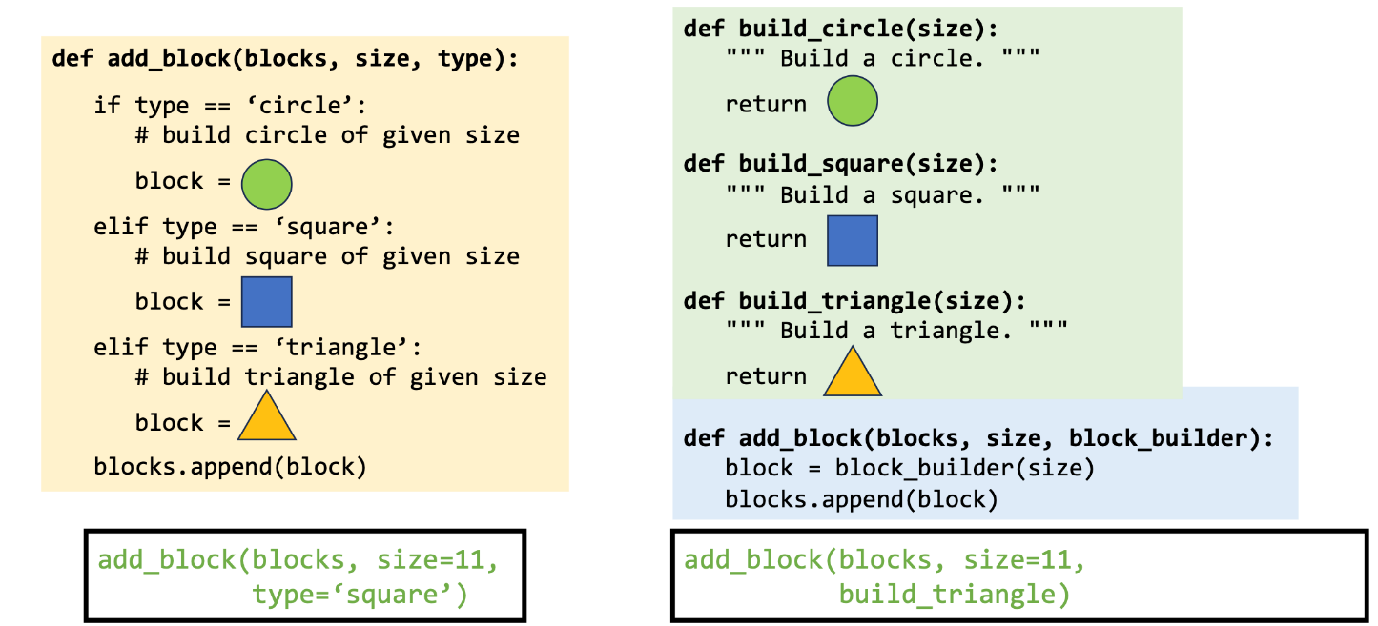
Reduce code complexity II
long if … else … chains are smell of independent code plug-ins

Slide 15
Code smells #4, #5, #6
Single responsibility principle
a function/variable/… should do one thing and one thing only
DRY – don‘t repeat yourself
if you are duplicating code, think about taking that part and putting it into a separate function/class/…
Discuss: Where does the code in make_pizzas.py violate this principle?
(5 min)

Slide 16
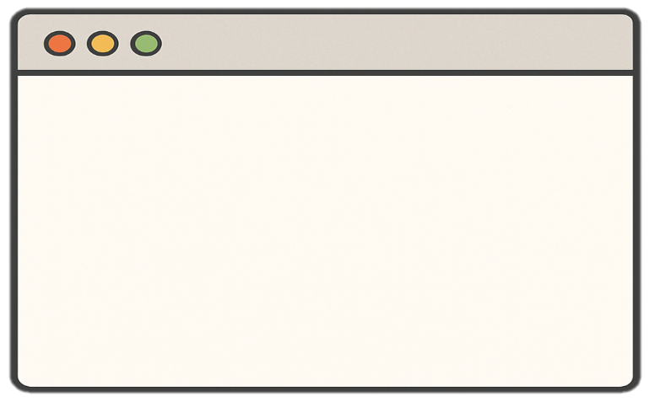
Magic numbers
Hard-coded value with unclear meaning
  Anything: number, string, path
can be anywhere in the code, therefore hard to maintain or update
  Need to hunt it down all the places it comes up
But: not every hard-coded variable has to be magic
  E.g. fix numbers: x // 2, it’s about readibility
v = 3.1415 * 4.52843
* 9.0254
volume = pi * radius**2
* height

Slide 17
Towards self-explanatory code
Examples of making functions less spaghetti and more modular and readable
avoid writing spaghetti code
  get rid of code repetitions
  get rid of code you do not need
  make things modular
  single responsibility principle
  break out things that vary independently
  put loading and saving stuff in extra functions, also plotting
  magic numbers
  nested if and for loops – naming of stuff

Slide 18

Code smells
Which smells du you recognise from your own code?
If you fix them, what do you gain?
  imports and other module variables in random order
  variables names all look same
  variables with mysterious names
  large chunks of duplicated code with small tweaks
  large functions
  highly complex code with many if and for loops
  magic numbers
(8 min)

Slide 19
Code smells
Imports, variables, functions in random order
Order makes placement predictable
Conventions let you recognize functions, classes, constants at a glance
All variables look the same
Mysteriously named variables
Choose clear name that indicates function
Chunks of duplicated code with small tweaks
Put it in a function or class
Break up big functions which do multiple things into individual functions where each does 1 thing
Large functions
Highly complex code with many if and for loops
Simplify where possible
Magic numbers
Name them, re-use them when you need them

Slide 20
Code smell # 8
side effects
Demontrate side effects in functions by modifying an array / data frame that comes in and getting a new list out, but original has also been altered

Slide 21

Towards a more efficient setup
Move away from Jupyter towards an IDE for developing code
  Learn how to debug (lets you do everything a jupyter notebook does)
Practice pairing on code
  Talk to the duck
  Pair programming - remember that everyone has written shitty code in their life
Notes:
Duck: wenn man nicht mit einer anderen person reden kann oder mag, dann sollte man mit dem rubber duckie sprechen.

Slide 22


Last words of wisdom
Aim for readibility and functionality…
…rather than elegance and beauty

Slide 23
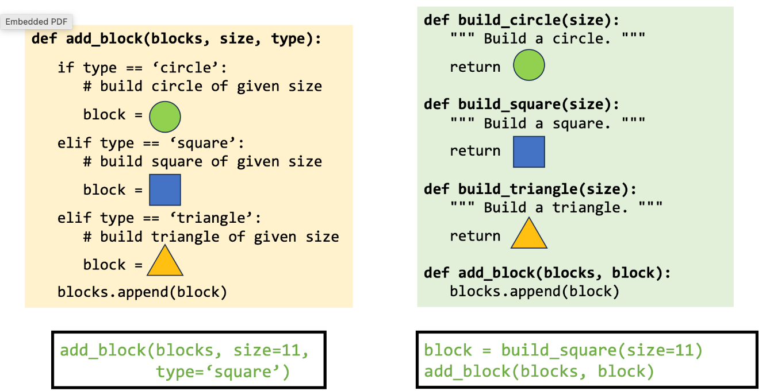
Variable names
added_points = [10, 5, 1]
# —> variable names use underscores
def add_points(house, house_points, points=0):
  if house == “Gryffindor”:
points += 1000
return house_points + points
# —> function names also use underscores
class ScoreKeeper():
    def __init__(self):
      self.house_points = 0
        self._secret_bonus = 5
    def add_points(self, house, points):
  if house == “Gryffindor”:
points += 1000
return house_points + points
# —> Class names use CamelCase
# —> private variables (intended for use only within the class) prepend “_”
if chatgpt tries to import pandas._testing, that is wrong!

Slide 24
accessibility
Notes:
Goal time: 20 minutes (?)

Slide 25
Motivation
Motivation 1. You want to be computationally literate [1].
Three pillars of comp. literacy
Material
  Writing a function, using an IDE, etc.
Cognitive
  From abstract to computationally tractable.
Social
  Community around code.
Motivation 2. You want to make your code easier to understand.
→ Also for future you :)

Slide 26
Accessibility
Two ways to enhance accessibility of your code:
Readibility
Adherence to stylistic conventions
Code layout, naming conventions etc.
Understandability
Helpful comments and docstrings
Document classes and functions for user
PEP 8 [1]
PEP257 [2]

Slide 27

What is PEP
PEP = “Python Enhancement Proposal”
Conventions to standardize python code
    Not a standard, not enforced
    Violating PEP does not break your code

Slide 28
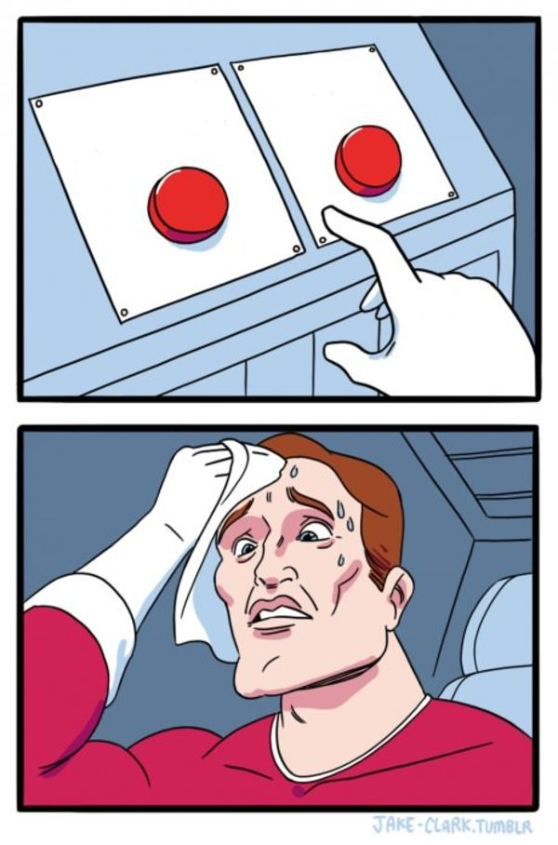
PEP8
“[I]ntended to improve the readability of code and make it consistent across the wide spectrum of Python code.”
Should that variable be capitalized or have underscores?
Surrounding
code
PEP8
How many spaces should go before and after an = sign?
What is the correct order of imports at the top of the script?
Notes:
Some projects may intentionally not follow PEP8. “Consistency…is the most important.” [2]

Slide 29
Investigate PEP8
We will assign you a letter: A, B, or C. Follow
the instructions in Exercise 4 PEP8.
There is no need to make a Pull Request for this exercise.
(10 minutes)

Slide 30
Anything interesting?
Set A
  (add in plenum)
Set B
  (add in plenum)
Set C
  (add in plenum)

Slide 31
Tools to help
PEP8:
  pylint.
    Static analysis tool.
    Informs you of PEP8 violations + other bad-coding practices.
    Enable it in your IDE!
  ruff.
    Python code formatter.
    Automatically formats your code to PEP8.
    Can enable in your IDE to auto-format on save.

Slide 32
Typing
As of Python 3.5, you can declare the type of the function argument.
There are pros and cons to using typing.
Be aware that this might be a pain to maintain if you change your functions often and pass complicated objects…
tuple[int, dict[str, str]]
See PEP484 [4].
""" This module demonstrates docstrings. """
def add_points(house: str,
    house_points: int,
    points: int = 0)
    -> int:
""" Adds up points for house cup.
If the house is Gryffindor, Dumbledore adds
  1000 points no matter what.
Parameters
----------
house_points : Current house cup score.
points : optional; New points to be added
"""
  if house == “Gryffindor”:
points += 1000
return house_points + points

Slide 33

Typing
As of Python 3.5, you can declare the type of the function argument.
There are pros and cons to using typing.
Be aware that this might be a pain to maintain if you change your functions often and pass complicated objects…
tuple[int, dict[str, str]]
See PEP484 [4].

Slide 34

Accessibility
Two ways to enhance accessibility of your code:
Readibility
Adherence to stylistic conventions
Code layout, naming conventions etc.
Understandability
Helpful comments and docstrings
Document classes and functions for user
PEP 8 [1]
PEP257 [2]

Slide 35

Documentation
Comments, docstrings etc. are a
great service towards people who
read your code
This includes future you
  Self-love!

Slide 36
Documentation
Keep in mind…
Only up-to-date documentation is useful
Maintaining it requires discipline and can be quite cumbersome
Find the balance that works for your project
… but always comment tricky bits
Write down non-intuitive decisions you made

Slide 37
PEP257
Docstring conventions [3]
Occurs as first statement in a module, function, class or method definition.
Describes args (+types), and returns
One-liners: for very obvious cases.
def data_path():
“““ returns the pathname of the data directory ”””
return data_path = ….

Slide 38
Documentation
Skip
Documenting your code provides a way of making you code usable for future you and others
  Comments (#): describe what a line (or multiple lines of code do); notes to self
  Function/method docstring (''' '''): purpose of function + params / return
  Module docstring (''' '''): what’s in this file
Accessible via mouse-overs in IDE or help(OBJECT).
""" Module docstring """
def add_points(points, extra_points):
""" Function docstring."""
# comment
points += extra_points
return points

Slide 39

Overloaded
Skip
Skip
We have three new PEPs…
  PEP8, PEP257 and PEP484.
Remembering all these rules is too much.
  → Static analysis tools!
[6]

Slide 40
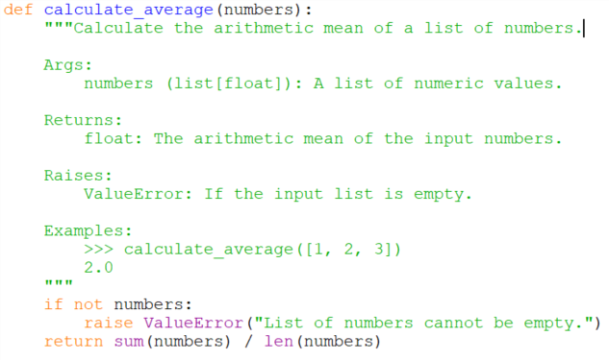
Documentation
Notes:
Numpy style documentation?
→ decide for one and stay consistent.
Add what style this is. There is many style guides and conventions.

Slide 41
Tools to help
PEP8:
  pylint.
    Static analysis tool.
    Informs you of PEP8 violations + other bad-coding practices.
    Enable it in your IDE!
  ruff.
    Python code formatter.
    Automatically formats your code to PEP8.
    Can enable in your IDE to auto-format on save.
PEP257:
  pydocstyle.
    Static analysis tool.
    Checks compliance with PEP257.
  autoDocstring.
    VS code plug-in to auto-generate docstring based on inputs, outputs.
PEP484:
  mypy.
    Static type checker for Python.
    Checks compliance with PEP484 (and more).
Notes:
Ask faculty: who of you all is using this?
Pam talks about ruff a little bit. Maybe: little demo.

Slide 42
Accessibility
Two ways to enhance accessibility of your code:
Readibility
Adherence to stylistic conventions
Code layout, naming conventions etc.
Understandability
Helpful comments and docstrings
Document classes and functions for user
PEP 8 [1]
PEP257 [2]

Slide 43
Extra material

Slide 44
Keeping track of docstrings
Most commonly used hosting websites: facilitate building, versioning, and hosting
  github.io
  readthedocs.org
Automate documentation
  Sphinx: a package to collect docstrings and create a nicely formatted documentation website

Slide 45
References
DiSessa, Andrea A. Changing minds: Computers, learning, and literacy. Mit Press, 2000.
PEP 8 – Style Guide for Python Code | peps.python.org
PEP 257 – Docstring Conventions | peps.python.org
PEP 484 – Type Hints | peps.python.org
Example NumPy Style Python Docstrings

Slide 46

Contents
usability features:
1) separate, individually usable projects
  virtual environments
2) clean folder and file structure
standard Python package structure
3) error-free importing of code
  editable pip installation
4) readability
  documentation, typing, naming

Slide 47
References
https://journals.plos.org/plosbiology/article?id=10.1371/journal.pbio.1001745
https://journals.plos.org/ploscompbiol/article?id=10.1371/journal.pcbi.1005510#pcbi.1005510.ref001
https://goodresearch.dev/

