Slide 1
Parallel Part III

Slide 2
Outline
Processes, threads and THE GIL
Hands-on investigations of embarrassingly parallel problems
  Multithreading with NumPy
  The multiprocessing package
  Blending processes and threads
Going further
Wrap-up
<number>

Slide 3
Going further
<number>

Slide 4
Topics
asyncio and coroutines
The near-future: changes in the python interpreter
Larger-than-memory problems
Not-embarrassingly-parallel problems
Other tools
Parallelism on clusters
<number>

Slide 5
Concurrency in Python
Concurrency: multiple tasks making progress at the same time.
Parallelism is a type of concurrency.
Multithreading (<=2.3)
Multiprocessing (<=2.6)
Coroutines and asyncio (3.4)
Sub-interpreters (3.12)
“Free-threaded” python (3.13)
See [1] for more discussion.
<number>

Slide 6
The asyncio package
Added in Python 3.4
Tasks are created by calling Python functions. The dependency graph of tasks is built automatically. Tasks run concurretnly. Tasks that need an earlier result block until that is available.
Use cases: slow I/O with many connections [2]
Web scraping
Communication with a database
A bit of a learning curve.
Pseudocode
Inspired by [3]
async def main():
urls = [‘www.yes.com’,
‘www.no.com’]
# asynchronously collect
# url content with 1 thread
content = await scrape(urls)
# process content here...
Food preparation example in extras/kitchen_asyncio/
<number>
Notes:
Concurrent: multiple tasks make progress at the same time. Parallel: two threads at the same time.

Slide 7
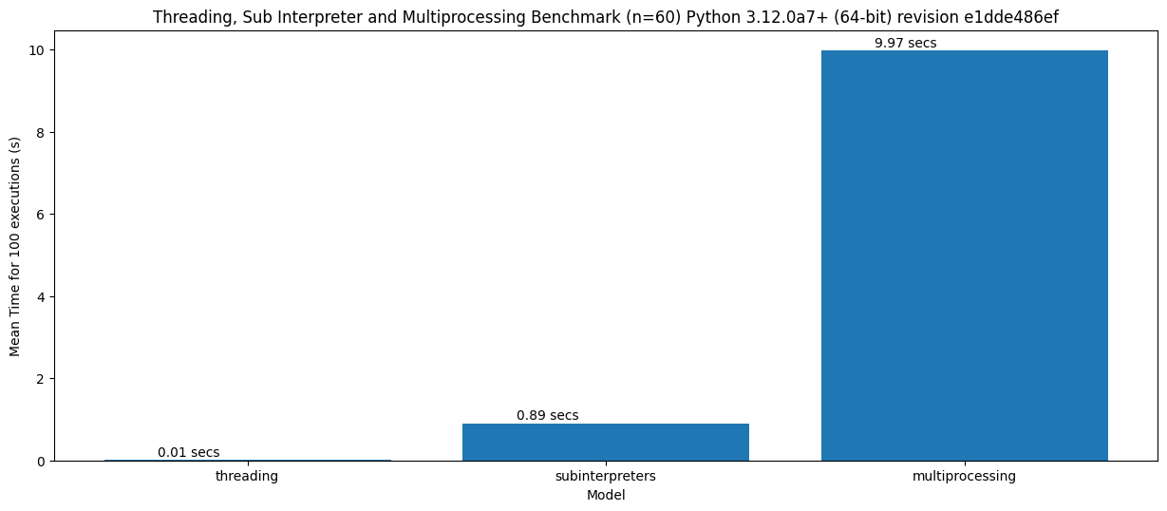
Sub-interpreters
Different Python interpreters within the same process.
Multiple GILs and object hierarchies in shared memory
Less time to spin up
compared to
multiprocessing [4]:
Released with 3.12. Still
undergoing bug fixes. [1]
<number>
Notes:
Concurrent: multiple tasks make progress at the same time. Parallel: two threads at the same time.

Slide 8
“Free-threaded Python”
The GIL is gone. Each object gets its own lock.
Allows multiple threads to operate in parallel if they don’t access the same objects. The interpreter itself works fine, but many extensions need to be updated.
Released with 3.13.
Still undergoing bug fixes.
Try it with sudo dnf install python3.13-freethreading && python3.13t
(on Fedora)
<number>
Notes:
Concurrent: multiple tasks make progress at the same time. Parallel: two threads at the same time.

Slide 9
Larger-than-memory problems
Consider a problem: calculating the mean value of each column in a numpy array, where the array is so big that you cannot hold it in memory.
Discuss for a minute with your partner: what code could you write to get around this problem?
<number>

Slide 10
A pseudocode solution
Break the array into n_chunks vertical chunks.
initialize mean_values to array of zeros
for each chunk in the array:
load the chunk into memory
calculate the mean values of all columns
divide the chunk mean values by n_chunks
add the result to mean_values
mean_values[i]
mean(chunk)
n_chunk
mean_values[i+1]
<number>

Slide 11
Not-embarrassingly parallel problems
It gets complicated. ☹
If I/O bound, perhaps asyncio.
CPU-bound...
MPI: Message Passing Interface. De facto standard for low-level massive parallelization. https://github.com/mpi4py/mpi4py/
Slides at end of deck
<number>

Slide 12
Other Python packages for parallel computing
https://www.dask.org/ (data objects [arrays, dataframes] for scaled computation, from laptop to cluster)
https://snakemake.readthedocs.io/en/stable/index.html (tool to create reproducible and scalable analyses)
https://ipyparallel.readthedocs.io/en/latest/ (parallel IPython)
https://github.com/ray-project/ray (parallelization for ML-style workflows)
https://github.com/modin-project/modin (parallel pandas)
https://www.bodo.ai/ (SQL & data processing)
https://spark.apache.org/docs/latest/api/python/index.html (big data analytics)
<number>

Slide 13
On the cluster at your institute
If a parallel Python workflow is available, use it.
If no workflow is available, be ready for challenges.
Efficacy of certain packages is cluster-dependent.
<number>

Slide 14
Wrapping up
<number>

Slide 15



Outline
Processes, threads and THE GIL
Hands-on investigations of embarrassingly parallel problems
  Multithreading with NumPy
  The multiprocessing package
  Blending processes and threads
Going further
Wrap-up
<number>

Slide 16
Thanks!
<number>

Slide 17
Supplementary material
<number>

Slide 18
Further reading
4 concurrency in Python and subinterpreters Python subinterpreters and free-threading [LWN.net]
Concurrency in Python. Note that code snippets are a little outdated. Async Python: The Different Forms of Concurrency · Abu Ashraf Masnun
Example of webscraping with asyncio Asynchronous Web Scraping in Python [2024] - ZenRows
Sub-interpreters in 3.12 https://tonybaloney.github.io/posts/sub-interpreter-web-workers.html
<number>

Slide 19


MPI (Message Passing Interface)
process 0
process 1
data xyz
data xyz
computer 0
computer 1
MPI is a standard for passing data ("messages") between processes.
OpenMPI/MPICH/… are C-libraries following the MPI standard.
mpi4py allows you to use these libraries from Python to communicate between processes.
<number>

Slide 20


Why (not) MPI?
high-level of flexibility
high performance (when used correctly)
leverage the combined power of thousands of computers
cognitive overhead
difficult to use effectively
debugging can is a nightmare
(pictured: typical MPI user)
<number>

