Slide 1
Blooket link
https://dashboard.blooket.com/edit?id=68d26f27f74f3672766e1df2

Slide 2
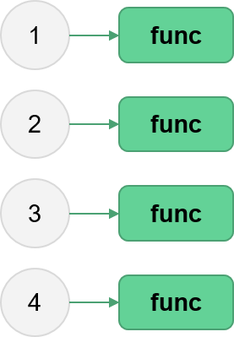
Parallel Python
Aitor Morales-Gregorio
Zbigniew Jędrzejewski-Szmek
ASPP 2025, Plovdiv
Fork/clone the repo now!

Slide 3
Outline
Processes, threads and THE GIL
Hands-on investigations of embarrassingly parallel problems
  Multithreading with NumPy
  The multiprocessing package
  Blending processes and threads
Going further
Wrap-up

Slide 4
Exercise: brainstorm
Why do we parallelize?
Talk to your partner and come up with three practical examples of where parallelization could be beneficial (in your work or another application).

Slide 5
Exercise: brainstorm
Why do we parallelize?
Talk to your partner and come up with three practical examples of where parallelization could be beneficial (in your work or another application).
In short, two reasons why:
Speed up computations.
Process “big” things.
As for the “how”...we’ll come back to that later.

Slide 6
Processes, threads and the GIL

Slide 7




Kitchen-2-Computer analogy
Workstation
Includes chef, tiny
countertop and tools
Customer
Gives orders
Transport
servants
Carry stuff
Large Pantry
across the street
Big Countertop
temporarily holds things
Notes:
Your goal is to optimize the dakos program, to make a dakos as fast as possible.
You can choose how many chefs and workstations you need, but you need to figure out which chefs do which tasks and in which order.
(estimate around 7 minutes -- put up green stickies when done)

Slide 8
Kitchen-2-Computer analogy
Workstation
Includes chef, tiny
countertop and tools
Customer
Gives orders
Transport
servants
Carry stuff
Large Pantry
across the street
Talk to your partner:
What is what?
Big Countertop
temporarily holds things
Notes:
Your goal is to optimize the dakos program, to make a dakos as fast as possible.
You can choose how many chefs and workstations you need, but you need to figure out which chefs do which tasks and in which order.
(estimate around 7 minutes -- put up green stickies when done)

Slide 9

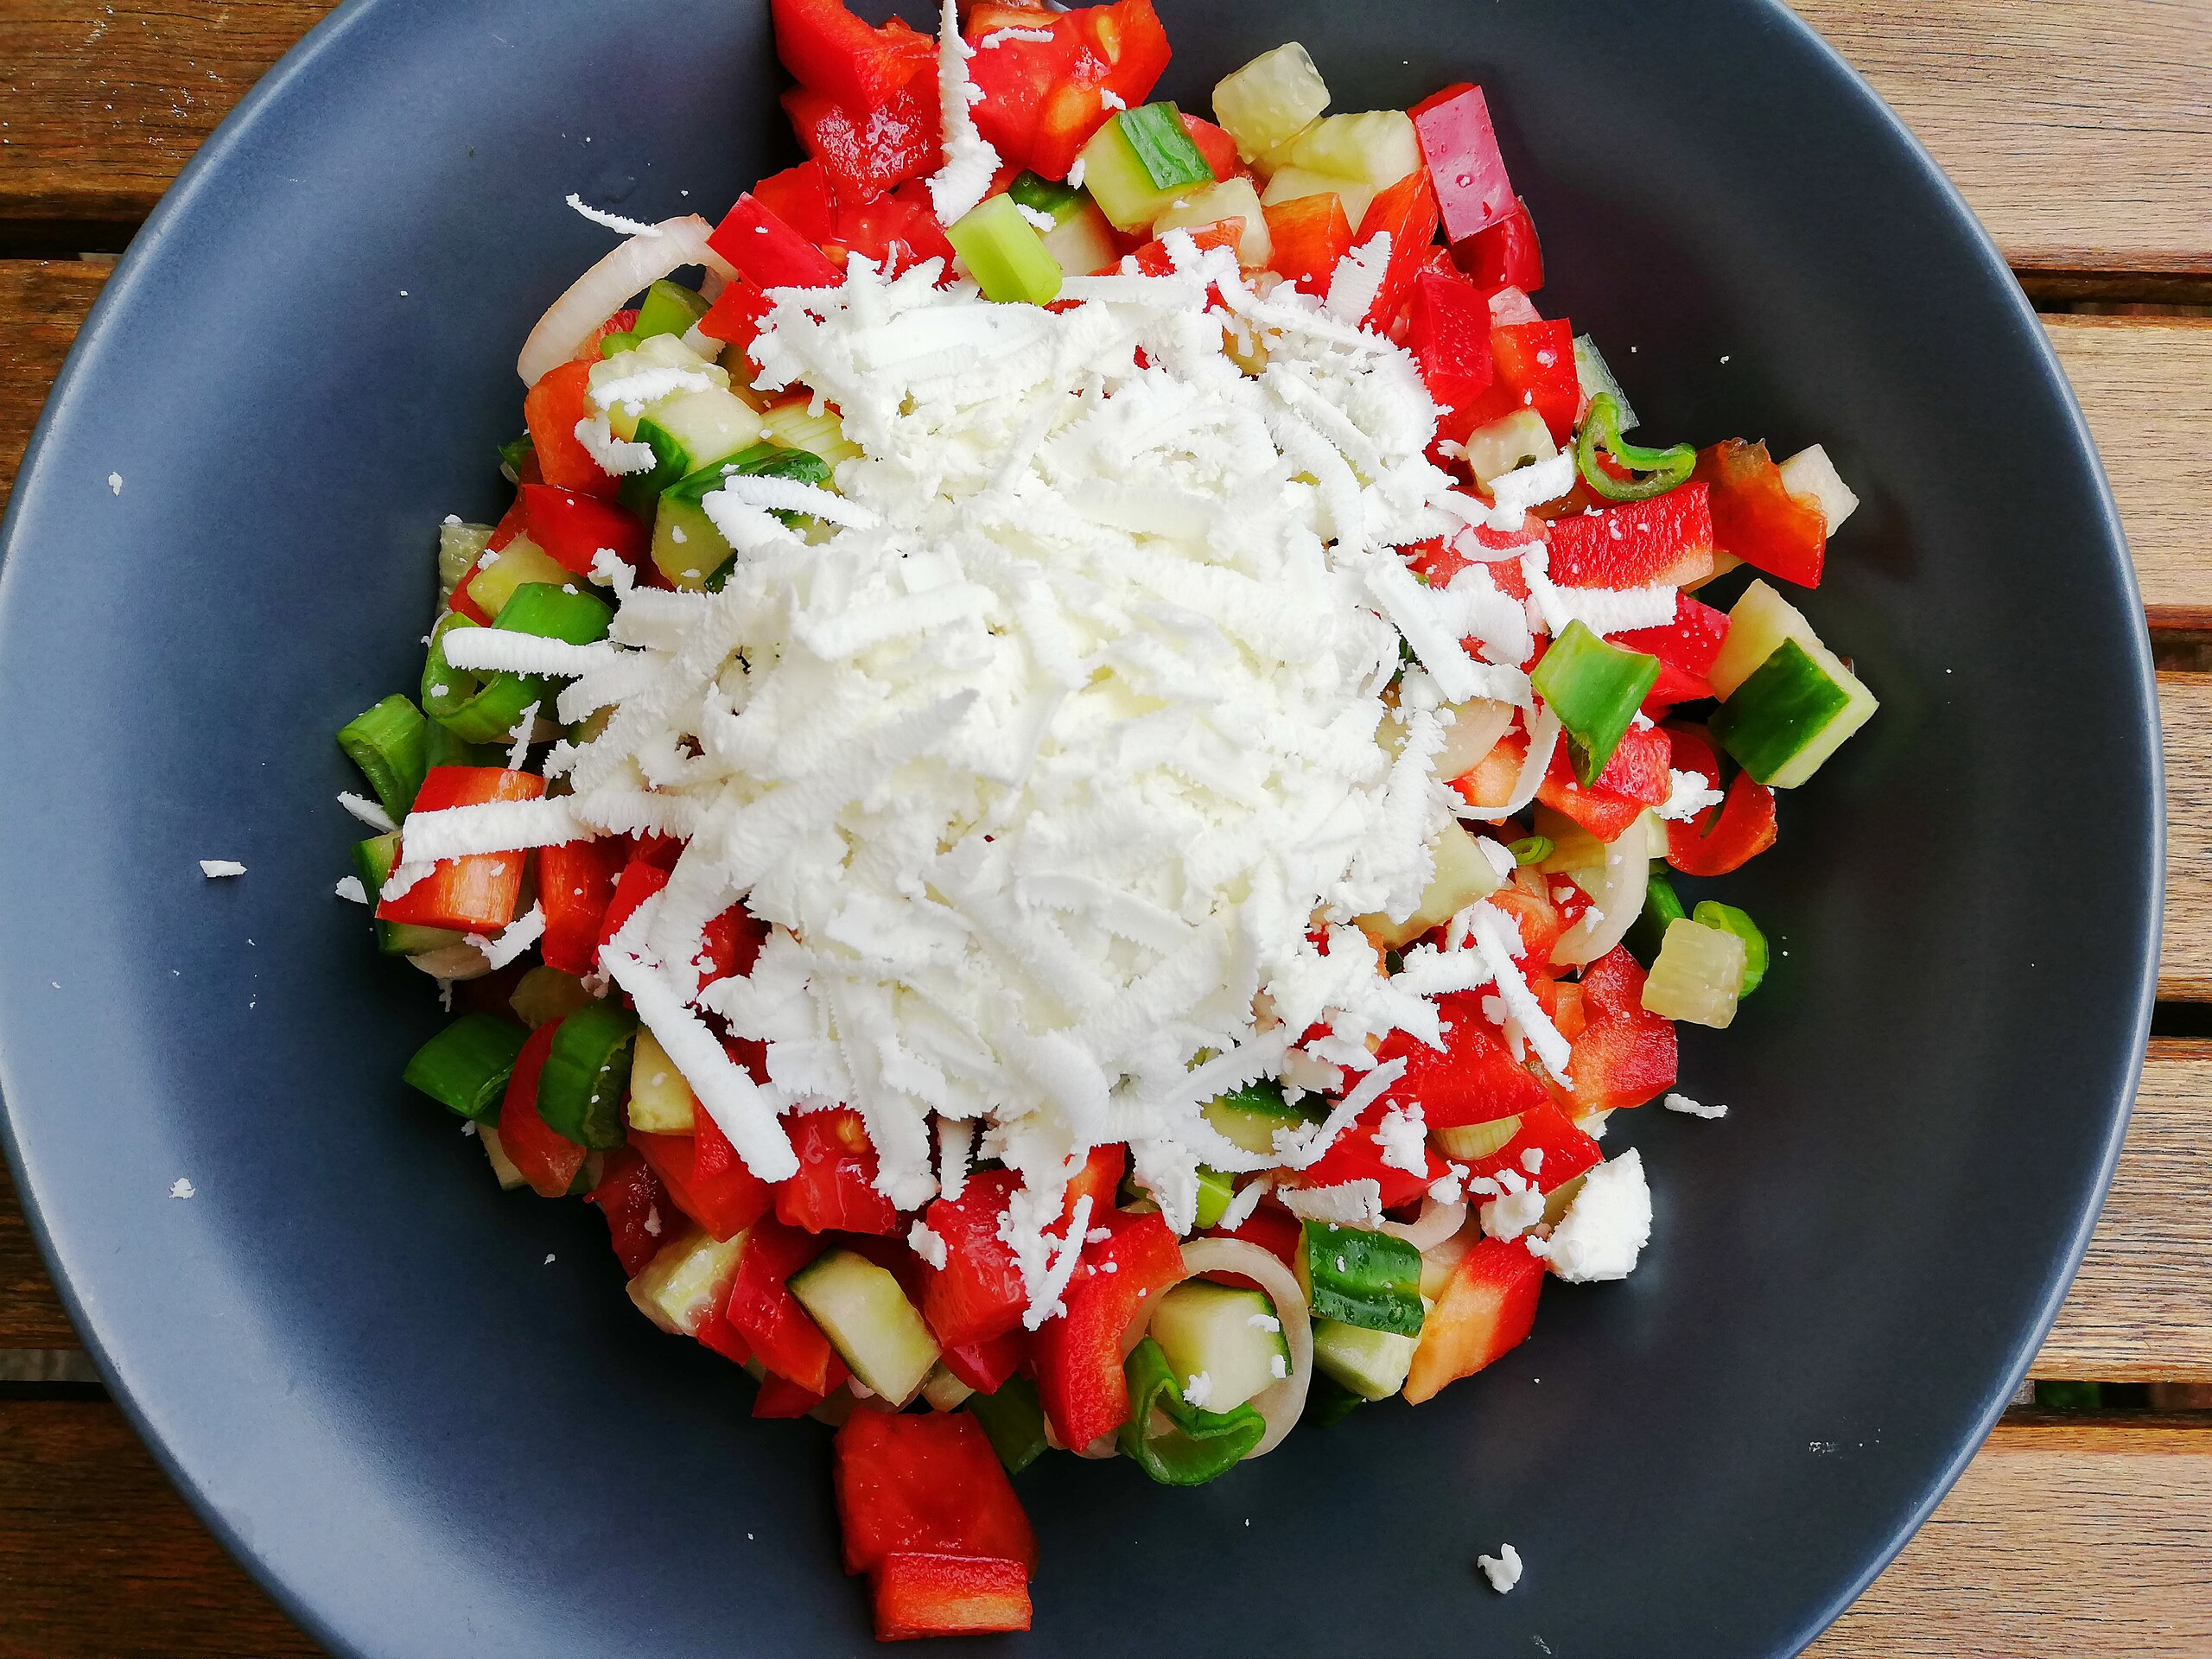
The шопска салата program
We need to make a single dish: шопска салата.
This requires:
Fetch vegetables from pantry
Wash vegetables
Fetch cheese from pantry
Grate cheese
Chop vegetables
Combine veggies and cheese
Place salad in the pantry
Notes:
Explain the dakos program (instructions) as a single-threaded process. Mention
(1) the pantry is across the street
(2) the countertop with the copy of the recipe, where everything is stored when it’s not being acted upon.
(3) that the chef is a stupid box who can only do one thing at a time.

Slide 10
The шопска салата program
We need to make a single dish: шопска салата.
This requires:
Fetch vegetables from pantry
Wash vegetables
Fetch cheese from pantry
Grate cheese
Chop vegetables
Combine veggies and cheese
Place salad in the pantry
Talk to your partner:
How can we make шопска салата faster?Without kitchen renovations
Notes:
Explain the dakos program (instructions) as a single-threaded process. Mention
(1) the pantry is across the street
(2) the countertop with the copy of the recipe, where everything is stored when it’s not being acted upon.
(3) that the chef is a stupid box who can only do one thing at a time.

Slide 11

Yay! We have just designed a
multi-threaded program

Slide 12


The restaurant owner made the kitchen larger!
Workstation #1
Workstation #2
So everything is twice as fast, right?
Countertop (memory)
Notes:
Explain the dakos program (instructions) as a single-threaded process. Mention
(1) the pantry is across the street
(2) the countertop with the copy of the recipe, where everything is stored when it’s not being acted upon.
(3) that the chef is a stupid box who can only do one thing at a time.

Slide 13
The restaurant owner made the kitchen larger!
Workstation #1
Workstation #2
Problem #1:
Memory corruption
Problem #2:
Race conditions
Countertop (memory)
Notes:
Explain the dakos program (instructions) as a single-threaded process. Mention
(1) the pantry is across the street
(2) the countertop with the copy of the recipe, where everything is stored when it’s not being acted upon.
(3) that the chef is a stupid box who can only do one thing at a time.

Slide 14
Race conditions
(Live coding)

Slide 15

Python’s approach: The Global Interpreter Lock (GIL)
* A mutual exclusion (mutex) lock.
* Within the Python process, only 1 thread is allowed to execute pure-Python code in a given instance. Leading to NO SPEED-UP from multithreading.
* The lock is acquired and released by threads, approximately every 100 bytecode instructions. Also released in other cases, e.g., I/O.
Notes:
(GIL introduced in Python version 1.5, January of 1998.)
Define what a lock is, keep the kitchen analogy (it’s a good one). “mutex lock” (mutual exclusion). “The lock is explicitly released and re-acquired periodically by each Python thread, specifically after approximately every 100 bytecode instructions executed within the interpreter. This allows other threads within the Python process to run, if present.
The lock is also released in some circumstances, allowing other threads to run.
An important example is when a thread performs an I/O operation, such as reading or writing from an external resource like a file, socket, or device.
The lock is also explicitly released by some third-party Python libraries when performing computationally expensive operations in C-code.”

Slide 16
Python’s approach: The Global Interpreter Lock (GIL)
* A mutual exclusion (mutex) lock.
* Within the Python process, only 1 thread is allowed to execute pure-Python code in a given instance. Leading to NO SPEED-UP from multithreading.
* The lock is acquired and released by threads, approximately every 100 bytecode instructions. Also released in other cases, e.g., I/O.
Hypothesize with your partner:
NumPy can achieve massive speed-up from multithreading. How is this possible?
Notes:
(GIL introduced in Python version 1.5, January of 1998.)
Define what a lock is, keep the kitchen analogy (it’s a good one). “mutex lock” (mutual exclusion). “The lock is explicitly released and re-acquired periodically by each Python thread, specifically after approximately every 100 bytecode instructions executed within the interpreter. This allows other threads within the Python process to run, if present.
The lock is also released in some circumstances, allowing other threads to run.
An important example is when a thread performs an I/O operation, such as reading or writing from an external resource like a file, socket, or device.
The lock is also explicitly released by some third-party Python libraries when performing computationally expensive operations in C-code.”

Slide 17


NumPy’s trick
NumPy runs compiled non-Python code, which operate free of the GIL
In other words, it is many threads disguised as one!

Slide 18
Faster solution: Protect the memory
Workstation #1
Workstation #2
Multi-processing:
Each process gets assigned private memory, other processes cannot read or write from it*, if they try there will be an error (Segmentation Fault)
Who does this?
The Operating System (OS)
Countertop (memory)
*usually
Process #1
#2
Notes:
Explain the dakos program (instructions) as a single-threaded process. Mention
(1) the pantry is across the street
(2) the countertop with the copy of the recipe, where everything is stored when it’s not being acted upon.
(3) that the chef is a stupid box who can only do one thing at a time.

Slide 19
Faster solution: Protect the memory
Great for embarrassingly parallel problems!
Workstation #1
Workstation #2
Multi-processing:
Each process gets assigned private memory, other processes cannot read or write from it*, if they try there will be an error (Segmentation Fault)
Who does this?
The Operating System (OS)
Countertop (memory)
*usually
Process #1
#2
Notes:
Explain the dakos program (instructions) as a single-threaded process. Mention
(1) the pantry is across the street
(2) the countertop with the copy of the recipe, where everything is stored when it’s not being acted upon.
(3) that the chef is a stupid box who can only do one thing at a time.

Slide 20
Process
* List of instructions, i.e. an instance of some program
* Has private memory
* Can be made up of one or more threads
* Is not a physical part of the computer, it is defined by the rules of the OS
Thread
* Some instructions from the program (all instructions if single-threaded)
* Always part of a process
* Shares memory with other threads of the same process
Processes and threads do not run on a specific CPU,
the OS will allocate them and can move them mid-run

Slide 21
To wrap things up…a pop quiz!
On your pair computer, please navigate to play.blooket.com and enter game pin
Notes:
https://create.kahoot.it/share/multithreading-or-multiprocessing/420c5efc-305b-4d6e-8790-fa037b8df9a6

Slide 22
Outline
Processes, threads and THE GIL ✅
Hands-on investigations of embarrassingly parallel problems
  Multithreading with NumPy
  The multiprocessing package
  Blending processes and threads
Going further
Wrap-up

