Slide 1

Scientific programming patterns
Lisa Schwetlick, Aitor Morales, Guillermo Aguilar,
Pietro Berkes

Slide 2

What is wrong with you?!
You studied the language
You learned the libraries
You coded for months
And yet the code still feels like a 7-headed apocalyptic monster. Changes are painful, new features break old functionality, reproducing previous results becomes a git-checkout juggling exercise

Slide 3
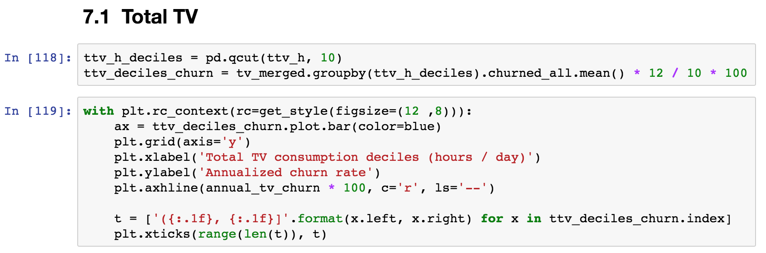
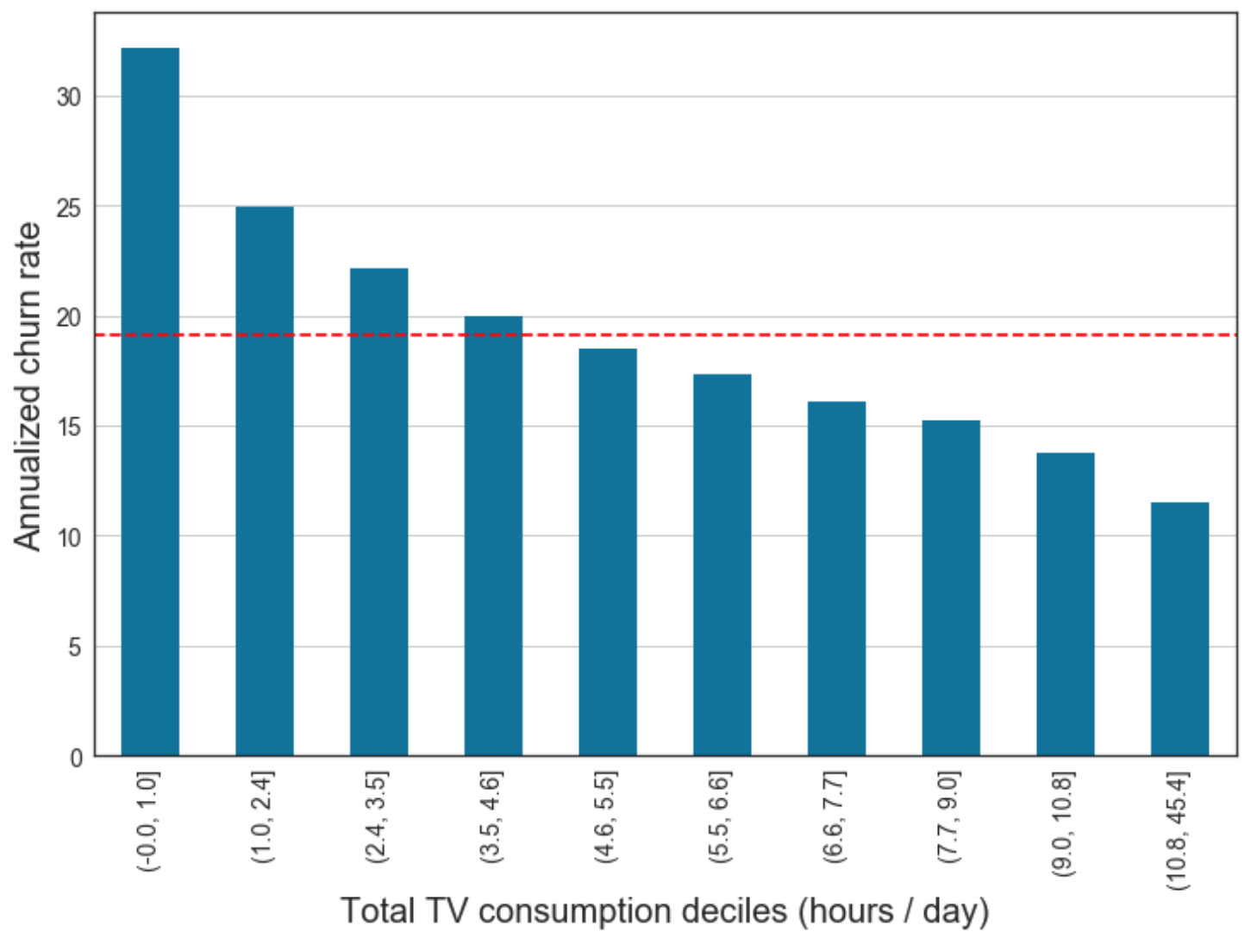

The good news: you can smell it

Slide 4
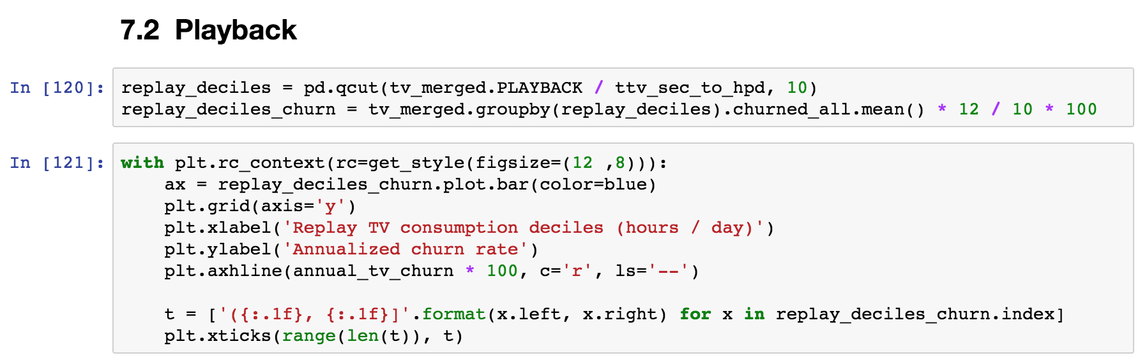
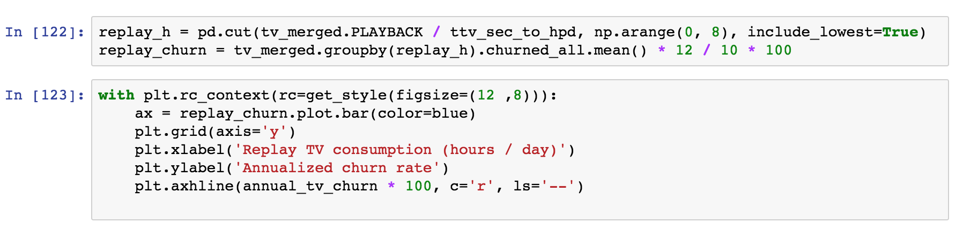
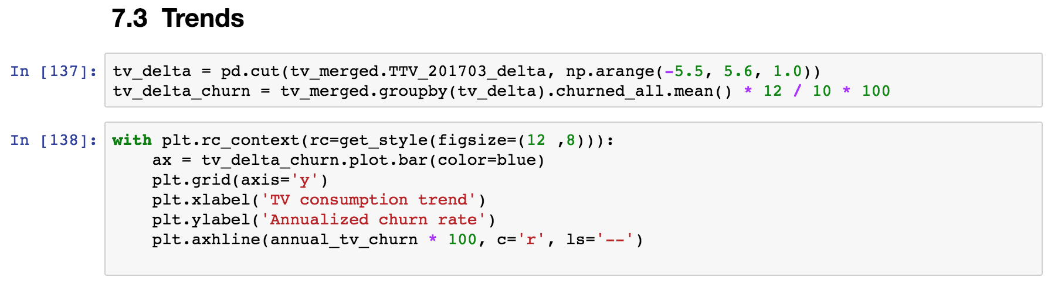
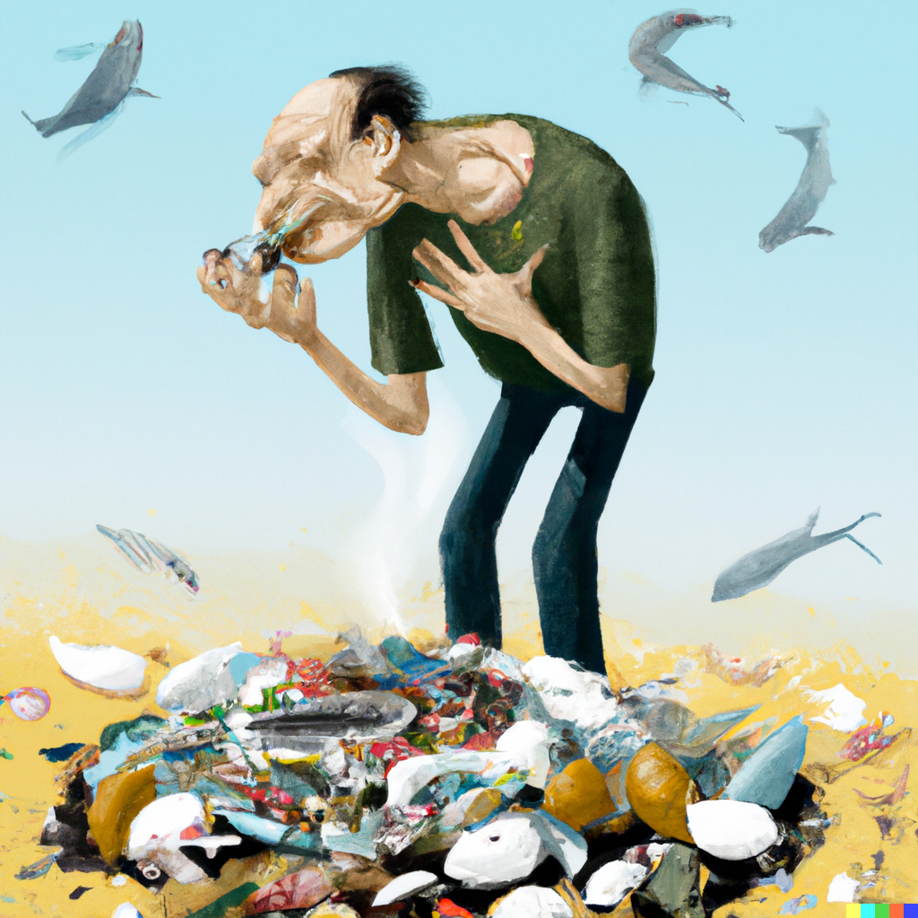
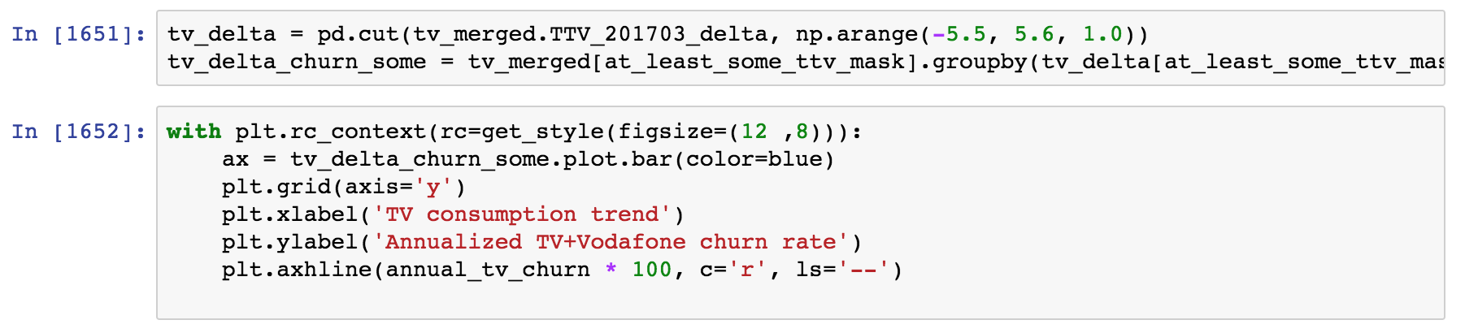
The good news: you can smell it

Slide 5
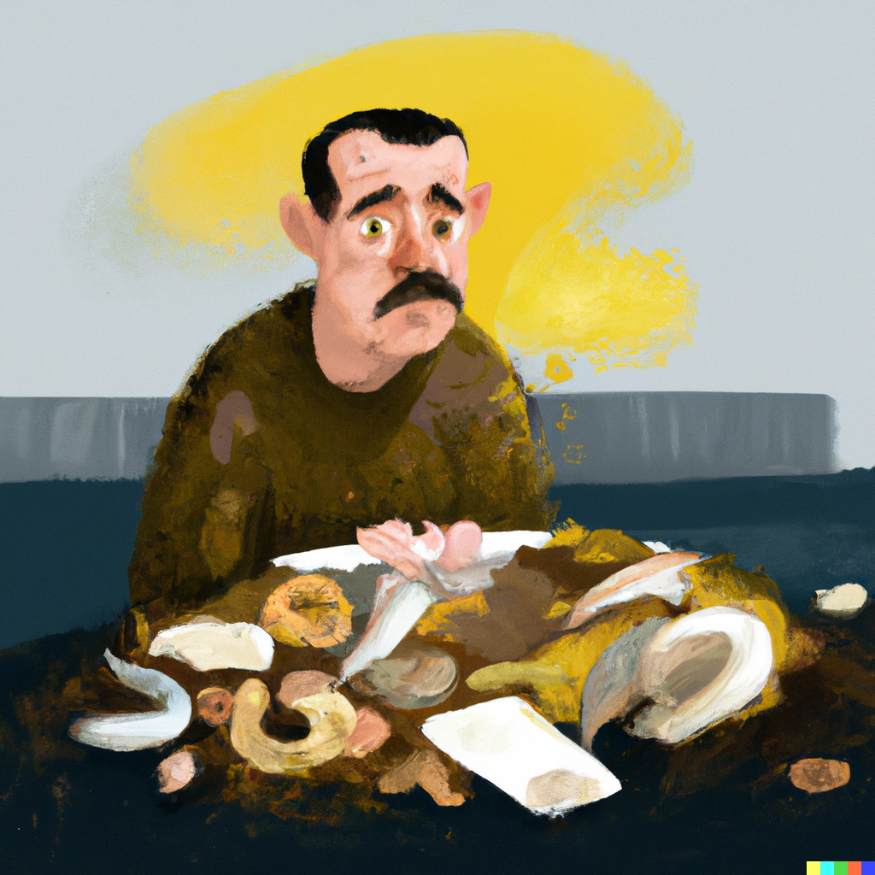
What is wrong with smelly code?
Smelly code might work right now, but in time it is going to have one or more of these issues:
Hard to read and test: it is difficult to see an overall structure; understanding the code in one place requires checking other code all over
Coupled: an update in one place requires several other changes in other places
Not flexible: adding new functionality and modifying exiting features require extensive rewrites or hacks

Slide 6
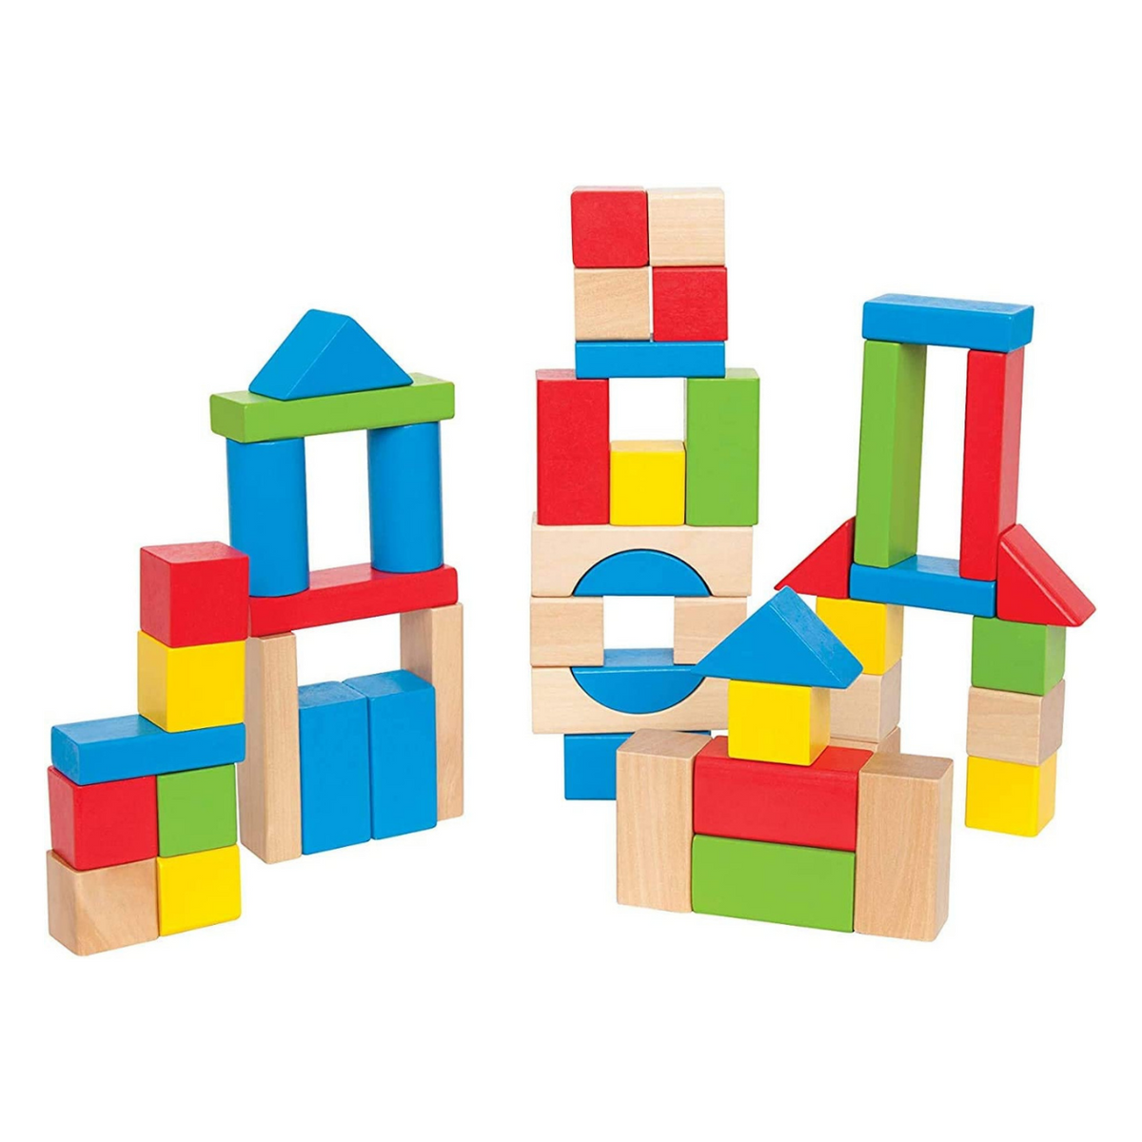
Code should be as a construction block structure
Functions and classes group together things that are coupled together and form the basic blocks.
We can easily and quickly rearrange the blocks to extend a structure or build a new one!
Flexible code is just like a block construction:
is easy to understand in terms of blocks
tolerates changes
is reusable
Notes:
These constructs are not very common in scientific code, and you don’t actually ”need” them. But the same is true of functions!

Slide 7
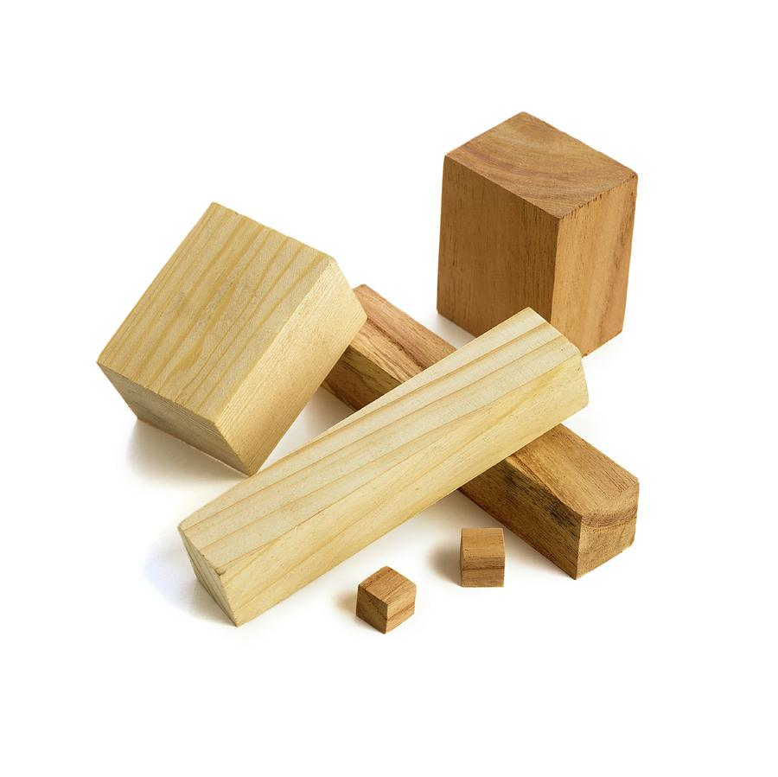

Words that we’ll say a lot
Your library
Library vs external code
  External code is anything that is not in your library: your script, 3rd party wanting to do other stuff, another library
Interface, API
  How you are supposed to call your library. The list of public functions and classes, and how to use them
Public interface vs private interface
  Changing the public interface forces all the external code to change
Public interface
Private interface
Your script
Another user’s script
“External code”

Slide 8
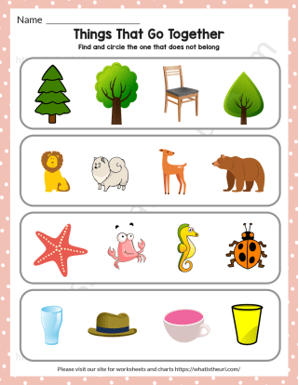
Chapter 1: Introduction to classes
Put together things that belong together

Slide 9

Classes live coding
Live Coding
notebooks/01a_Classes.ipynb

Slide 10

Hands-on
Add a new method to the Particle class
Exercise
exercises/particle_update_position
Make the function update_position into a method of the class Particle.
Where does the position of the particle belong? Modify the class constructor if necessary.
Submit a PR for Issue #1 on GitHub.

Slide 11
Summary: Classes organize your code
class Xyz:
def __init__(self, x, y, z):
...
def first_function(self):
# Something
def second_function(self):
# Something else
def third_function(self):
# Something more
def first_function(x, y, z):
# Something
def second_function(x, y, z):
# Something else
def third_function(x, y, z):
# Something more
… becomes …
Classes help us group data and functionalities that belong together
When used judiciously, the code becomes more usable as we get rid of a lot of manual book-keeping; details are hidden away
Understanding what belongs to the class and what does not is important to keep the code flexible!

Slide 12
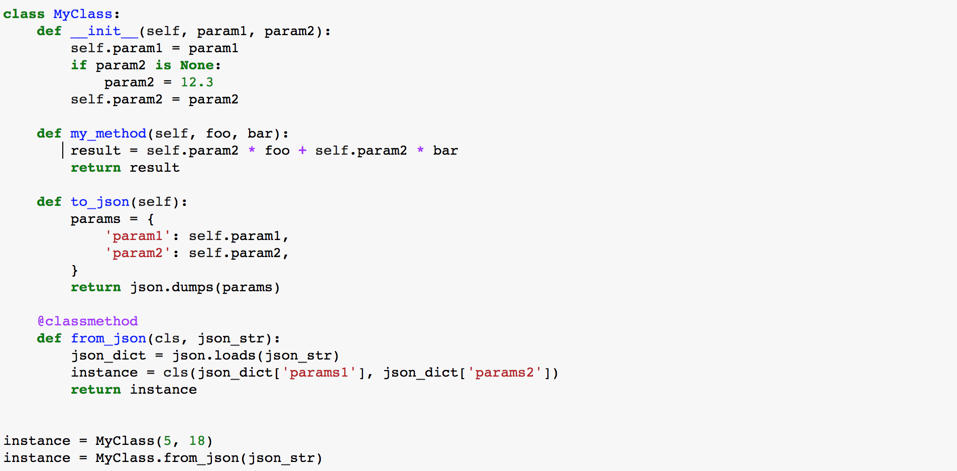
Recap: Class structure
The constructor is used to first populate an instance, called by convention “self”
Classes can define “methods”, i.e. functions that have access to the data stored in an instance
A ”class method” can be used to build an instance in some alternative way, e.g. using data from a file
Here is how you create instances from the constructor or a class method

Slide 13
Chapter 2: Break out things that vary independently

Slide 14

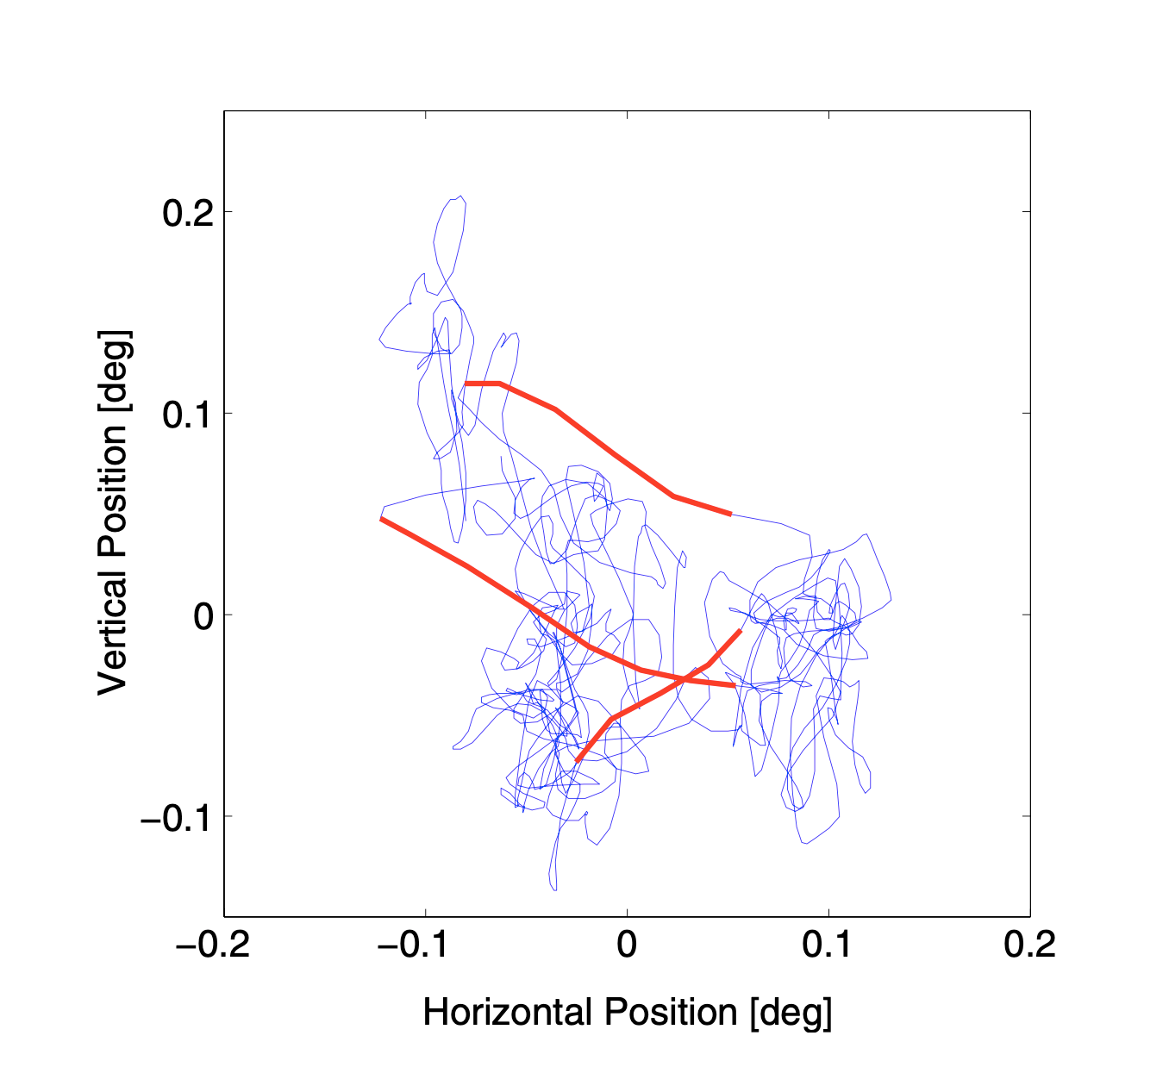
Excursion: let’s walk!
Even when people think they are holding their eyes still, they still move around:
  Drift, microsaccades, jitter
The movement has statistical properties such as self avoidance, directional persistence…
The upcoming exercise is a simplified version of a model Lisa is working on

Slide 15
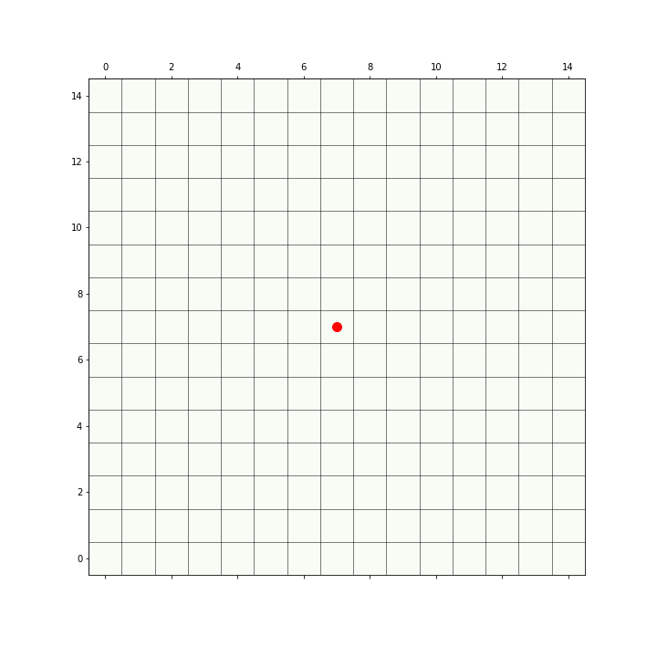
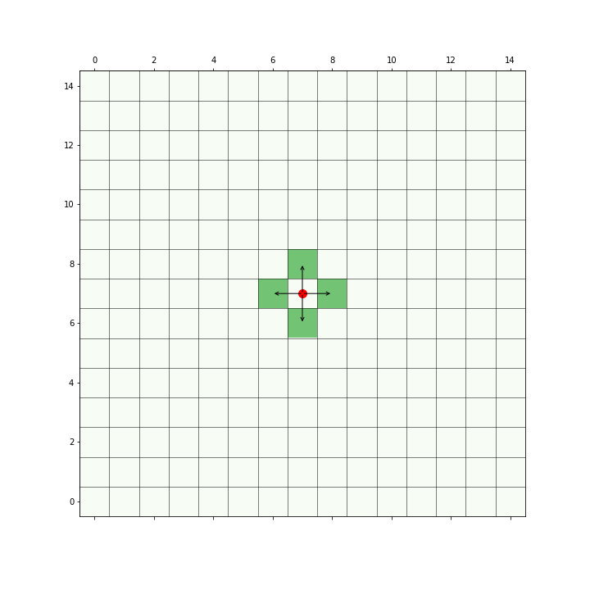
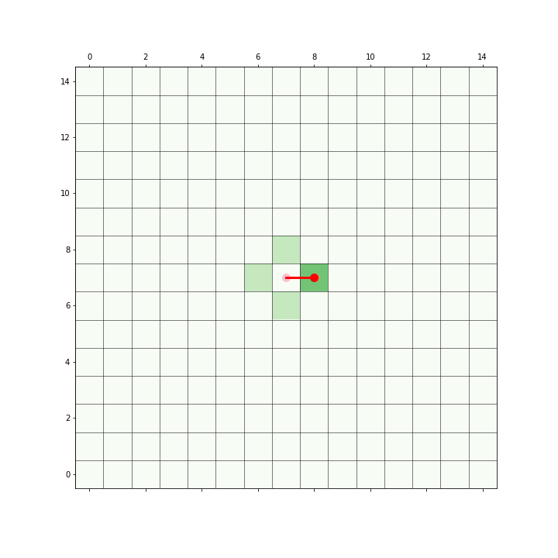
Excursion: let’s walk!
Walker starts somewhere
It could walk one step in any direction
It randomly selects one step

Slide 16
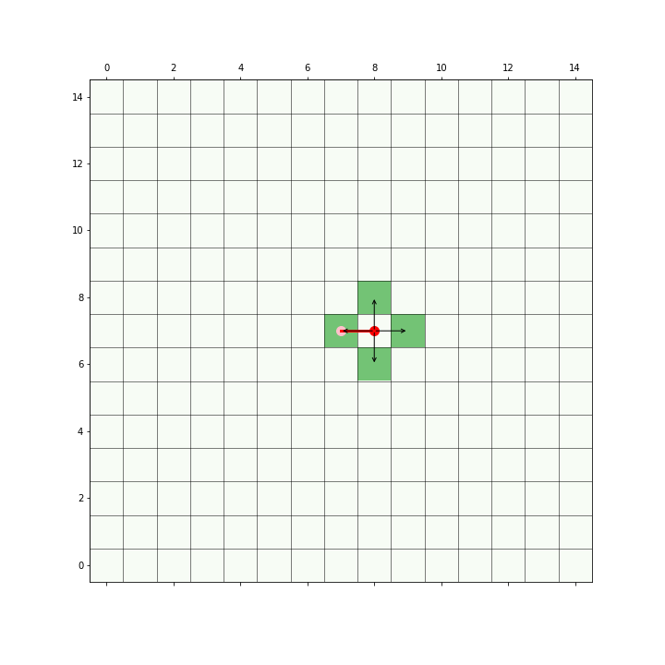
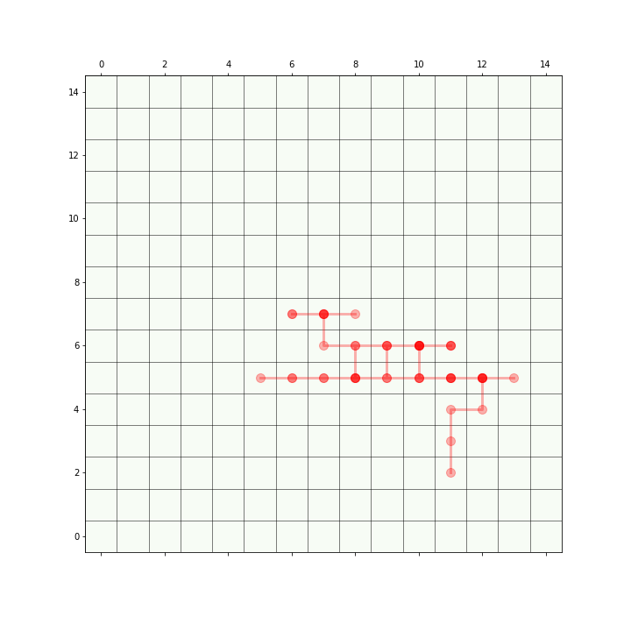
Excursion: let’s walk!
In the next step it has the same stepping options
By iterating this procedure, we get a trajectory

Slide 17
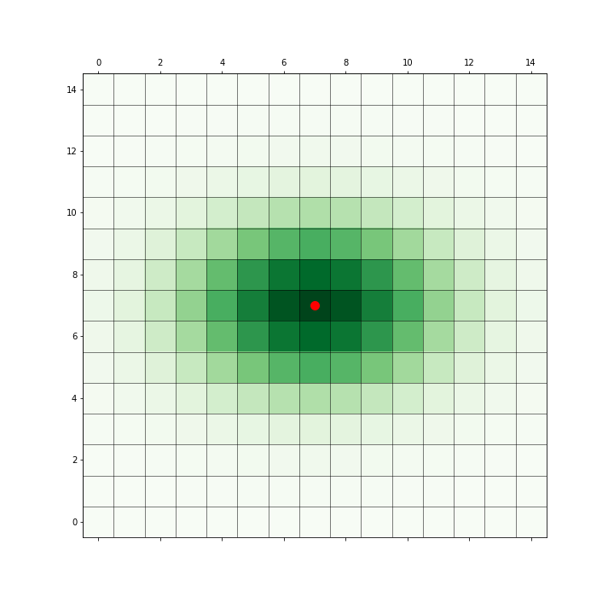
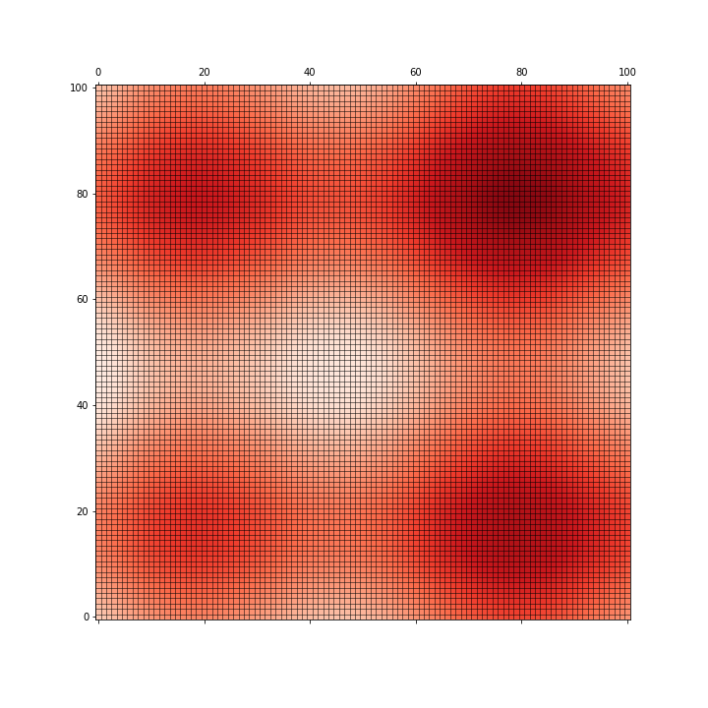
Excursion: let’s walk!
To make the behavior a little bit more interesting the walker in the exercise…
  Choses its next step from a probability distribution
  Can also walk over a non-uniform background, that influences how likely it is to go there
Stepping Probability
Background Activation

Slide 18
The walker Functions
Live Coding
walker/Step_0_Introduction/
next_step_proposal(current_i, current_j, sigma_i, sigma_j, size)
create_context_map(size, map_type='flat')
sample_next_step(current_i, current_j, sigma_i, sigma_j, context_map,
random_state=np.random)
Combines and , and probabilistically selects the next location
Notes:
LIVE CODE!
ASK: what’s the smell?

Slide 19
Conceptual Exercises
All the exercises are about reformatting and pseudocode! You are not expected to go into detail about how the code works- copy&pasting is fine!
There are many ways to solve the exercises. It is more important to think about the implementation choices with your partner than to finish.
We will give you working code to start from at each step, so don’t worry about finishing!
Notes:
Discussion: is the trajectory part of the class?
Is plotting?

Slide 20
Conceptual Exercises
We DON’T expect a PR, or working code! Instead, decide what would be a good way to build the code and comment our opinion in the git.aspp.school issue.
# Markdown Title
Comment in words, what you think!
```python
S = “The maintainers of the library are awsome!”
print(s)
```
Notes:
Discussion: is the trajectory part of the class?
Is plotting?

Slide 21
Conceptual Exercise
A walker class
Exercise
walker/Step_1_classes/
Open the notebook “Step_1_classes_exercise” execute the code, and follow the instructions
Comment on Issue #2 on git.aspp.school, suggesting what you think the code should look like.
From…
To… ?
i, j = 100, 50 # initial position
sigma_i, sigma_j = 3, 4 # parameters of the next step map
size = 200 # size of the image
context_map = create_context_map(size, 'hills') # fixed context map
# Sample a next step 1000 times
trajectory = []
for _ in range(1000):
i, j = sample_next_step(i, j, sigma_i, sigma_j, context_map)
trajectory.append((i, j))
walker = Walker(sigma_i=3, sigma_j=4, ...)
# Sample a next step 1000 times
…
Notes:
Discussion: is the trajectory part of the class?
Is plotting?

Slide 22
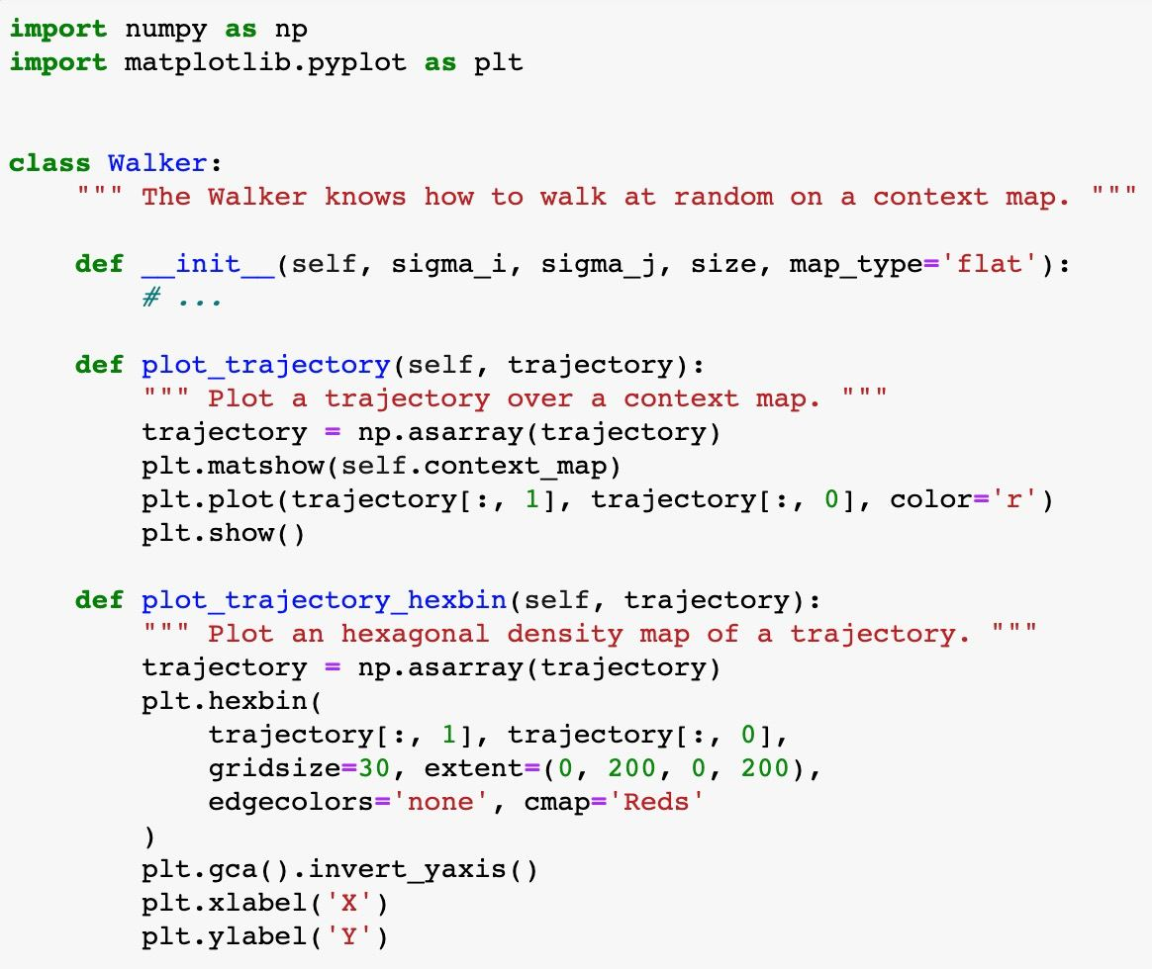
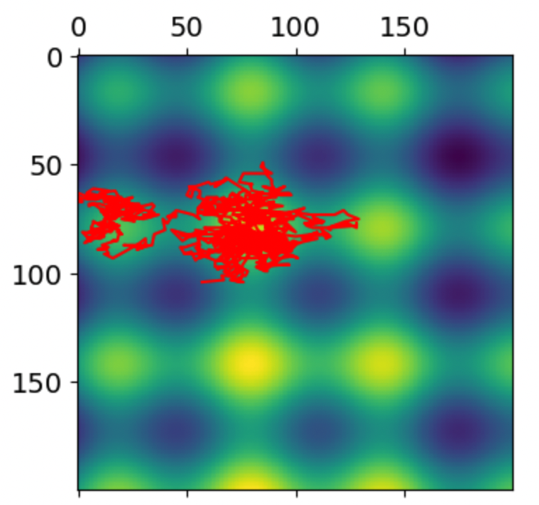
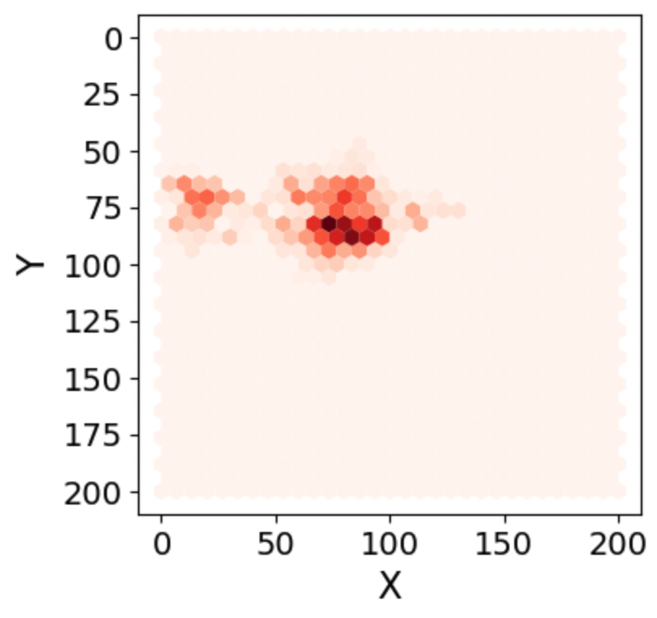
Plotting does not belong to the Walker
Live Coding
walker/Step_2_plotting/
Changing or adding new way of plotting (e.g. by a colleague) would require modifying the Walker’s code, without changing its behavior
Changing the Walker behavior will typically not modify the plotting code
Using your walker requires you to install matplotlib
These are smells of the fact that plotting varies independently of the Walker
plot_trajectory
plot_trajectory_hexbin
vs.
Notes:
THIS AS LIVE CODING
The real dependency is: plotting code requires a Walker’s trajectory, so it is the plotting that should depend on a Walker, not the other way around

Slide 23
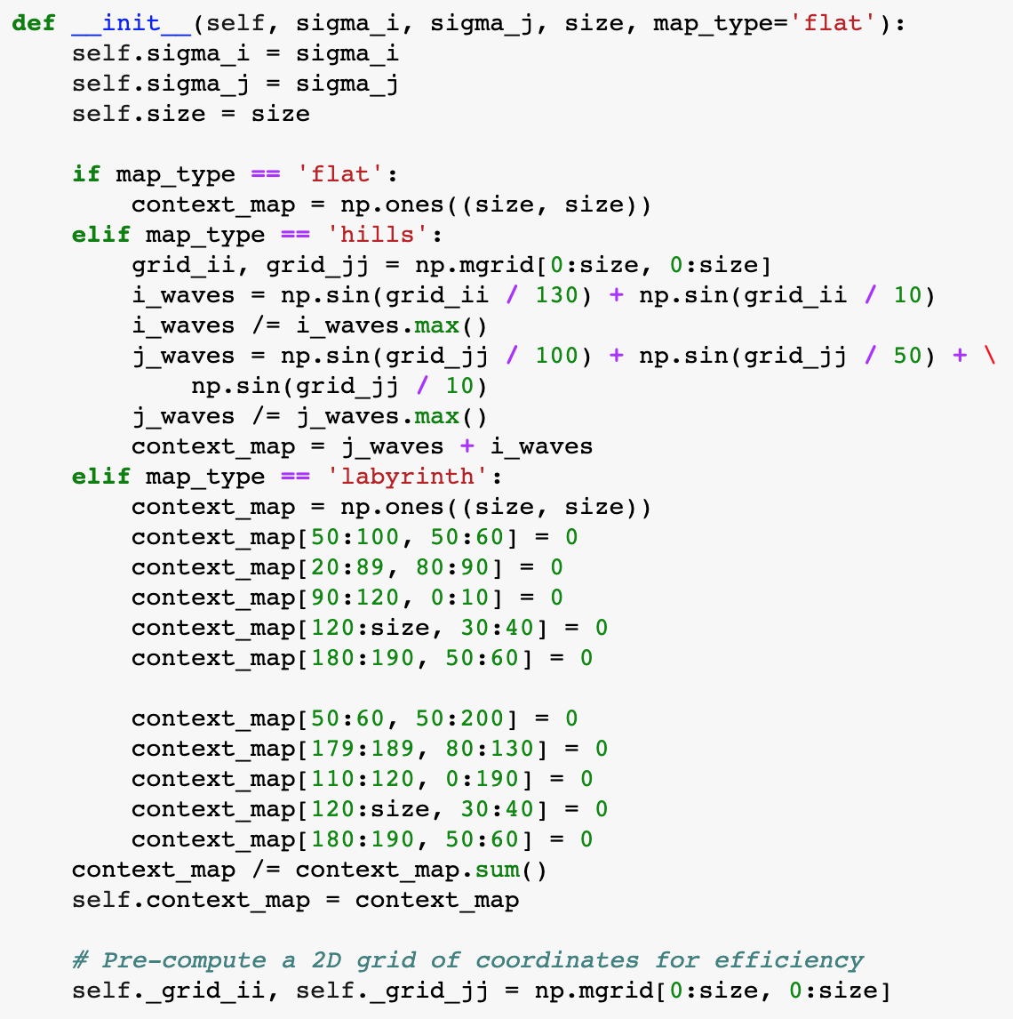
The smells of the Walker constructor

Slide 24
The smells of the Walker constructor
The constructor will become longer with more map types
We cannot contribute a new map type without modifying the code
It is difficult to test
It is not flexible, e.g. what happens if we want to create an instance from a context map saved on file?
These are smells of the fact that the initialization of context_map
varies independently of the Walker

Slide 25
if … elif … else chain is often the smell of independent plug-in blocks
def add_block(blocks, size, type):
if type == ‘circle’:
# build circle of given size
block =
elif type == ‘square’:
# build square of given size
block =
elif type == ‘triangle’:
# build triangle of given size
block =
blocks.append(block)
add_block(blocks, size=11,
type=‘square’)

Slide 26
if … elif … else chain is often the smell of independent plug-in blocks
def build_circle(size):
""" Build a circle. """
return
def build_square(size):
""" Build a square. """
return
def build_triangle(size):
""" Build a triangle. """
return
def add_block(blocks, block):
blocks.append(block)
def add_block(blocks, size, type):
if type == ‘circle’:
# build circle of given size
block =
elif type == ‘square’:
# build square of given size
block =
elif type == ‘triangle’:
# build triangle of given size
block =
blocks.append(block)
add_block(blocks, size=11,
type=‘square’)
block = build_square(size=11)
add_block(blocks, block)

Slide 27
Exercise
Conceptual Exercise
Moving context map creation to separate modules
Walker/Step_3_break_out ...
Go to the Notebook and follow the instructions there
Comment on Issue #3 on git.aspp.school, suggesting what you think the code should look like.

Slide 28
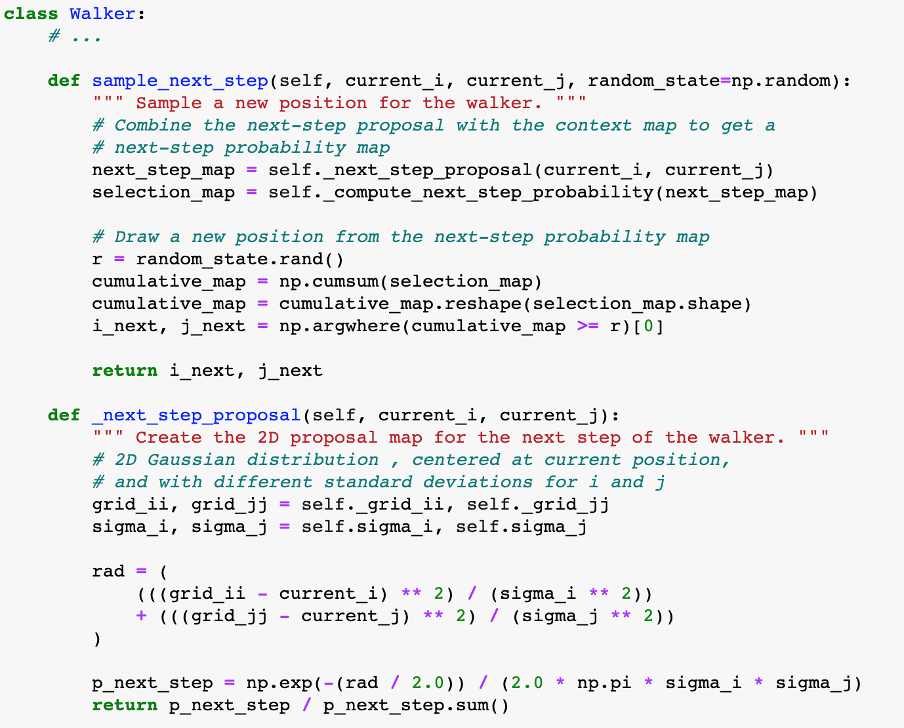
New requirement: we need to use different next-step proposals for different experiments
We would like to run some experiments with a Gaussian next step proposal, some with a rectangular proposal, etc.
How can we do that?

Slide 29
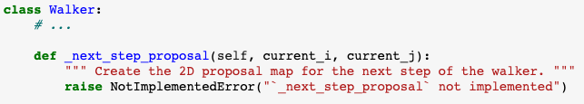
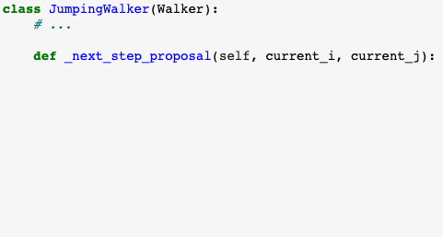
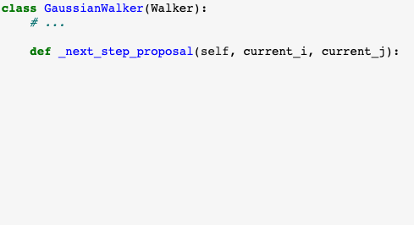
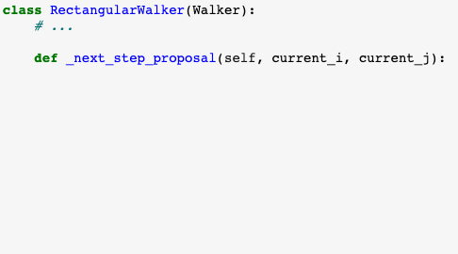
The inheritance solution

Slide 30
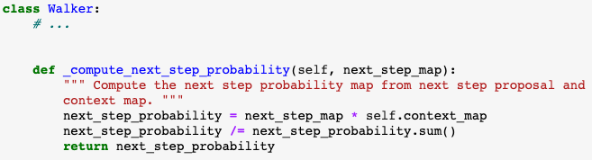
The problem with inheritance
New requirement: the way of combining next step proposal and context map can also vary
This combination can now be done through product, sum, or other

Slide 31
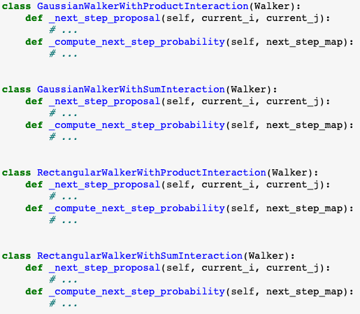
The problem with inheritance
The inheritance approach leads to a combinatorial explosion of subclasses
Gaussian
Rectangular
Jumping
Product
Sum
x
June 2023, v. 2.0, CC BY-SA 4.0

Slide 32
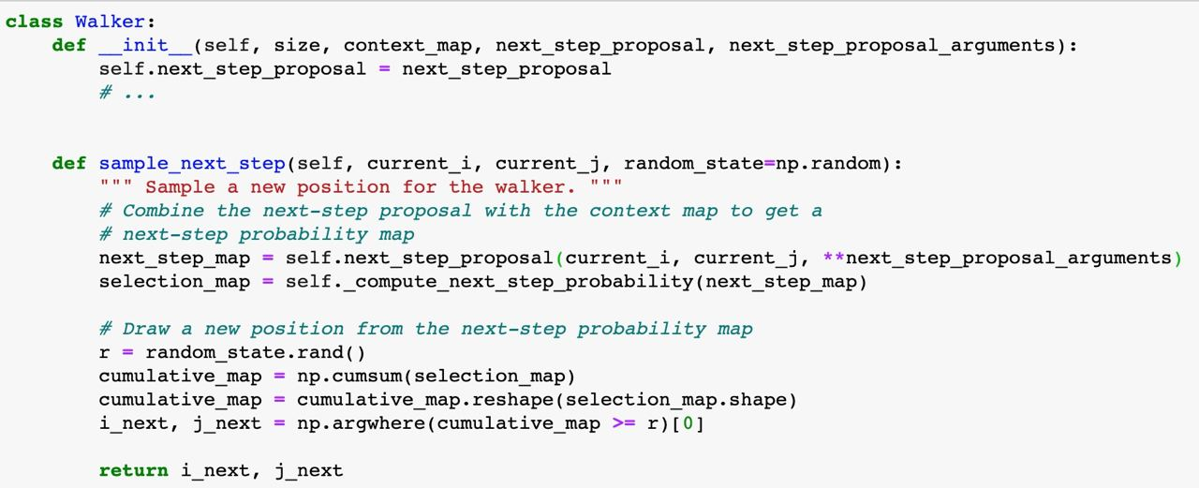
Passing varying behavior (e.g. functions) as an argument is usually a better alternative
In this way, we can define the behavior independently of the class, avoiding the combinatoric explosion

Slide 33
if … elif … else chain is often the smell of independent plug-in blocks
def add_block(blocks, size, type):
if type == ‘circle’:
# build circle of given size
block =
elif type == ‘square’:
# build square of given size
block =
elif type == ‘triangle’:
# build triangle of given size
block =
blocks.append(block)
add_block(blocks, size=11,
type=‘triangle’)

Slide 34
if … elif … else chain is often the smell of independent plug-in blocks
def build_circle(size):
""" Build a circle. """
return
def build_square(size):
""" Build a square. """
return
def build_triangle(size):
""" Build a triangle. """
return
def add_block(blocks, block):
blocks.append(block)
def add_block(blocks, size, type):
if type == ‘circle’:
# build circle of given size
block =
elif type == ‘square’:
# build square of given size
block =
elif type == ‘triangle’:
# build triangle of given size
block =
blocks.append(block)
add_block(blocks, size=11,
type=‘triangle’)
block = build_triangle(size=11)
add_block(blocks, block)

Slide 35
if … elif … else chain is often the smell of independent plug-in blocks
def build_circle(size):
""" Build a circle. """
return
def build_square(size):
""" Build a square. """
return
def build_triangle(size):
""" Build a triangle. """
return
def add_block(blocks, size, type):
if type == ‘circle’:
# build circle of given size
block =
elif type == ‘square’:
# build square of given size
block =
elif type == ‘triangle’:
# build triangle of given size
block =
blocks.append(block)
def add_block(blocks, size, block_builder):
block = block_builder(size)
blocks.append(block)
add_block(blocks, size=11,
type=‘square’)
add_block(blocks, size=11,
build_triangle)

Slide 36
if … elif … else chain is often the smell of independent plug-in blocks
def build_circle(size):
""" Build a circle. """
return
def build_square(size):
""" Build a square. """
return
def build_triangle(size, angle):
""" Build a triangle. """
return
def add_block(blocks, size, type):
if type == ‘circle’:
# build circle of given size
block =
elif type == ‘square’:
# build square of given size
block =
elif type == ‘triangle’:
# build triangle of given size
block =
blocks.append(block)
def add_block(blocks, size, block_builder, kw_args):
block = block_builder(**kw_args)
blocks.append(block)
add_block(blocks, size=11,
type=‘square’)
add_block(blocks, size=11,
build_triangle, {‘angle’: 35})

Slide 37
Exercise
Conceptual Exercise
Two next-step proposals
walker/Step_4_break_out ...
Go to the Notebook and follow the instructions there
Comment on Issue #4 on git.aspp.school, suggesting what you think the code should look like.

Slide 38

The Walker: what have we achieved?
We can run simulations with different combinations of context maps and next step proposals
New context maps and next step proposals can be contributed by external people without changing the code in your package, or even knowing how it works
We achieved flexibility and openness to change

Slide 39
Chapter 3: Separate what varies at the level of projects

Slide 40

The holy trinity of scientific computing
Provenance
Reproducibility
Organization

Slide 41
The holy trinity of scientific computing
Provenance
Reproducibility
Organization
It needs to be clear where data and plots come from, when and how they were generated
All information necessary to get the same result needs to be saved
For your own sanity, you should have a consistent system for all this data and artefacts

Slide 42
1. Provenance
Data Provenance, or lineage, documents where data comes from
Recording when and by which code the dataset has been changed
But HOW?
  External software? Usually not specific for scientific use case.
  Folder structure/Filenames?
  Code generated meta-information files? (see next slide)
In case of plots:
  data that generated the plots
  For work in progress plots: plt.annontate()
  Save .ipynb as pdf (with all the paths/version information in the notebook)
  Could use metadata in images https://github.com/dfm/savefig

Slide 43
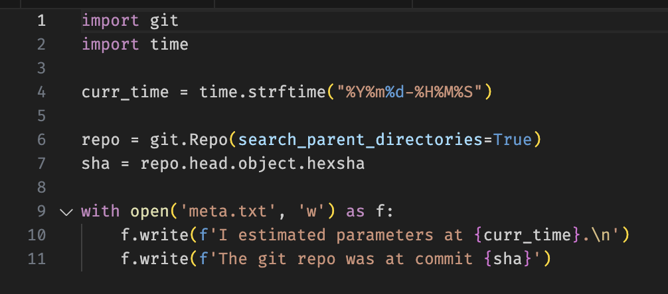
2. Reproducibility
Save all information necessary to get the same result again
  All input parameters to the code
  Randomness- if used, save the seed
  Which version of the code was used?
Serialization of intermediate steps in the code (estimation and analysis)

Slide 44
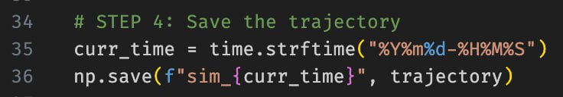
2. Reproducibility
We also recommend using file names containing a version number or a time stamp, so that two subsequent runs do not overwrite previous results

Slide 45
3. Organization
Research Project (Modelling)
Research Project (Analytical)
Model
Parameter Estimation
Analysis
and Plotting of Results
OR
Data Pre-processing pipeline
Statistical Analyses
Plotting of Results
Your research project may look something like this (or maybe you have different steps or a subset of steps)
In any case it is likely that you will go through the steps many times before you‘re ready to publish your work

Slide 46

3. Organization
Research Project
Model
Parameter Estimation
Analysis
and Plots of Results
Data
Estimation
Parameters
(input)
Estimated Model
Parameters
(output)
Simulated Data
Meta Data from estimation
(input, output)
Meta Data from Analysis
(input, output)
Each run has a bunch of associated data resulting folders and folders of data where no one knows which version of the code generated it or is using it!

Slide 47
3. Organization
Suggestion:
Data should always be separated from code
The model or algorithms or things that are applied to your data should be packages (see packaging lecture)
Think of “runs” as Experiments. Each experiment has its own folder. The folder contains:
  Minimal code that calls the model and saves the result
  All inputs necessary to produce the result saved separately
  Meta information about which version of your code was used (and maybe a note about what you were trying to achieve, if you want to be extra nice to future you)
  The result
  Maybe the visualization of the result
Research folder
data
model
projects
project_1
22_08_30_experiment
22_09_01_experiment
(1) run.py
(2) inputs.json
(3) meta.txt
(4) result.npy
(5) visualize.ipynb

Slide 48
Organization
Research folder
Base dataset
data
Provenance
Reproducibility
Organization
model
projects
Informative File/folder names
project_1
22_08_30_experiment
Info about when and how data was changed
22_09_01_experiment
Where does this data come from?
(1) run.py
(2) inputs.json
(3) meta.txt
(4) result.npy
(5) visualize.ipynb

Slide 49
Organization
Research folder
data
Provenance
Reproducibility
Organization
model
Code package that can be re-used
projects
project_1
22_08_30_experiment
Parameters, inputs, seed etc.
22_09_01_experiment
(1) run.py
Code version, date
(2) inputs.json
How do we reproduce these results?
(3) meta.txt
(4) result.npy
(5) visualize.ipynb

Slide 50
Organization
Research folder
data
Provenance
Reproducibility
Organization
model
Split code and analyses
Split data and code
projects
project_1
22_08_30_experiment
Separate folders for „experiments“ and „runs“
22_09_01_experiment
(1) run.py
(2) inputs.json
(3) meta.txt
(4) result.npy
(5) visualize.ipynb

Slide 51
Exercise
Provenance and Reproducibility
Exercise
walker/Step_5_reproducibility/
Go through the following steps:
Complete the run.py script
  - In the file, at the top we give the desired parameters for the run
  - create a context map and walker (see previous exercises for reference)
  - simulate a trajectory (see previous exercises for reference)
Save the trajectory using `np.save()`, and also save some metadata
Run the run.py script twice and confirm the results are identical by plotting them using the provided notebook
Submit PR for Issue #5 on GitHub

Slide 52
Provenance and Reproducibility
Live Coding
walker/Step_6_load_parameters_...

Slide 53
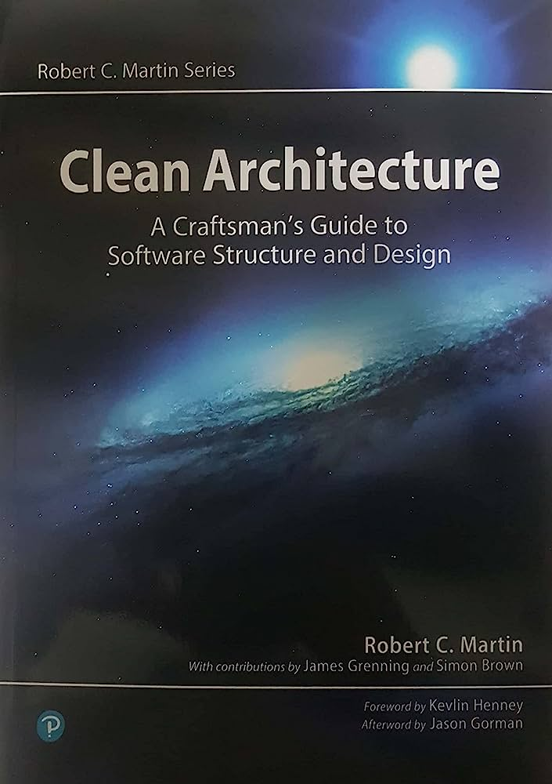
Where to go from here…
Trust your nose! When your code smells, spend some time figuring out where the smell come from
Don’t get carried away: over-engineering counts as premature optimization

Slide 54

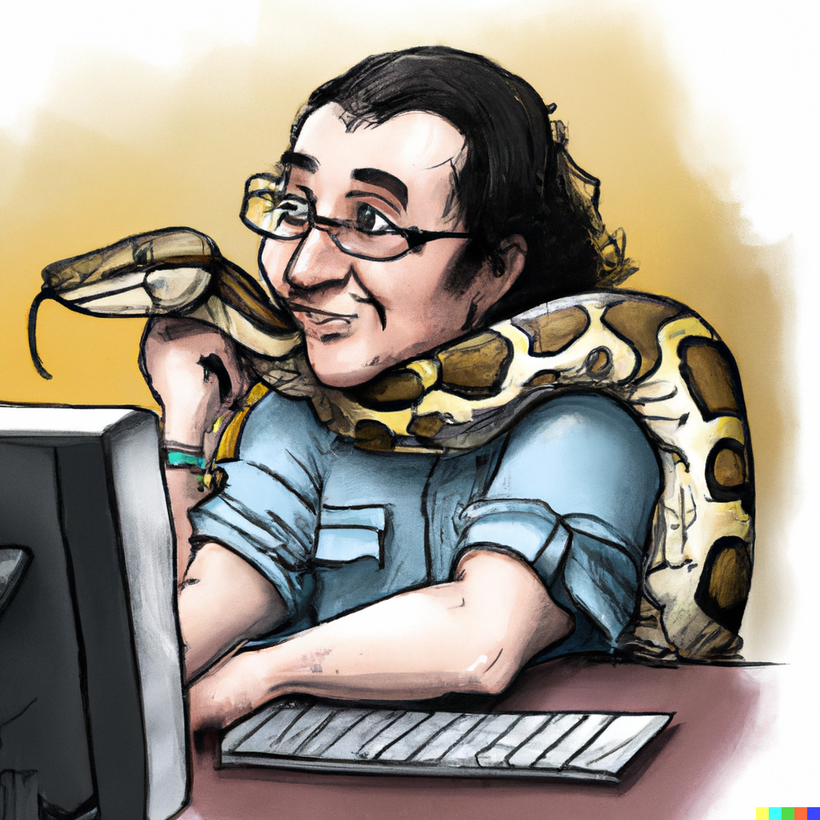
Thank you!

Slide 56
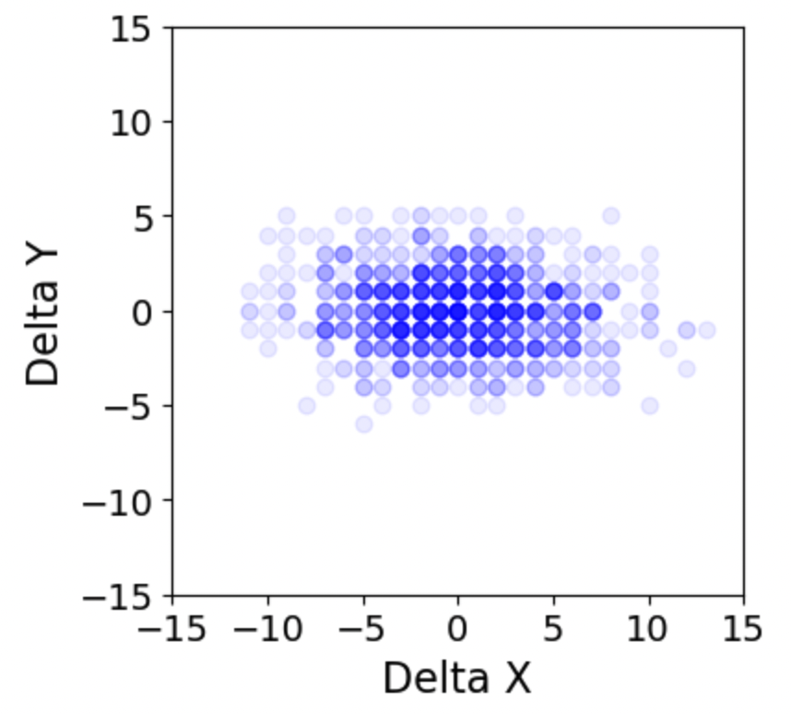
Hands-on
Move plotting code to a new module
Exercise
walker/Step 2 plotting/
Move plotting code to a separate plotting.py module
Modify the notebook to import the plots and make sure it runs
Add a new plotting function, plot_delta_trajectory, that plots a scatter plot of delta_x and delta_y for a (x, y) trajectory. Observe how we did not have to touch the walker.py file at all.
Submit a PR for Issue #2 on GitHub.

Slide 57
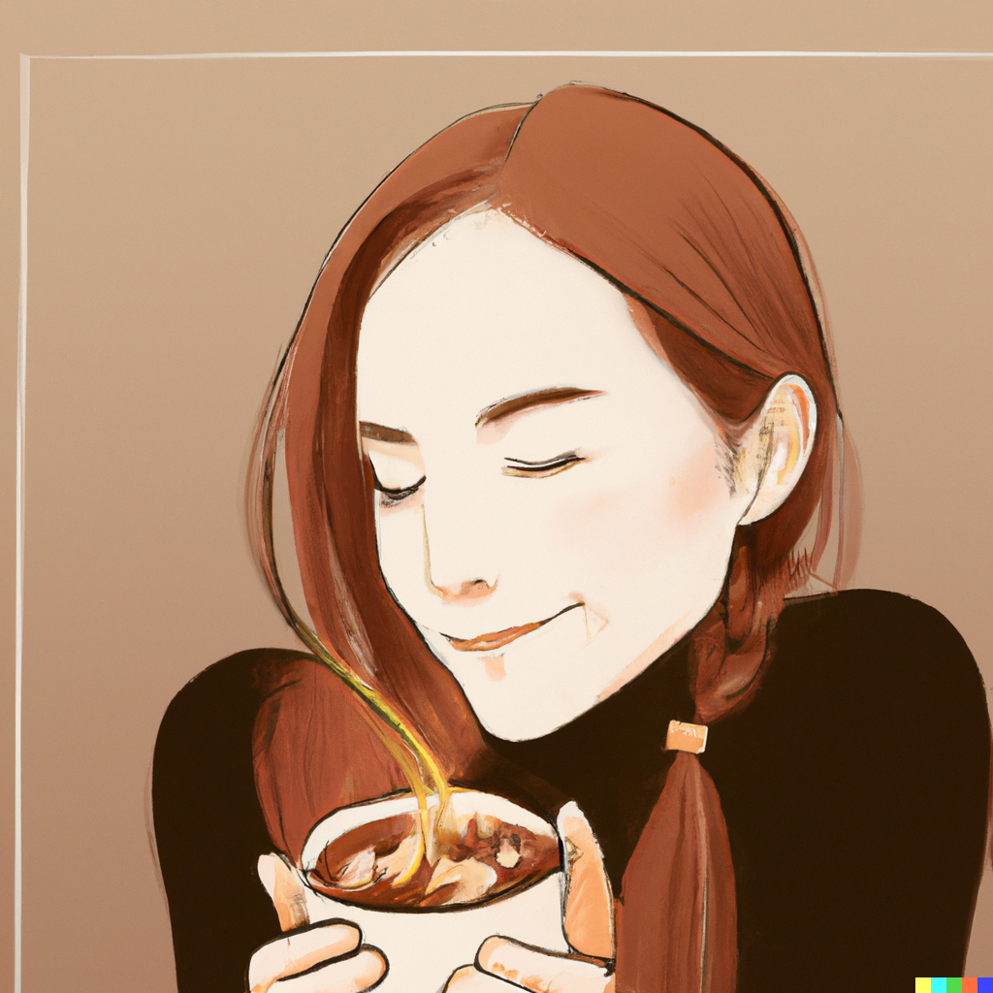
Here is how to fix it, class dismissed
What are you missing? A few patterns that make your code odor as nice as a spring meadow
Group together things that belong together
Break out things that vary independently
Keep code open for extension
Notes:
These constructs are not very common in scientific code, and you don’t actually ”need” them. But the same is true of functions!

Slide 58
Keep things open for extension
Bonus material

Slide 59
Hooks patterns
Bonus material
common cases:
  in graph traversing algorithms (e.g., depth-first search) the graph traversing is generic, but the operation to be done with the data on the nodes is specific to the application. Graph libraries often implement the traverversing, and allow implementing the operation through hooks (hook when first visiting node, and when all children are visited on the way back)
  in some UI frameworks, hooks can be added to react to certain UI events

Slide 60
Architecture discussion?
walker.from_data(data)
walker.fit(data)
walker_from_data(data), return fitted instance
fit(walker, data), return parameters
trajectory from walker
walker.trajectory(n_steps) (hooks might be useful)
trajectory(walker, n_steps) (hooks not so useful – just write another trajectory creator)

Slide 61
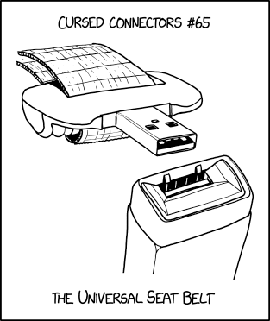
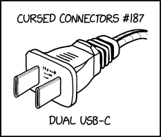
What is an API?
How is the interface between your code and your manager scripts?
Other things to consider when writing your code:
  Who will be using it?
    Maybe your code has a practical application
    Even if it‘s most likely no one, imagine someone trying to replicate your research after you publish
  Are there parts of the code you may want to use in your next project?
    E.g. a fitting algorithm can be reused when you move on to the next model
    E.g. a class for your data may be reusable for the next dataset

