Slide 1
Testing scientific code
Because you’re worth it
Lisa Schwetlick and Pamela Hathway

Slide 2
Introduction to testing project

Slide 3

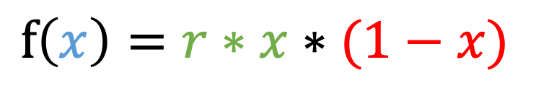
Excursion: Logistic Map
Simple, discrete model for population growth
reproduction
$$f\left(x\right)=r∗x∗(1−x)$$
starvation
growth rate, 0…4
current population size, as fraction of maximum possible size, 0…1
Notes:
The logistic map is a discrete dynamical system
Often used to model population growth
2 terms: reproduction term and starvation term
Uses x as current population, equation finds the population at the next discrete time step

Slide 4
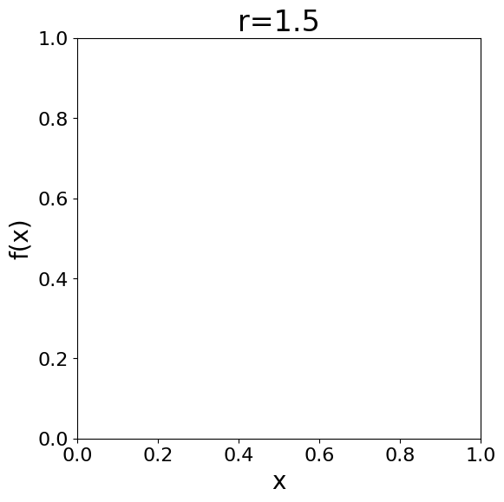
Excursion: Logistic Map
Simple, discrete model for population growth
reproduction
$$f\left(x\right)=r∗x∗(1−x)$$
starvation
growth rate, 0…4
current population size, as fraction of maximum possible size, 0…1
Next population size
(e.g. # bunnies in 2026)
Current population size (e.g. # bunnies in 2025)
Notes:
The logistic map is a discrete dynamical system

Slide 5
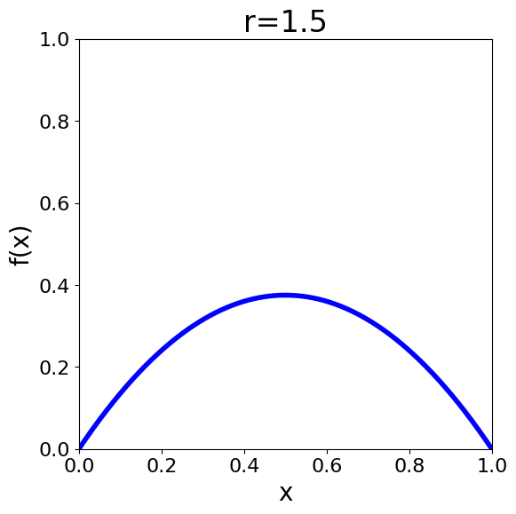
Excursion: Logistic Map
Simple, discrete model for population growth
reproduction
$$f\left(x\right)=r∗x∗(1−x)$$
starvation
growth rate, 0…4
current population size, as fraction of maximum possible size, 0…1
Next population size
(e.g. # bunnies in 2026)
Current population size (e.g. # bunnies in 2025)
Notes:
The logistic map is a discrete dynamical system

Slide 6
Excursion: Logistic Map
Simple, discrete model for population growth
reproduction
$$f\left(x\right)=r∗x∗(1−x)$$
starvation
growth rate, 0…4
current population size, as fraction of maximum possible size, 0…1
Next population size
(e.g. # bunnies in 2026)
reproduction
dominates
starvation
dominates
Current population size (e.g. # bunnies in 2025)
Notes:
The logistic map is a discrete dynamical system

Slide 7
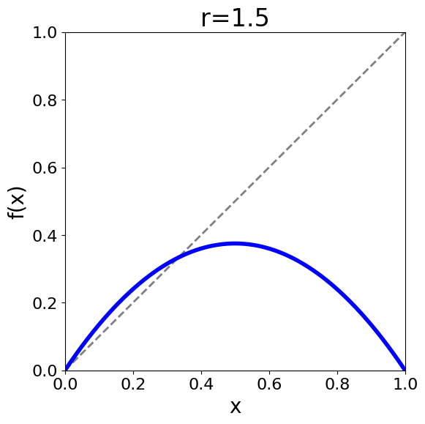
Excursion: Logistic Map
Simple, discrete model for population growth
reproduction
$$f\left(x\right)=r∗x∗(1−x)$$
starvation
growth rate, 0…4
fixed point:
x = f(x)
current population size, as fraction of maximum possible size, 0…1
Next population size
(e.g. # bunnies in 2026)
Current population size (e.g. # bunnies in 2025)
Notes:
A fixed point is when the population stabilizes because x = f(x)

Slide 8
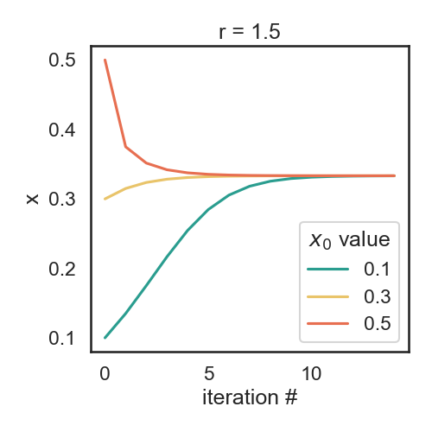
Excursion: Logistic Map
x₀ : initial population size
Iterated function: f(x₀)=x₁ -> f(x₁)=x₂ -> f(x₂)=x₃
Population size
(e.g. # bunnies)
converges
to fixed point
Time (e.g. year)
Notes:
Now we plot over iteration (i.e. time) instead

Slide 9
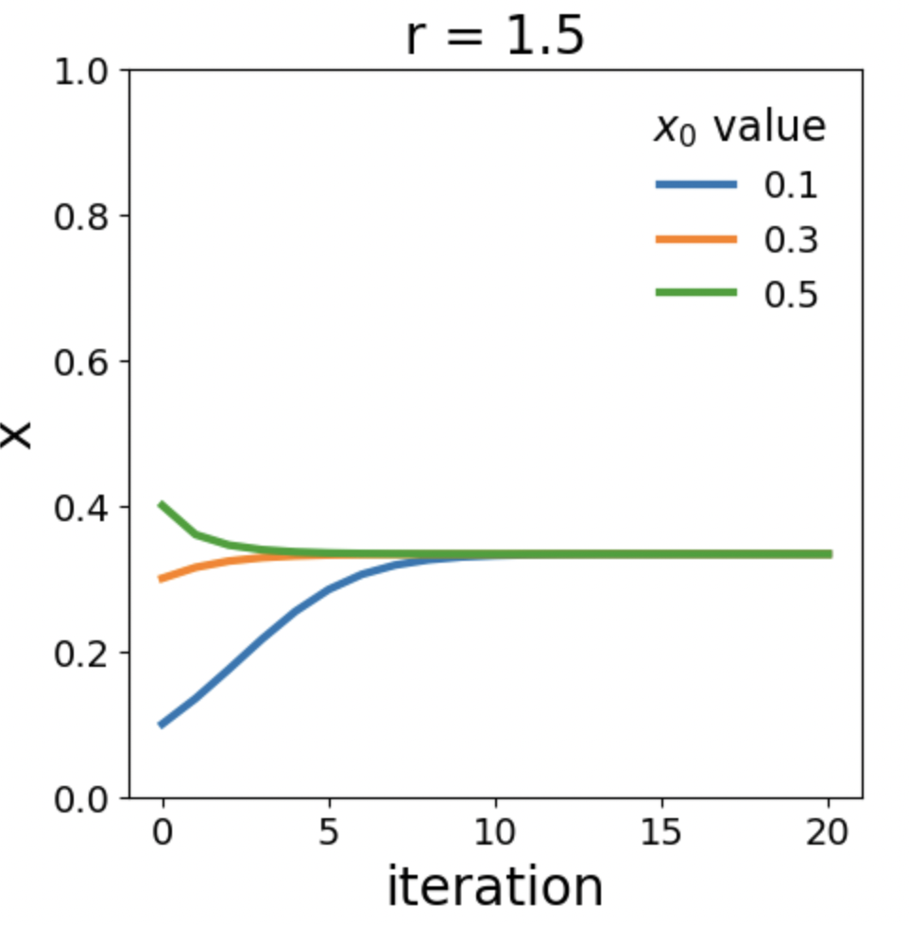
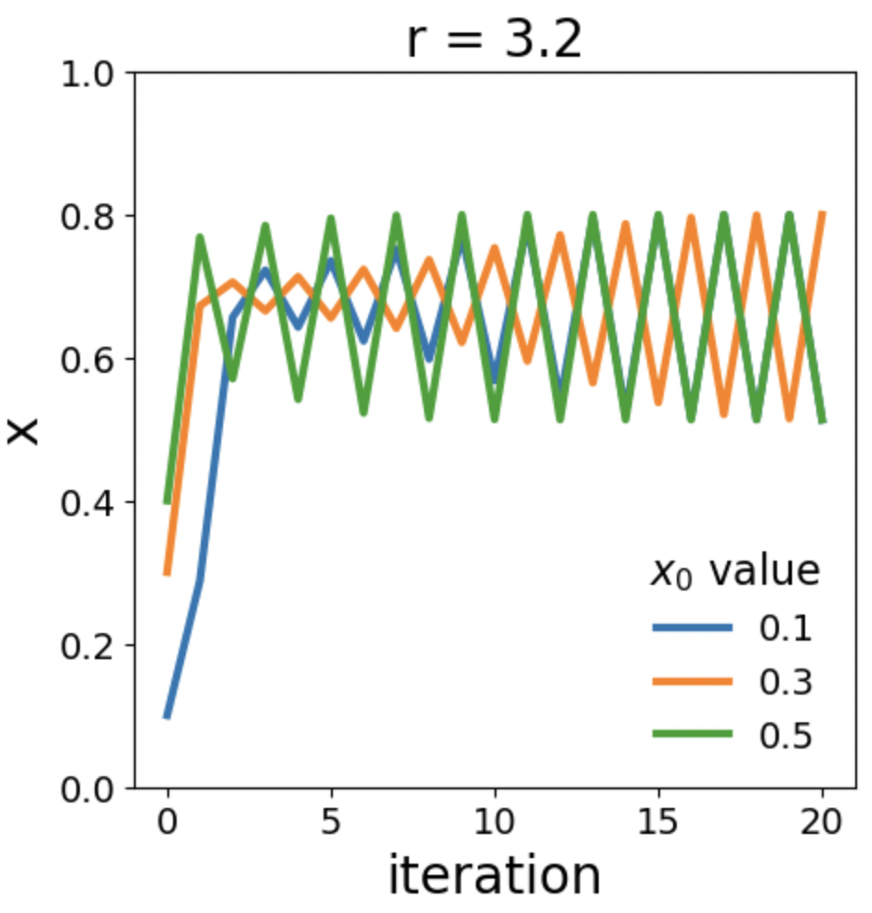
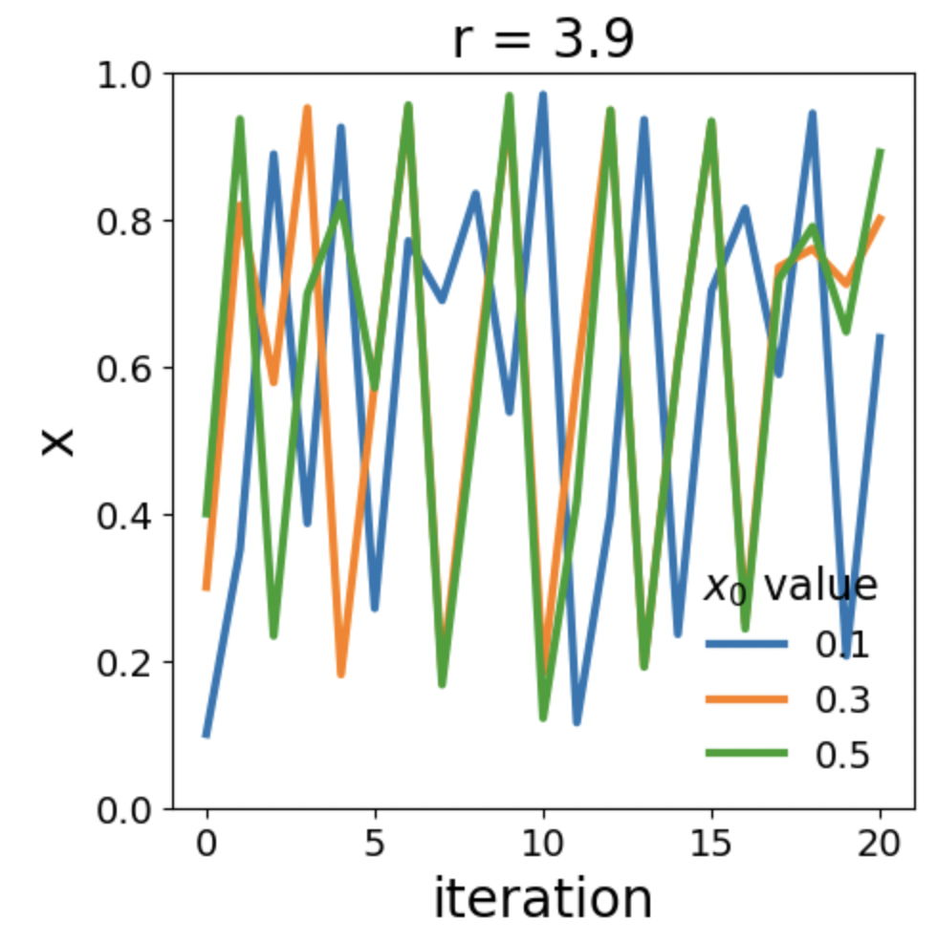
Excursion: Logistic Map
Different growth rates lead to a variety of population dynamics
Convergence
to fix point
Convergence
to oscillations
Chaos

Slide 10

Testing patterns

Slide 11
What does a good test look like? What should I test?
Good:
  Short and quick to execute
  Easy to read
  Tests one thing
Bad:
  Relies on data files
  Messes with “real-life” files, servers, databases
Notes:
We saw how to test, but what is a good test? and what should we test?

Slide 12
Basic structure of test
  Given: Put your system in the right state for testing
    Create data, initialize parameters, define constants…
  When: Execute the feature that you are testing
    Typically, one or two lines of code
  Then: Compare outcomes with the expected ones
    Define the expected result of the test
    Set of assertions that check that the new state of your system matches your expectations

Slide 13
Test simple but general cases
Start with simple, general case
  Take a realistic scenario for your code, try to reduce it to the simplest example
Example: Tests for ‘lower’ method of strings
def test_lower():
# Given
string = 'HeLlO wOrld'
expected = 'hello world'
# When
output = string.lower()
# Then
assert output == expected

Slide 14
Test special cases and boundary conditions
Code often breaks in corner cases: empty lists, None, NaN, 0.0, lists with repeated elements, non-existing file, …
This often involves making design decision: handle corner case with special behavior, or raise a meaningful exception?
def test_lower_empty_string():
# Given
string = ''
expected = ''
# When
output = string.lower()
# Then
assert output == expected
Other good corner cases for string.lower():
  ‘do-nothing case’: string = 'hi'
  symbols: string = '123 (!'
Notes:
First of all, you should start with testing your code with
explain typical test structure
show general case: two words, upper case chars randomly dispersed
special cases

Slide 15
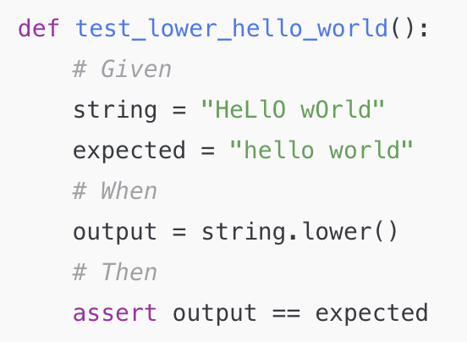
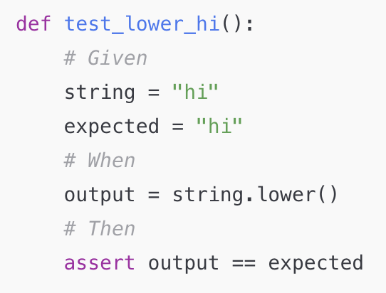
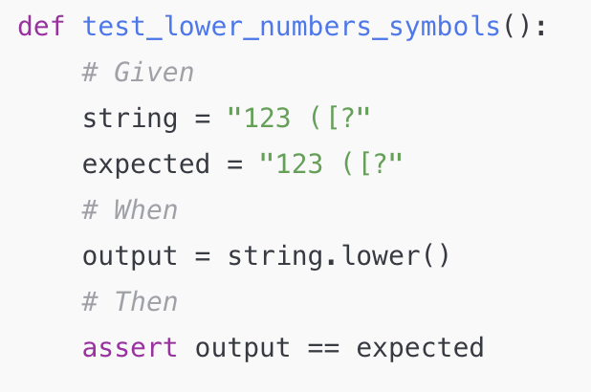
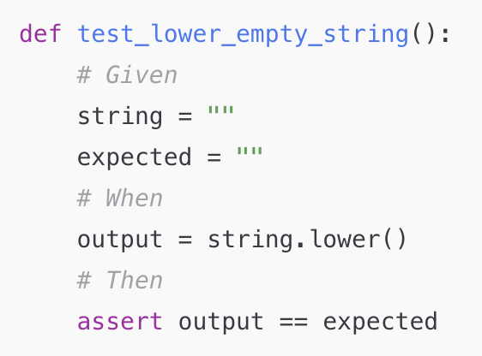
Similar testcases

Slide 16
Common for-loop pattern for testing multiple cases
Often these cases are collected in a single test:
def test_lower():
# Given
# Each test case is a tuple of (input, expected_result)
test_cases = [('HeLlO wOrld', 'hello world'),
('hi', 'hi'),
('123 ([?', '123 ([?'),
('', '')]
for string, expected in test_cases:
# When
output = string.lower()
# Then
assert output == expected

Slide 17
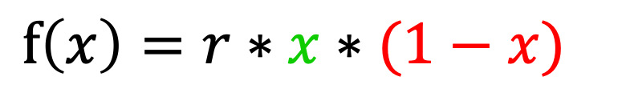
Discuss!
$$f\left(x\right)=r∗x∗(1−x)$$
Take a look at the logistic map
or, in Python
What should we test?
  Generic cases
  Corner cases
def f(x, r):
""" Compute the logistic map for a given value of x and r. """
return r * x * (1 - x)
Notes:
Generic: what would convince you that it works? would 1 value be sufficient? where do we find the values?
compute by hand, look it up, fixed points -- the important is that the source is independent
would writing the function, running it, then using the output as a test value be meaningful? only to avoid regressions
Corner cases: x = 0, x= 1
Error cases (r<=0, r>=4, x<0, x>1)

Slide 18
Hands-on 1!
In the testing_project folder, open the file logistic.py and implement the logistic function, f(x, r)
In test_logistic.py we already added a reference test for these corner cases:
  x=0, r=1.1 => f(x, r)=0
  x=1, r=3.7 => f(x, r)=0
Add a new test for these generic cases using the for-loop pattern:
  x=0.1, r=2.2 => f(x, r)=0.198
  x=0.2, r=3.4 => f(x, r)=0.544
  x=0.5, r=2 => f(x, r)=0.5

Slide 19
The for-loop pattern can be improved
It is repetitive to write the for-loop pattern
If one of the cases breaks, it can be complicated to figure out which one
pytest has many helpers for simplifying common testing cases!
One of them is the parametrize decorator, that simplifies running the same test with multiple cases

Slide 20
Simple example
def test_for_loop_simple():
cases = [1, 2, 3]
for a in cases:
assert a > 0
test_for_loop_simple runs once and loops over
3 test cases

Slide 21
Simple example, with the parametrize decorator
Name of the variable that varies
List of values for the variable
test_parametrize_simple runs 3 times
with a=1, a=2, and a=3
@pytest.mark.parametrize('a', [1, 2, 3])
def test_parametrize_simple(a):
assert a > 0
The test must take an argument with the same name
Notes:
Remember to import pytest!

Slide 22
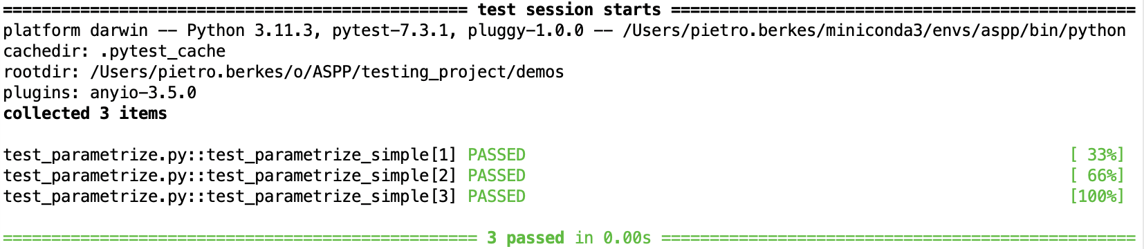
Simple example, with the parametrize decorator
Name of the variable that varies
List of values for the variable
@pytest.mark.parametrize('a', [1, 2, 3])
def test_parametrize_simple(a):
assert a > 0
The test must take an argument with the same name
pytest automatically creates one separate test for each test case

Slide 23
Example with multiple values
This is a more typical case with several input values and the expected result of the test
def test_for_loop_multiple():
cases = [
(1, 'hi', 'hi’),
(2, 'no', 'nono’)
]
for a, b, expected in cases:
result = b * a
assert result == expected
test_for_loop_multiple runs once and loops over
2 test cases

Slide 24
Same example, with the parametrize decorator
Name of all the variables, separated by commas in one string
List of tuples with the values for each varialbe, one for each test case
@pytest.mark.parametrize('a, b, expected', [(1, 'hi', 'hi'), (2, 'no', 'nono')])
def test_parametrize_multiple(a, b, expected):
result = b * a
assert result == expected
The test must take arguments with the same names as in the string
test_parametrize_multiple runs 2 times with
1) a=1 b=‘hi’ expected=‘hi’
and
2) a=2 b=‘no’, expected=‘nono’

Slide 25
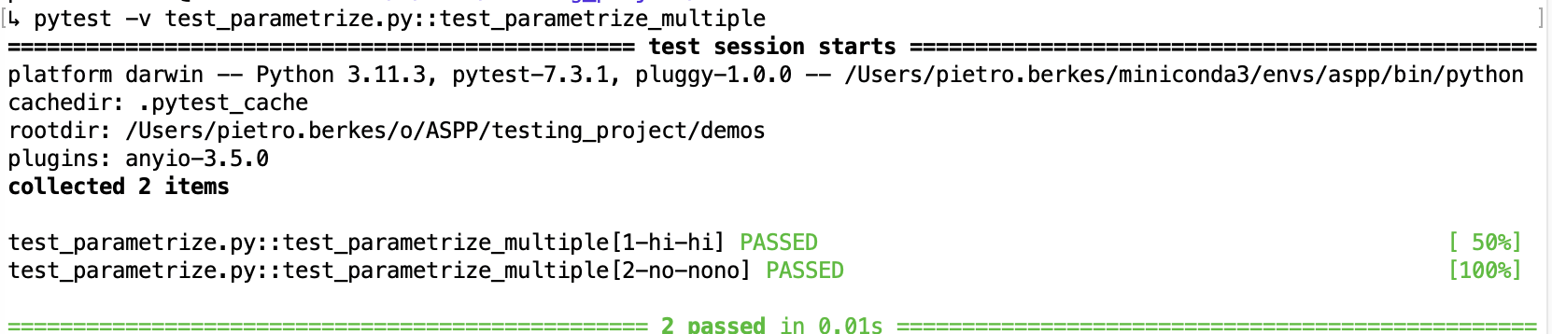
Same example, with the parametrize decorator
Name of all the variables, separated by commas in one string
List of tuples with the values for each varialbe, one for each test case
@pytest.mark.parametrize('a, b, expected', [(1, 'hi', 'hi'), (2, 'no', 'nono')])
def test_parametrize_multiple(a, b, expected):
result = b * a
assert result == expected
The test must take arguments with the same names as in the string
pytest automatically creates one separate test for each test case

Slide 26
Hands-on 2!
Rewrite the test with the generic cases for the logistic map using parametrize
Reference example for the corner cases test:
import pytest
@pytest.mark.parametrize('x, r, expected', [
(0, 1.1, 0),
(1, 3.7, 0),
]
)
def test_f_special_x_values(x, r, expected):
result = f(x, r)
assert_allclose(result, expected)

Slide 27
Hands-on 3! Simulate a population over time
  Implement a function iterate_f that runs f for it iterations.
  Write tests for the following cases:
    x=0.1, r=2.2, it=1
    => iterate_f(it, x, r)=[0.1, 0.198]
    x=0.2, r=3.4, it=4
    => iterate_f(it, x, r)=[0.2, 0.544, 0.843418, 0.449019, 0.841163]
    x=0.5, r=2, it=3
    => iterate_f(it, x, r)=[0.5, 0.5, 0.5]
  (Bonus) Import the plot_trajectory function from the plot_logistic module and use it to visualize the trajectories generated by your code.
  Try with values r<3, and 3<r<4 to get an intuition for how the function behaves differently with different parameters.

Slide 28
Strategies for testing scientific code

Slide 29
Strategies for testing learning algorithms
Learning algorithms can get stuck in local maxima, the solution for general cases might not be known (e.g., unsupervised learning)
Turn your validation cases into tests
Stability tests:
  Start from final solution; verify that the algorithm stays there
  Start from solution and add a small amount of noise to the parameters; verify that the algorithm converges back to the solution
Parameter Recovery: Generate synthetic data from the model with known parameters, then test that the code can learn the parameters back
Notes:
…
There is no general rule for testing these algorithm, for each specific algorithm there are usually validation cases (e.g, a classifier might be validated using two classes of very different objects)

Slide 30
Learning algorithms fit the parameters of a model to observed data
y = ax + b + noise
a = -1.2
b = 3

Slide 31
Generate synthetic data from the model to test the learning algorithm by recovering the parameters
1) Fix initial parameters
a* = 0.5
b* = -1.3

Slide 32
Generate synthetic data from the model to test the learning algorithm by recovering the parameters
1) Fix initial parameters
2) Generate synthetic data
y = a* x + b*
+ noise
a* = 0.5
b* = -1.3

Slide 33
Generate synthetic data from the model to test the learning algorithm by recovering the parameters
1) Fix initial parameters
2) Generate synthetic data
y = a* x + b*
+ noise
a* = 0.5
b* = -1.3
3) Run the algorithm
a = 0.5098
b = -1.287
y = ax + b
+ noise

Slide 34
Generate synthetic data from the model to test the learning algorithm by recovering the parameters
1) Fix initial parameters
2) Generate synthetic data
y = a* x + b*
+ noise
a* = 0.5
b* = -1.3
4) Compare
3) Run the algorithm
a = 0.5098
b = -1.287
y = ax + b
+ noise

Slide 35
Hands-on 4! Recover the population growth, r
  In the module logistic_fit, we implemented a function fit_r that, given a population trajectory, finds the value of r that generated it
  For example:
In [1]: from logistic import iterate_f
In [2]: from logistic_fit import fit_r
In [3]: xs = iterate_f(it=23, x0=0.3, r=3.421)
In [4]: fit_r(xs)
Out[4]: 3.4210000000000003

Slide 36
Hands-on 4!
  Write a test for the function fit_r using the parameters recovery method in a new test_logistic_fit.py test file.
  The test should
    Set a initial value for x0 and r
    Use iterate_f to generate a population trajectory
    Pass the population trajectory to fit_r and collect the result parameters
    Check that the fitted r is close enough to the original r
In [1]: from logistic import iterate_f
In [2]: from logistic_fit import fit_r
In [3]: xs = iterate_f(it=23, x0=0.3, r=3.421)
In [4]: fit_r(xs)
Out[4]: 3.4210000000000003
Notes:
No need to parametrize this at all.

Slide 37

Randomness in Testing can be useful
… to check that the code is stable and works correctly in many different cases
… to find corner cases or numerical problems
def test_logistic_fit_randomized():
random_state = np.random.RandomState(SEED)
for _ in range(100):
x0 = random_state.uniform(0.0001, 0.9999)
r = round(random_state.uniform(0.001, 3.999), 3)
xs = iterate_f(it=17, x0=x0, r=r)
recovered_r = fit_r(xs)
assert_allclose(r, recovered_r, atol=1e-3)
Notes:
What this code does: try 100 times with a random starting point and rate, to recover r.
But what happens if this fails?

Slide 38
Random Seeds and Reproducibility
When running tests that involve radomness and some test doesn’t pass it is vital to be able to reproduce that test exactly!
Computers produce pseudo-random numbers: setting a seed resets the basis for the random number generator
This is essential for reproducibility
At a minimum, you should manually set the seed for each of your random tests
SEED = 42
random_state = np.random.RandomState(SEED)
random_state.rand()
Notes:
numpy.random.RandomState!
random_state = np.random.RandomState(SEED)
random_state.rand()
otherwise using the global seed, if any external library uses np.random it can screw up the determinism

Slide 39
Hands On 5!
  In test_logistic_fit.py write a randomized test that checks that fit_r can recover r for any random value of x0 and r
    Write a for loop of 100 iterations, in each iteration create a random x0 and r
    Test that fit_r(xs) == r , where xs = iterate_f(…)

Slide 40
A Pytest Solution
Non-scientific coding uses random testing more rarely, so there is no helper tools for that in pytest
However, in scientific coding it is quite common
What do we want?
  For each (random) test there should be a seed
  For each run of the test, the seed should be different
  That seed should be printed with the test result
  It needs to be possible to explicitely run the test again with that seed!
Notes:
Problem with that: still need to manually change the seed, remember the seed, etc
So I’m going to show you 2 very magical things:
Livecode from solution:
Look at the part we would like to be separate
Say: okay, wouldn’t it be nice if this were just a thing that I can run separately just at the beginning
We still need the SEED globvar at the top, so we can still rerun

Slide 41
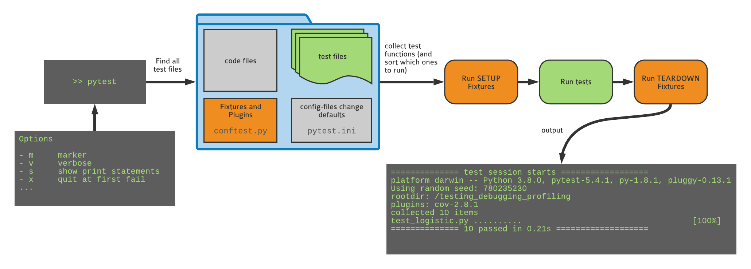
What happens when you run pytest?

Slide 42
Stop! Fixtures???
A fixture is a reusable setup tool: mostly used for integration tests/pipeline-level tests
It’s a function that prepares some data, objects, or state that your test needs, so you don’t have to repeat the same setup code in every test.
e.g.
Generate some synthetic data
Create temporary files
Create some synthetic environment
  like connection to microscope test environment or a server
e.g.
delete temporary files
Shut down some synthetic environment

Slide 43
What happens when you run pytest
this is where our extra setup and teardown code can live

Slide 44

Conftest.py
conftest.py is a special pytest config file
(don’t import it!)
conftest.py can be used to define custom behavior or plugins. Fixtures can also be defined here, so that they can be used by all tests.

Slide 45
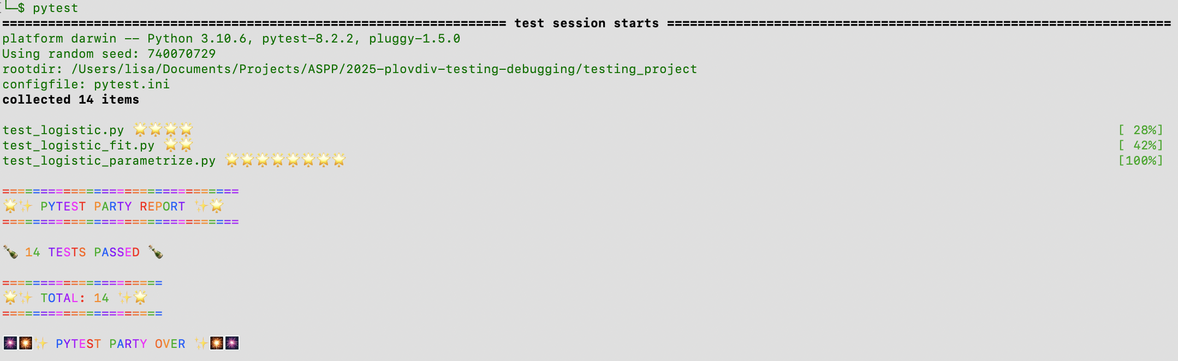

Slide 46
Setting up randomness
What do we want?
  For each (random) test there should be a seed
  For each run of the test, the seed should be different
  That seed should be printed with the test result
  It needs to be possible to explicitely run the test again with that seed!
A setup fixture, called before any tests are run:
  Creates a random state for the tests to use
  Picks a random SEED by default
  Prints that SEED with the test results
  Allows us to input a SEED so we can reproduce a speific run
Notes:
Problem with that: still need to manually change the seed, remember the seed, etc
So I’m going to show you 2 very magical things:
Livecode from solution:
Look at the part we would like to be separate
Say: okay, wouldn’t it be nice if this were just a thing that I can run separately just at the beginning
We still need the SEED globvar at the top, so we can still rerun

Slide 47
Hands On 5!
  Write a randomized test that checks that fit_r can recover r for any random value of x0 and r
  Add the conftest.py file the root directory of the project (hint: it is hiding in the demos folder!). It sets a random seed before each run and makes it possible to reproduce failures in random tests
  conftest.py defines a new random_state fixture. Modify your test to take random_state (the name of the fixture) as an argument. You can then use it like a regular variable:
  def test_random_convergence_decorator(random_state)
  Check that the console output of pytest now includes the seed and that you can pass a seed too using --seed 123123!
Notes:
If an input argument of a test matches the name of a fixture, then the fixture is called and the return value assigned to the argument.
pytest handles that automatically as part of running the test suite

Slide 48
Other commonly used helpers in pytest

Slide 49
Decorating “special” tests
@xfail: Expected failure, outputs an “x” (or “X”) in the report
@skip: Skip test, useful e.g. when the feature doesn’t exist yet
@skipif: Skip the test if a condition is met, useful for tests that only works on a specific platform, or for a specific version of Python
@pytest.mark.xfail
def test_something():
...
@pytest.mark.skip(reason=“functionality not yet implemented”)
def test_something():
...
@pytest.mark.skipif(sys.version_info < (3, 10),
reason="requires python3.10 or higher")
def test_something():
...

Slide 50
Marking tests with custom markers
If you have lots of tests, you can categorize them with your own markers
  although for custom mark names you need to register the marks “pytest.ini”
  https://docs.pytest.org/en/7.1.x/example/markers.html#registering-markers
Example:
  Smoke tests check for really basic features: run these frequently
  Other tests may be many or too slow to run every time and test for more edge cases
@pytest.mark.smoke
def test_something_basic():
...
> pytest –m smoke
> pytest –m ”smoke and not slow”

Slide 51
Writing temporary files: tmp_path
To test functions that write to disk without leaving around the files when the test is finished, use the tmp_path fixture
The value of tmp_path is a pathlib.Path object
The directory is created at the start of the test, and removed at the end
def test_create_file(tmp_path):
d = tmp_path / "sub"
d.mkdir()
p = d / "hello.txt"
content = "some random text"
p.write_text(content)
assert p.read_text() == content
assert len(list(tmp_path.iterdir())) == 1
All you need to do is add an argument with this exact name

Slide 52

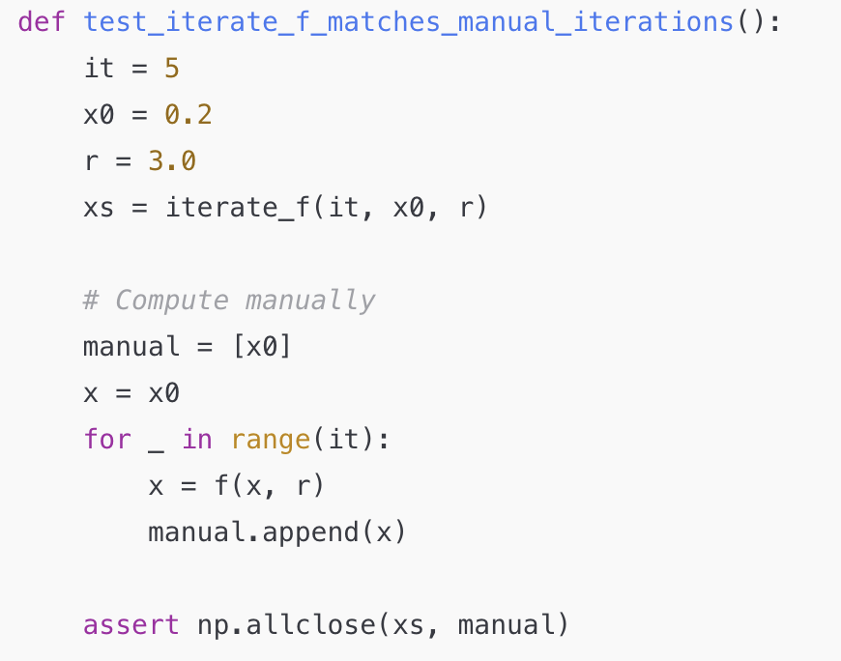
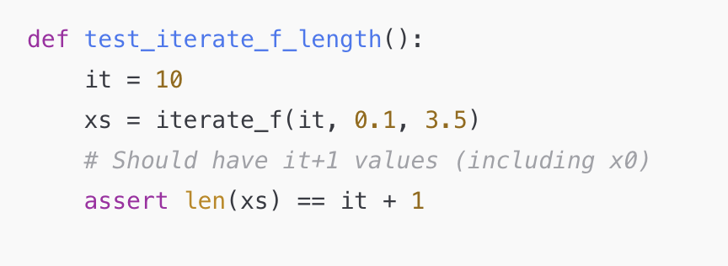
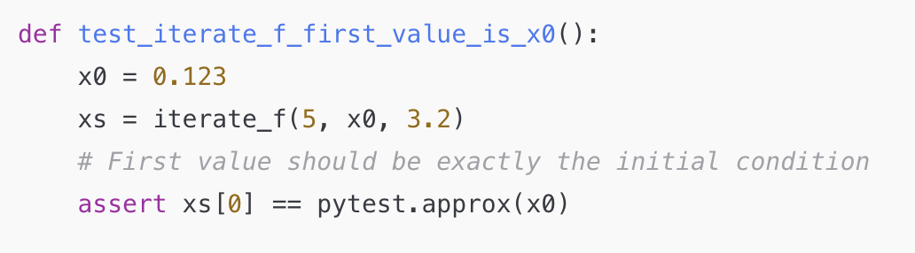
Hi, ChatGPT, write some tests for logistic.py !
… aside for generating very satisfying dots in pytest, are these tests useful?

Slide 53

If you must….
… at least ask yourself:
Does this test just re-implement my function?
Does this test use my function in a sane way/context?
Does this test check something that can actually plausibly go wrong?
  e.g. the length of a list in a function that just iterates and appends would be quite strange to go wrong.
Does this test check something that is critical if it fails?
  e.g. checking function does not return NaN -> maybe that’s not the worst case
Does this test use code that I don’t understand?
  Or does it use python code that I would never normally use and/or won’t understand when I check back in a few months.

Slide 54
Final exercise

Slide 55
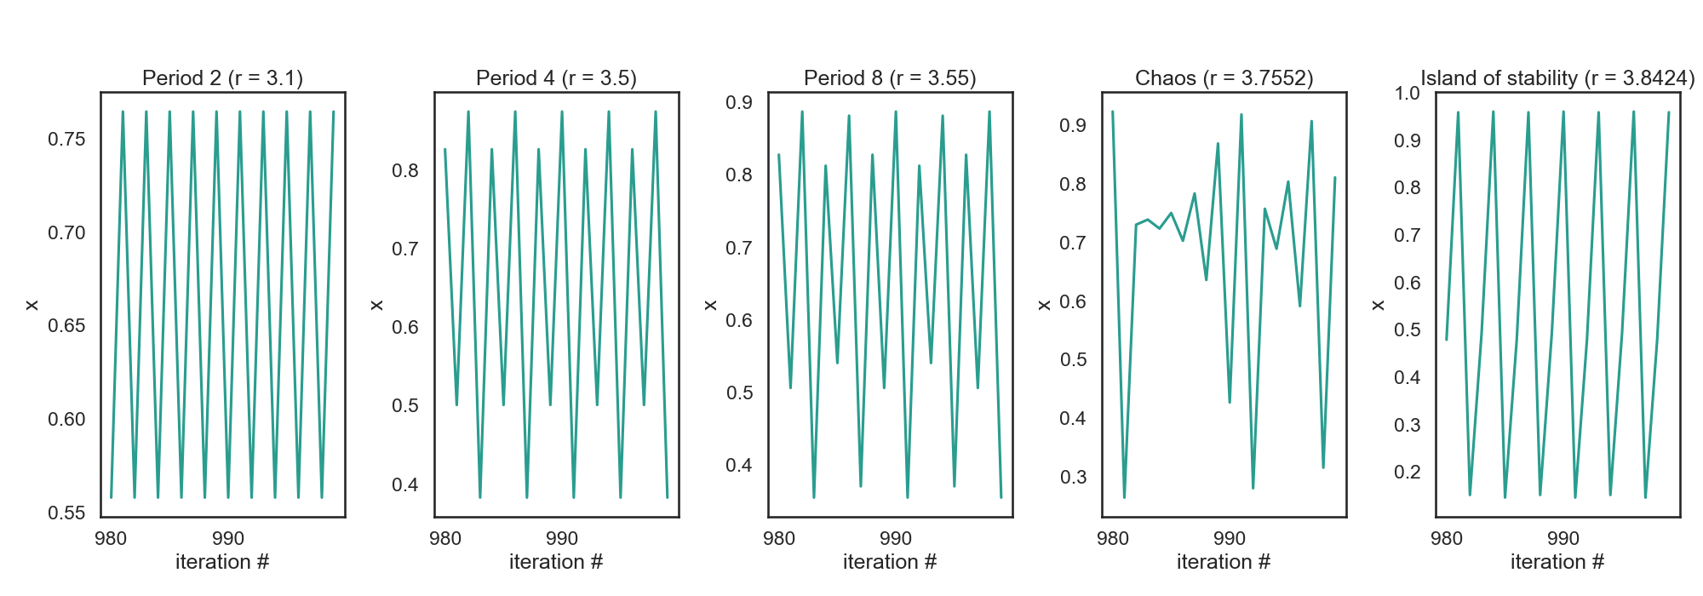
Excursion: Logistic map
Between r=3 and r=4 the logistic map has a range of behaviors
Periodic vs. chaotic

Slide 56
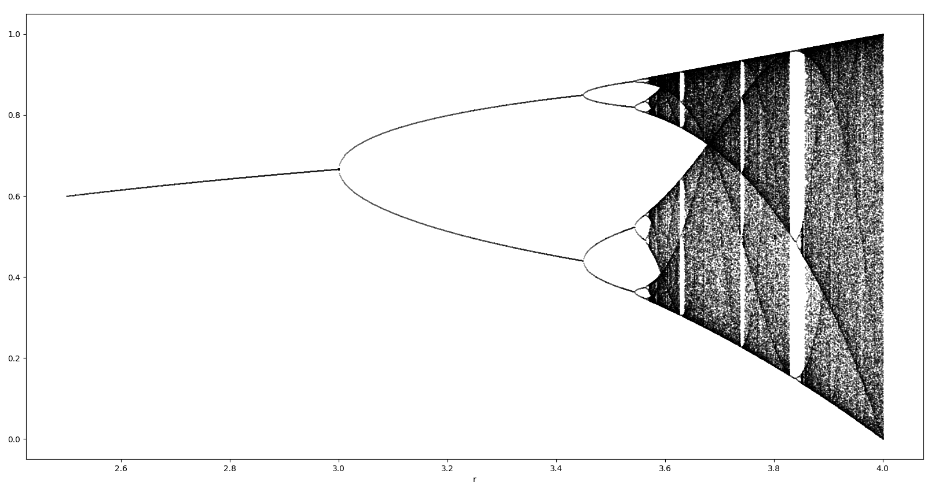
Excursion: Logistic map

Slide 57
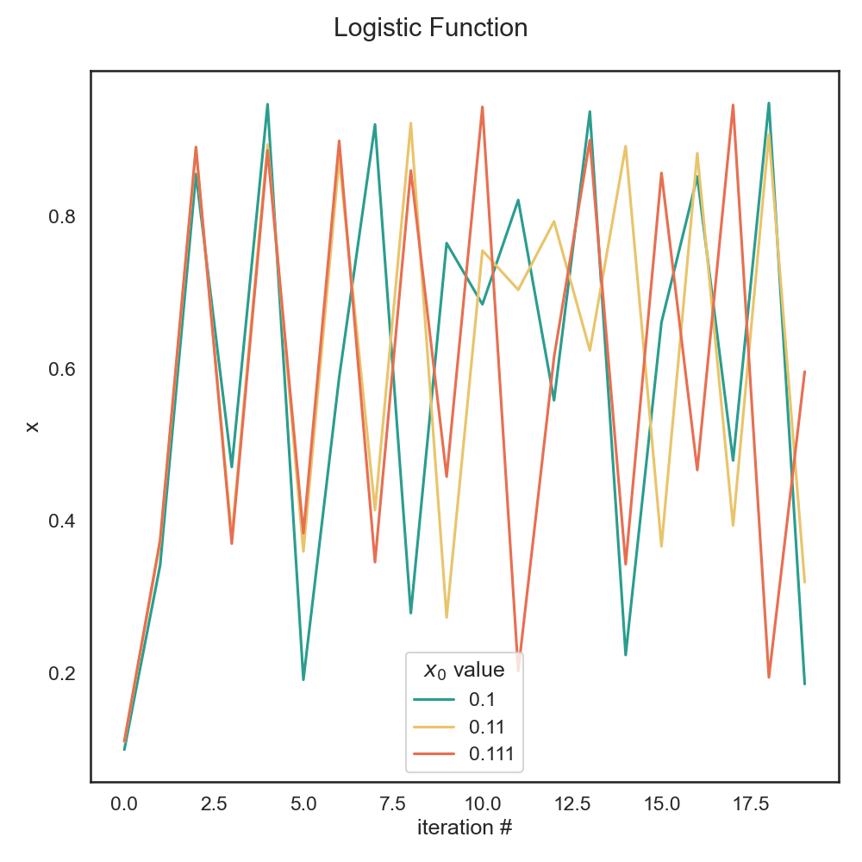

Excursion: Logistic map and chaos
Sensitive Dependence on Initial Conditions (SDIC)
Even starting points that are very close quickly diverge to completely different itineraries
This is called the
“Butterfly effect”

Slide 58
Hands on!
Some r values for 3 < r < 4 have some interesting properties: a chaotic trajectory neither diverges nor converges.
  a) Use the plot_bifurcation function from the plot_logfun module using your implementation of f and iterate to look at the bifurcation diagram. The function generates an output image, bifurcation_diagram.png
  b) Write a test that checks for chaotic behavior when r=3.8. Run the logistic map for 100’000 iterations and verify the conditions for chaotic behavior:
    1) The function is deterministic: this does not need to be tested in this case
    2) Orbits must be bounded: check that all values are between 0 and 1
    3) Orbits must be aperiodic: check that the last 1000 values are all different
    4) Sensitive dependence on initial conditions: this is the bonus exercise (in readme)
  The test should check conditions 2) and 3)!

Slide 59

Testing is good for your self-esteem
Immediately: Always be confident that your results are correct, whether your approach works of not
In the future: save your future self some trouble!
If you are left thinking “it’s cool but I cannot test my code because XYZ”, talk to us during the week and we’ll show you how to do it ;-)
You, in 2025
You, in 2026

Slide 60



Debugging
Up next:

